Slide 1
Antipiracy Screen System

Slide 2
ABSTRACT :
Film theft has such a profound impact on a wide range of economy that it is a crime in almost all countries. One major source of the movie piracy is camcorder piracy i.e., movies are recorded by portable devices inside theaters and then sold on internet and grey markets.
Different techniques and strategies are explored to overcome the problem and secure the digital cinema content, some are based on spatiotemporal modulation of light, watermarking techniques, maximizing annoyance and temporal effects.

Slide 3
This paper deals with a projection technique to avoid piracy in movie theaters. We aim to defeat camcorder piracy by severely degrading the visual quality of the recorded movie while making the interference signals invisible to the audience.
Infrared emitters are installed in movie theaters to interfere with the camcorder and create glares in the recorded frames.

Slide 4
Existing System:
I. M. Epstein and Stanton proposed a system by locating the camera and projecting scanning light beam disturbs the camera sensors from illegal video capturing . The shining objects reflect light which is transmitted from the screen, the target is detected and the camera sensors are saturated by scanning light beam. The disadvantage of the system is miss catch of the illegal recording camera that might be any other glittering objects (e.g. earrings, necklaces ) also reflect light. Also scanning light affects human eyes by scanning eye spectacles and causes injury to human eyes.

Slide 5
II. M. Nailmark presented an idea based on spatiotemporal modulation of light beam. The idea is of introducing non-permanent aliasing artifact during captured movie creating irregularity between projected frequency and camera sampling frequency .This modulation system must be designed more carefully so that movie will not contain artifacts which are noticeable for viewers, unlikely disadvantage of this technique is the artifacts can be removed by using simple method of low pass filtering.

Slide 6
  III. Zhongpai Gao and Guangtao Zhai presented a DLP based concept of defeating camera piracy, which us temporal psycho-visual modulation (TPMV).This is making use of difference in human eye acquisition of light and camera recording, the movie. The camera b recording will be in discrete samples but the human perception of light will be in continuous form, by making use of this idea TPMV system is designed to block out the camera recording. Disadvantage of the system is which causes the rainbow effect . Fortunately, not everyone see the rainbows.

Slide 7
DISADVANTAGE OF EXISTING SYSTEM
1. In this system anyone can upload video as it may be already presented on given website.
2.It just blocks but it won’t detect the location where piracy is happening.

Slide 8
PROPOSED SYSTEM
This system prevents disclosure of private and personal information through unauthorized recording screens effectively by disturbing the acquisition functions of any camera making an illegal recording in the theatre. The way this technology works is that one component flashes an infrared light in a particular pattern. This Approach reduces costs, heat and power use.

Slide 9
ADVANTAGES :
In the proposed system we deal with a projection technique to avoid piracy in movie theatres.
This technique can visually destroy the recorded movie contents .

Slide 10
Literature Review
TITLE | AUTHOR | CONCEPT
The true cost of copyright industry piracy to the US economy. IPI Center for Technology Freedom | S. E. Siwek | Camcorder piracy has great impact on the movie industry. Although there are many methods to prevent recording in theatre, no recognized technology satisfies the need of defeating camcorder piracy as well as having no effect on the audience.
Intellectual Property Theft: A Threat to U.S. Workers, Industries, and Our Economy. DPE Research Department | J. Dorning | Nowadays, camcorder piracy has great impact on the motion picture industry.

Slide 11
TITLE | AUTHOR | CONCEPT
”Method for spoiling copies of theatrical motion picture made using a video camera and recorded,” | C.R. Odgers | In the present time frame, the issue of burglary transformed into a noteworthy issue for survival of Indian film industry.
CCD and CMOS imaging array Technologies Technology. | A. TAYLOR, “ | This paper provides an overview of both CCD (charged coupled device) and CMOS (complementary metal oxide semiconductor) imaging array technologies.

Slide 12
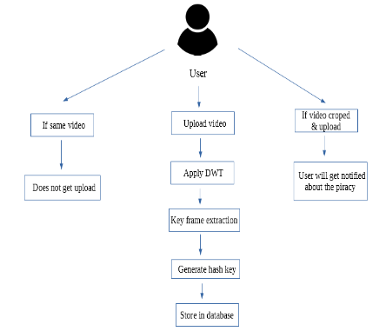
SYSTEM ARCHITECTURE

Slide 13
Hardware Requirements:
System : Intel i3 2.4 GHz.
Hard Disk : 250 GB.
Monitor : 14’ Colour Monitor.
Mouse : Optical Mouse.
Ram : 2 Mb.

Slide 14
Software Requirements:
Embedded C Program

Slide 15
References
[1] The fact and fiction of camcorder piracy,.
[2] C.R. Odgers.”Method for spoiling copies of theatrical motion picture made using a video camera and recorded,”.
[3] .A. TAYLOR, “CCD and CMOS imaging array technologies-Technology review,.
[4] M. Epstein and Stanton. “A method and device for preventing piracy of video material from theater screens.

Slide 16
[5] S. E. Siwek, The true cost of copyright industry piracy to the US economy.
[6] J. Dorning, Intellectual Property Theft: A Threat to U.S. Workers, Industries, and Our Economy.
[7] B. NEWS, “The fact and fiction of camcorder piracy,”.
[8] J. Bloom and C. Polyzois, “Watermarking to track motion picture theft,” in Signals, Systems and Computers, .

