Slide 1
A Real Time Electrical Load Distribution Monitoring and Controlling System Based on PLC and Web server

Slide 2
ABSTRACT
As global energy demand is constantly on the rise; power management has been becoming a major issue in the past decades or so due to less energy reserves.
Power shutdown is a key crisis at the present time whereas disruption of power can cause a huge production loss for industries which calls for proper power management and monitoring in a systematic way.

Slide 3
This paper deals with this issue by developing a prototype system and implementing real time energy monitoring and controlling of the system. In this system, power from main line is distributed and supplied to certain loads.
If capacity of distributed load is less than required, then another line will be activated in parallel in order to prevent power shutdown and avoid production losses. Moreover, this process can ensure safety by tripping the system in case of any fault occurrence. All these are performed in an automated process using PLC and Web server.

Slide 4
Existing System
Power distribution SCADA system is a computer-based production process control and scheduling automation system.
It uses the data acquisition module to monitor and control the operation of field devices so as to achieve data acquisition, device control, measurement, parameter adjustment, and various signal alarms.
Electrical load distribution, monitoring & controlling using PLC is comparatively reliable, accurate and more efficient technique than any existing controllers.
LAN is used to communicate with PLC and PC with the help of Web server and a Communication board (RS 485) is used also for collecting data from energy meters to execute logical commands using program uploaded in the PLC memory.

Slide 5
Disadvantages
LAN based communication will send data in Short distance Computer server.
Energy usage data's in server may corrupt without any back up files in LAN

Slide 6
Proposed System
Here we use Cloud Web server based PLC Controlling and Monitoring System as Proposed work.
To carry out the load controlling and monitoring of overall system, energy meters, PLC and PC are used.
Multiple energy meters with a single PLC CPU connects with a PC to monitor and control required electrical load distribution.
Which monitor voltage current and fault occurrence and updated in server.
WSN is used to communicate with PLC and PC with the help of Web server .

Slide 7
Advantages
PLCs along with energy control functions in order to minimize energy costs and CO2 emissions using milling machine.
Energy monitoring system deals with auditing the energy usage in industries in Cloud Web Server.

Slide 8
Literature Survey
TITLE | AUTHOR | CONCEPT
Real Time Smart Grid Load Management By Integrated and Secured Communication | Muhammad Abrar, M. Ali Tahir, H.M. Umar Hamid, RohaMasroor | Demand of electrical energy is increasing day by day. We need better grids to reduce the stress on power system by making it more reliable and secured. Smart grid (SG) is a new technology towards the conventional grids due to its two ways communication and multi-featured properties.
Energy management system using PLC & SCADA | Kamaldeep Kaur, Prof. Rvindar Kaur | This paper presents the load control in the industry during peak hours by using PLC and monitors all load parameters of the motors on PC by using SCADA.

Slide 9
TITLE | AUTHOR | CONCEPT
INTELLIGENT SCADA FOR LOAD CONTROL | FILIPE FERNANDES , TIAGO SOUSA , PEDRO FARIA , MARCOSILVA , HUGO MORAIS , ZITA A. VALE, | A supervisory control and data acquisition (SCADA) system is an integrated platform that incorporates several components and it has been applied in the field of power systems and several engineering applications to monitor, operate and control a lot of processes. In the future electrical networks, SCADA systems are essential for an intelligent management of resources like distributed generation and demand response, implemented in the smart grid context.
Quality monitoring of electrical power distribution network using a low-power microcontroller | C. Dughir ; V. Groza ; A. Vârtosu ; G. Prostean | This paper presents a system for monitoring the electrical disturbances which are present every day in electrical power distribution networks. A simple solution for detecting the disturbances using a low power microcontroller (MSP 430) was developed. The system was devised to work with 230 V 50 Hz electrical power networks in Europe.

Slide 10
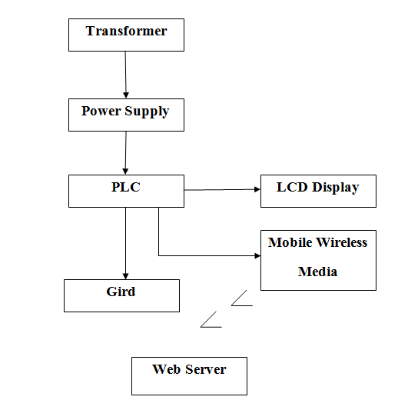
Block Diagram

Slide 11
Software Requirements
Windows 7
PLC Ladder diagram or Ladder Login

Slide 12
Hardware Requirements
Transformer (230v to 12 v)
Power Supply Board
PLC Board
Grid
LCD Display

Slide 13
Reference
“ [1] Muhammad Abrar, M. Ali Tahir, H.M. Umar Hamid, RohaMasroor, Real Time Smart Grid Load Management By Integrated and Secured Communication”, International Conference on Innovative Trends in Computer Engineering .
[2] Kamaldeep Kaur, Prof. Rvindar Kaur, “Energy management system using PLC & SCADA”, International Journal of Engineering Research.

Slide 14
[3] Eberhard Abele, Niklas Panten, “Standardized approach to collect
energy relevant data of production machines and their components on the PLCs”, Elsevier B.V. Peer-review under responsibility of the International Scientific Committee of the 22nd CIRP conference.
[4] P.Thamarai, R.Amudhevalli, “ENERGY MONITORING SYSTEM dealing with auditing the energy usage in industries.

Slide 15
[5] Hardeep Kaur, Harinder Singh, ”Design of Prepaid Metering System byusing PLC (Programmable Logic Controller) and SCADA (Supervisory Control and Data Acquisition)”, International Journal on Emerging Technologies.
[6] C. Dughir ; V. Groza ; A. Vârtosu ; G. Prostean, Quality monitoring of electrical power distribution network using a low-power microcontroller, IEEE Electrical Power & Energy Conference .

