Slide 1
Unified and Automated Fault Management Platform for Optical Networks

Slide 2
Abstract
A united and automated fault management platform for heterogeneous optical networks is quite important for telecom operators to monitor and respond to various levels of network events. In this demo, we are demonstrating the details of the design, implementation and evaluation of the proposed Optical router platform while targeting to manage the underlying optical network of a telecom operator in real time.

Slide 3
The proposed system consists of three major building blocks i) a data collection layer that is integrated with the telecom operator infrastructure, (ii) data association and analysis layer that is used to measure the severity levels based on pre-deﬁned alarm severity levels and constraints, and (iii) user interface layer that is on top of management and infrastructure layer which is used to demonstrate the faulty optical lines and is also integrated with fault management systems. Through the dashboard interface of the proposed Optical router platform, telecommunication operator’s network optimization experts can easily detect the problems related to either or DWDM link and can take appropriate actions.

Slide 4
Existing System
Location information is of paramount importance for wireless sensor networks (WSN).
The accuracy of the collected data can significantly be affected by an imprecise positioning of the event of interest.
Despite the importance of location information, real system implementations that do not use specialized hardware for localization purposes have not been successful.
In this paper, we propose a location estimation scheme that uses a probabilistic approach for estimating the location of a node in a sensor network.
Our localization scheme makes use of additional knowledge of topology deployment.

Slide 5
Disadvantage of Existing System
The server is expensive to purchase
A specialist network operating system is needed

Slide 6
PROPOSED SYSTEM :
In this paper, we attempt to answer these and other related questions by following a careful analytical approach.
Specifically, we first show that when the number of cheating destination client system is greater than or equal to a given threshold, there do not exist any two-dimensional distance-based localization algorithms that can guarantee a bounded link error in router.
Furthermore, when the server transfer files, we configure the router and enable it to send to destination client. that can always guarantee a efficient data transfer from source to destination via router control if any error occurs in link while transfer it automatically reconfigure the router . Finally, we achieve efficient data transfer .

Slide 7
ADVANTAGE
All files are stored in a central location
Network peripherals are controlled centrally.

Slide 8
TITTLE | AUTHOR | DESCRIPTION

Slide 9
TITTLE | AUTHOR | DESCRIPTION
Mobqos: Mobility-aware and qos-driven sdn framework for autonomous vehicles | S. Garg, K. Kaur, S. H. Ahmed, A. Bradai, G. Kaddoum,and M. Atiquzzaman | An intelligent transportation system (ITS) is a cyber physical system (CPS) that is well recognized due to its distinctive applications such as passenger safety, enhanced traffic efficiency, and infotainment services.
Estimation ofcost savings from participation of electric vehicles invehicle to grid (v2g) schemes, | M. Kiaee, A. Cruden, and S. Sharkh, | The storage capacity of the batteries in an electric vehicle (EV) could be utilised to store electrical energy and give it back to the grid when needed by participating in vehicle to grid (V2G) schemes.

Slide 10
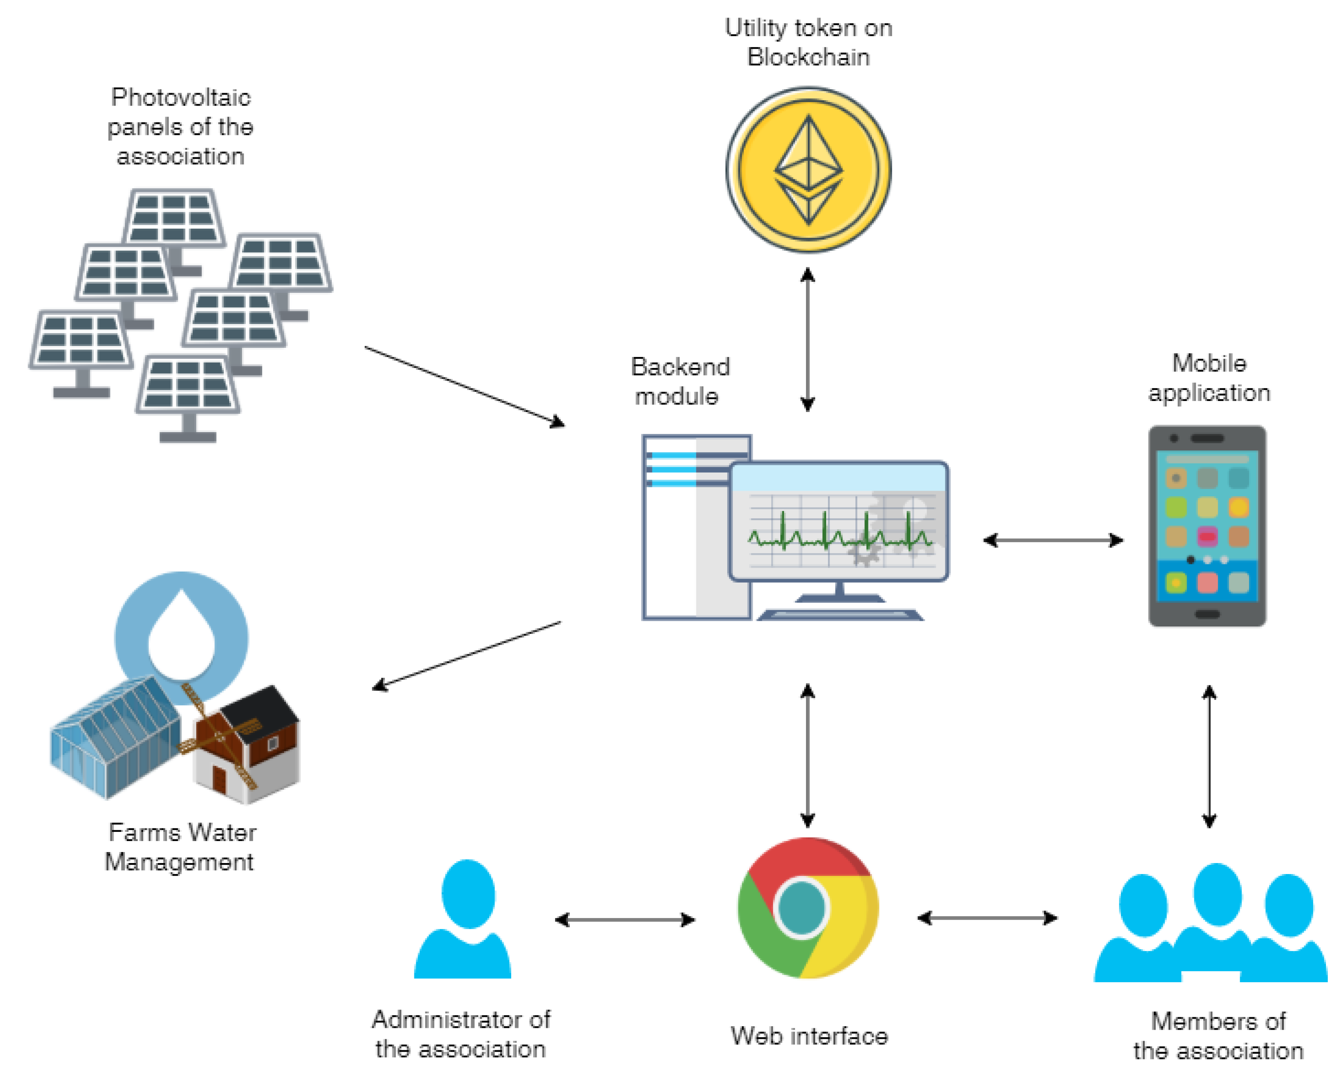
Architecture Diagram

Slide 11
SOFTWARE REQUIREMENTS:
Operating System : Windows 10
Platform : DOT NET TECHNOLOGY
Front End : ASP.Net 4.0
Back End : SQL SERVER 2014

Slide 12
HARDWARE REQUIREMENTS:
Keyboard
Mouse
Hard disk 500GB
Ram 4 Gb

Slide 13
REFERENCE
[1] H. Farhangi, “The path of the smart grid,”IEEE Powerand Energy Magazine, vol. 8, no. 1, pp. 18–28, January2010.
[2] W. Kempton and S. E. Letendre, “Electric vehicles as anew power source for electric utilities,”TransportationResearch Part D: Transport and Environment, vol. 2,no. 3, pp. 157–175, 1997.
[3] L. Gan, U. Topcu, and S. H. Low, “Optimal decentralizedprotocol for electric vehicle charging,”IEEE Transac-tions on Power Systems, vol. 28, no. 2, pp. 940–951,2012.
[4] S. Garg, K. Kaur, S. H. Ahmed, A. Bradai, G. Kaddoum,and M. Atiquzzaman, “Mobqos: Mobility-aware and qos-driven sdn framework for autonomous vehicles,”IEEEWireless Communications, vol. 26, no. 4, pp. 12–20,August 2019.
[5] S. Garg, K. Kaur, G. Kaddoum, S. H. Ahmed, andD. N. K. Jayakody, “Sdn-based secure and privacy-preserving scheme for vehicular networks: A 5g per-spective,”IEEE Transactions on Vehicular Technology,vol. 68, no. 9, pp. 8421–8434, Sep. 2019.

Slide 14
[6] M. Kiaee, A. Cruden, and S. Sharkh, “Estimation ofcost savings from participation of electric vehicles invehicle to grid (v2g) schemes,”Journal of Modern PowerSystems and Clean Energy, vol. 3, no. 2, pp. 249–258,2015.
[7] W. Tushar, W. Saad, H. V. Poor, and D. B. Smith, “Eco-nomics of electric vehicle charging: A game theoreticapproach,”IEEE Transactions on Smart Grid, vol. 3,no. 4, pp. 1767–1778, 2012.
[8] W. Tushar, C. Yuen, H. Mohsenian-Rad, T. Saha, H. V.Poor, and K. L. Wood, “Transforming energy networksvia peer to peer energy trading: Potential of gametheoretic approaches,”arXiv preprint arXiv:1804.00962,2018.
[9] W. Tushar, B. Chai, C. Yuen, D. B. Smith, K. L. Wood,Z. Yang, and H. V. Poor, “Three-party energy manage-ment with distributed energy resources in smart grid,”IEEE Transactions on Industrial Electronics, vol. 62,no. 4, pp. 2487–2498, 2014.
[10] S. Nakamotoet al., “Bitcoin: A peer-to-peer electroniccash system,” 2008.

