Slide 1
Power Quality Improvement Using Dynamic Voltage Restorer

Slide 2
Abstract
Power system consist of large number of nonlinear load which causes power quality issues.
Sensitive components like electronic devices, medical equipment working on power supply are vulnerable to power quality problems.
Voltage sag ,Swell ,harmonics ,noise are considered to be some important power quality issues .
Voltage dips are the major disturbance affecting the power system On load tap changers can be used to compensate voltage dip but it is not economical.
Dynamic voltage restorer (DVR) is an alternate to conventional method of compensating the voltage .These are custom power devices.
The main applications of DVR is to protect sensitive loads that are severely affected by fluctuations in system voltage.

Slide 3
Existing System
A power system is having number of components which are to be operated in such a way to satisfy certain .
One such criteria is power quality .It plays a very important role in determining efficiency and performance of a power system.
As the number of consumer’s increase, the demand for the power also increasing drastically .
Along with its quality ,continuity of supply has to be ensured for good economy.
The power quality issues that are most likely to occur in a power system are voltage sag, voltage swell, flickering and harmonics. These causes malfunctioning in electrical equipment.

Slide 4
Disadvantage of Existing System
Due to large and complex power system voltage sag/sweel became important power quality issues.
The electronic device like oscilloscope are used in hospitals are affected due to harmonics created in the system and flicker causes an irritation to the eyes.

Slide 5
PROPOSED SYSTEM :
Here in our paper we are making use of a DVR i.e dynamic voltage restorer to reduce power quality problems DVR is used to reduce voltage sags/swells by injecting amount of voltages in series with the supply voltage and load point, and maintains reliability of power supply. In steady state condition, DVR will not absorbs/delivers real power.
But, whenever voltage sag/swell or unbalance in supply voltage arises in the power system, DVR will operate.

Slide 6
ADVANTAGE
SVPWM has an advantage over such technique such as better dc utilisation and easy implementation with digital signal processor.
In order to prevent the consequences of poor PQ and to improve the utility performance the electric power are analysed to resolve the PQ issues in order to determine the efficient compensation technique.

Slide 7
TITTLE | AUTHOR | DESCRIPTION
The role of DVR | T.appalanaidu, | In this paper, an overview of the DVR, its functions, configurations, components, operating modes, voltage injection methods and closed-loop control of the DVR output voltage are reviewed along with the device capabilities and limitations.

Slide 8
TITLE | AUTHORS | DESCRIPTION
Power quality enhancement using custom power devices | Ghosh and G.Ledwich, | This paper presents brief review on various power quality issues and its mitigation techniques used at distribution side because various industrial and commercial consumer equipments are highly affected by power quality disturbances.

Slide 9
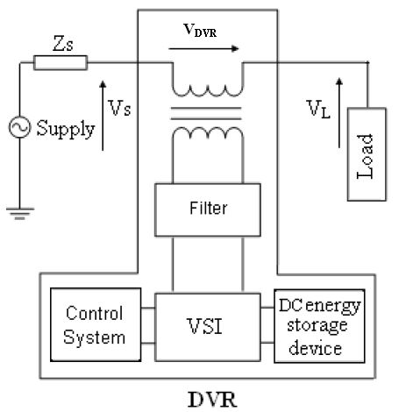
Architecture Diagram

Slide 10
SOFTWARE REQUIREMENTS:
Operating System : Windows 10
Platform : DOT NET TECHNOLOGY
Front End : ASP.Net 4.0
Back End : SQL SERVER 2014

Slide 11
HARDWARE REQUIREMENTS:
Keyboard
Mouse
Hard disk 500GB
Ram 4 Gb

Slide 12
REFERENCE
[1] T.appalanaidu, “The role of DVR”, @AEEICB16, IEEE.
[2] Ghosh and G.Ledwich, Power quality enhancement using custom power devices: springer science, 2012
[3] N.G.Hingorani “ Introducing custom power”, spectrum, IEEE, Volume 32, pp 41-48, 1995.
[4] Lakshmi, T.Swapna,” Modeling and simulation of DVR”.
[5] S.Satish Kishore, P.Abirami, “Voltage sag reduction” @ICCPEIC 2017.
[6] Santhosh kumar, Sudhir kumar, “Enhancement in power quality”, @ICIIECS 2017.

