Slide 1
FABRICATION OF PNEUMATIC BREAKING SYSTEM

Slide 2
ABSTRACT
The aim is to design and develop a control system based on breaking system of an AIR controlled safely automotive wheel braking system.The control valve which directs the air to the double acting cylinder for breaking control. This braking actions is implemented In our project, we have to apply this braking system in one wheel as a model.

Slide 3
List Of Components
Double Acting cylinder
5/2 Solenoid Valve
Electric Motor
Disc Brake
Brake Actuator

Slide 4
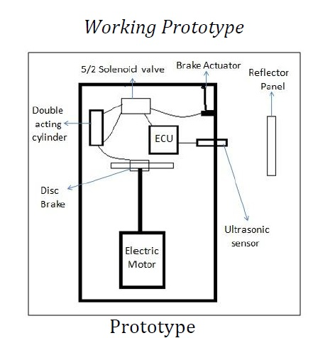
Block Diagram

Slide 5
WORKING PRINCIPLE
The compressed air from the compressor at the pressure of 5 to 7bar is passed through a pipe connected to the Solenoid valve with one input. The Solenoid Valve is actuated with Control Timing Unit. The Solenoid valve has two outputs and one input. The air entering into the input goes out through the two outputs when the timing control unit is actuated. Due to the high air pressure at the bottom of the piston, the air pressure below the piston is more than the pressure above the piston. So these moves the piston rod upwards which move up the effort are, which is pivoted by control unit. This force acting is passed on to punch/rivet which also moves downwards. The IR TRANSMITTER circuit is to transmit the Infra-Red rays. If any obstacle is there in a path, the Infra-Red rays reflected. This reflected Infra-Red rays are received by the receiver circuit is called “IR receiver”. The IR receiver circuit receives the reflected IR rays and giving the control signal to the control circuit. The control circuit is used to activate the solenoid valve. The operating principle of solenoid valve is already explained in the above chapter.

Slide 6
If the solenoid valve is activated, the compressed air passes to the Single Acting Pneumatic Cylinder. The compressed air activates the pneumatic cylinder and moves the piston rod. If the piston moves forward, then the breaking arrangement activated. The breaking arrangement is used to break the wheel gradually or suddenly due to the piston movement. The breaking speed is varied by adjusting the valve is called “Flow Control Valve”. In our project, we have to apply this breaking arrangement in one Wheel as a model. The compressed air drawn from the compressor in our project. The compressed air flow through the Polyurethane tube to the flow control valve. The flow control valve is connected to the solenoid valve as mentioned in the circuit diagram.

Slide 7
ADVANTAGES
It able to Increase the sureness in braking system.
Braking system able to give fast response.
System able to increase the pre-crash safety.
System able to provide more safety to the passengers.
System plays an important role to save human .

Slide 8
DISADVANTAGES
System has few limitations in densely traffic road.
Hard and thick materials cannot be riveted.
Due to the linkages there will be frictional losses.
Maintenance will be more due to the number of moving parts.
Stroke length is fixed.

Slide 9
Applications
This system may be applicable in all types of light vehicles like cars, Rickshaws, Tempos.
This system also successfully installed in the heavy vehicles like buses, trucks, trailers, etc.
This system may be applicable in all types of light vehicles like cars, Rickshaws, Tempos.
This system also successfully installed in the heavy vehicles like buses, trucks, trailers, etc.

Slide 10
CONCLUSION
This project work has provided us an excellent opportunity and experience, to use our limited knowledge. We are feeling that we have completed the work within time successfully. The is working with satisfactory conditions. Thus we have prepared an “Automatic Pneumatic Braking System” which helps to know the how to achieve low cost product.

