Slide 1
FABRICATION OF PEDAL OPERATED MIXI

Slide 2
Abstract
The main aim of the project is to save the electrical power in house, hotels and fast food stalls. Pedal operated maxi is operated by chain and sprocket. The manual power is utilized to run the maxi. This project consists of a pedal, bevel gear arrangement, cutting blades, bearing blocks, arrangement for jar removing.

Slide 3
List Of Components
Pedal
Sprocket
Chain
Bevel gear
Maxi
Blades
Bearing Block
Seat

Slide 4
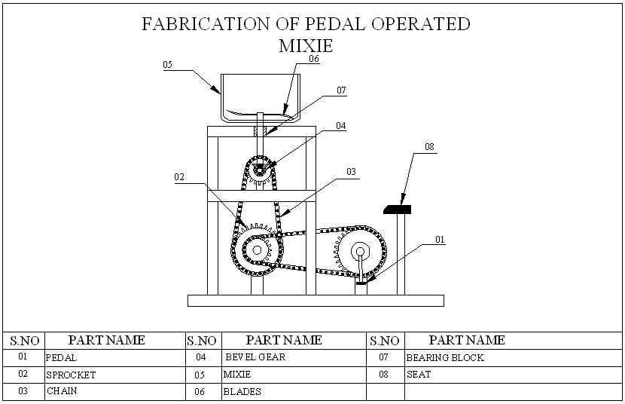
Block Diagram

Slide 5
WORKING PRINCIPLE
The following working principle is about pedal operated mixi. In this project the chain and sprocket plays a vital role. A pedal is attached with the chain and sprocket arrangement. Normally the gears are used to transmit power. Driven sprocket is attached with bevel gear arrangement. Here we have used 4 sprockets in two different sizes and 2 chains. When the pedal which is attached with the larger sprocket is rotated, then the smaller sprocket which is connected with another larger one. hence the smaller sprocket attached to the gear shaft will rotated in high speed . This leads to speed up the rotation of the mixi jar. In the above project to transmit the power in 90° we use a bevel gear arrangement. The shaft from the bevel gear is attached to the mixi jar. Here the jar is of removable type. Since the jar is attached with the bevel gear shaft the blades in the jar also rotates in a very high speed.

Slide 6
ADVANTAGES
No need electricity
Simple design
Easily operate
Simple maintenance.

Slide 7
DISADVANTAGES
Noisy Operation
More weight
More time consumption.

Slide 8
Applications
Reduce operator effort and increase efficiency.
Multi field application that is industry, household, griculture,etc
Substantial savings on cost.

Slide 9
CONCLUSION
The main objective behind development of pedal operated flour mill was on producing cheap, easy to operate system which can be easily fabricated by readily available material and thus we proposed simplistic design that can deliver efficient, productive and reliable flour mill which can be used in rural as well as urban areas. this equipment can be easily operated by semi rather low skilled operator. Further this equipment can easily find its place where there is no or limited power supply.

