Slide 1
Architectural Design of Cloud Applications a Performance-aware Cost Minimization Approach

Slide 2
Abstract
Cloud Computing has assumed a relevant role in the ICT, profoundly influencing the life-cycle of modern applications in the manner they are designed, developed, deployed and operated.
In this paper, we tackle the problem of supporting the design-time analysis of Cloud applications to identify a cost-optimized strategy for allocating components onto Cloud Virtual Machine infrastructural services, taking performance requirements into account. We present an approach and a tool, SPACE4Cloud, that supports users in modeling the architecture of an application, in defining performance requirements as well as deployment constraints, and then in mapping each architecture component into a corresponding VM service, minimizing total costs.

Slide 3
An optimization algorithm supports the mapping and determines the Cloud configuration that minimizes the execution costs of the application over a daily time horizon.
The benefits of this approach are demonstrated in the context of an industrial case study. Furthermore, we show that SPACE4Cloud leads to a cost reduction up to 60%, when compared to a first-principle technique based on utilization thresholds, like the ones typically used in practice, and that our solution is able to solve large problem instances within a time frame compatible with a fast-paced design process (less than half an hour in the worst case).
Finally, we show that SPACE4Cloud is suitable to model even micro service-based applications and to compute the corresponding optimized deployment configuration which is compared with a state-of-the art meta-heuristic alternative method, achieving savings between 21% and 85%.

Slide 4
Existing System
Existing solutions do not fully address all of the pre-ceding challenges. For example, Ernest [37] trains a performance model for machine learning applications with a small number of samples but since its performance model is tightly bound to the particular structure of ma-chine learning jobs, it does not work well for applications such as SQL queries (poor adaptively). Further, Ernest can only select VM sizes within a given instance family, and performance models need to be retrained for each instance family

Slide 5
Disadvantage of Existing System
In addition, trying each cloud configuration multiple times to get around the dynamics in the cloud (due to resource multiplexing and stragglers)would exacerbate the problem even further.
While such data is available to data center operators, it is out of reach for normal users. Cherry Pick works with a restricted amount of data to get around this problem.

Slide 6
PROPOSED SYSTEM :
In this paper, we present Cherry Pick a system that unearths the optimal or near-optimal cloud configurations that minimize cloud usage cost, guarantee application performance and limit the search overhead for recurring big data analytic jobs. Each configuration is rep-resented as the number of VMs, CPU count, CPU speeder core, RAM per core, disk count, disk speed, and net-work capacity of the VM.

Slide 7
ADVANTAGE
A good cloud configuration can reduce the cost of analytic jobs by a large amount.
The arithmetic mean and maximum running cost of configurations com-pared to the configuration with minimum running cost for four applications across 66 candidate configurations.

Slide 8
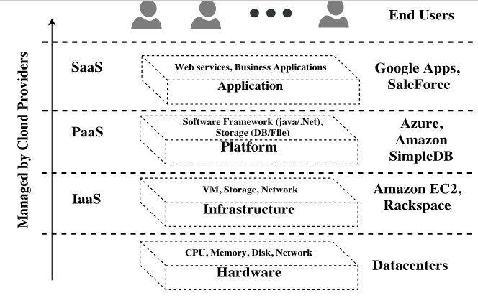
Architecture Diagram

Slide 9
Literature Survey
TITTLE | AUTHOR | CONCEPT
Adaptively Unearthing the Best Cloud Configurations for Big Data Analytics.” | Alipourfard, H. H. Liu, J. Chen, S. Venkataraman, M. Yu, and M. Zhang, “ | Picking the right cloud configuration for recurring big data analytics jobs running in clouds is hard, because there can be tens of possible VM instance types and even more cluster sizes to pick from.
“Scalable differential analysis of process algebra models,” | M. Tribastone, S. Gilmore, and J. Hillston, | The exact performance analysis of large-scale software systems with discrete-state approaches is difficult because of the Well-known problem of state-space explosion.

Slide 10
TITTLE | AUTHOR | CONCEPT
“Search-based genetic optimization for deployment and reconfiguration of software in the cloud,” | S. Frey, F. Fittkau, and W. Hasselbring, | Migrating existing enterprise software to cloud plat-forms involves the comparison of competing cloud deployment options (CDOs).
“Hybrid multi-attribute qos optimization in component based software systems,” | A. Koziolek, D. Ardagna, and R. Mirandola | This paper extends this approach to more QoS properties by providing analytical algorithms for availability-cost optimization and three-dimensional availability-performance-cost optimization.

Slide 11
SOFTWARE REQUIREMENTS:
Operating System : Windows XP.
Platform : DOT NET TECHNOLOGY
Front End : ASP.Net 3.5
Back End : SQL SERVER 2005

Slide 12
HARDWARE REQUIREMENTS:
Keyboard
Mouse
Hard disk 500GB
Ram 4 Gb

Slide 13
REFERENCES
[1] O. Alipourfard, H. H. Liu, J. Chen, S. Venkataraman, M. Yu, and M. Zhang, “CherryPick: Adaptively Unearthing the Best Cloud Configurations for Big Data Analytics.” in NSDI, 2017.
[2] G. Casale and M. Tribastone, “Modelling exogenous variability in cloud deployments,” SIGMETRICS Performance. Evaluation Review, vol. 40,
no. 4, pp. 73–82, 2013.
[3] S. Becker, H. Koziolek, and R. Reussner, “The Palladio component model for model-driven performance prediction,” Journal of Systems and Software, vol. 82, no. 1, pp. 3–22, 2009.
[4] A. Koziolek, H. Koziolek, and R. Reussner, “PerOpteryx: Automated
Application of Tactics in Multi-objective Software Architecture Optimization,” in Proc. of QoSA 2011, 2011, pp. 33–42.
[5] M. Tribastone, S. Gilmore, and J. Hillston, “Scalable differential analysis
of process algebra models,” IEEE Trans. on Software Engineering,
vol. 38, no. 1, pp. 205–219, 2012.

Slide 14
[6] S. Gilmore and J. Hillston, “The pepa workbench: A tool to support
process algebra-based approach to performance modelling,” in Computer
performance evaluation modelling techniques and tools. Springer, 1994,
pp. 353–368.
[7] A. Aleti, S. Bj¨ornander, L. Grunske, and I. Meedeniya, “Archeopterix:
An extendable tool for architecture optimization of aadl models,” in Proc.
of MOMPES’09, 2009, pp. 61–71.
[8] A. Koziolek, D. Ardagna, and R. Mirandola, “Hybrid multi-attribute qos
optimization in component based software systems,” Journal of Systems
and Software, vol. 86, no. 10, pp. 2542 – 2558, 2013.
[9] M. Ciavotta, D. Ardagna, and A. Koziolek, “Palladio optimization
suite: Qos optimization for component-based cloud applications,” EAI
Endorsed Trans. Cloud Systems, vol. 2, no. 6, 2016.

