Slide 1
Multi-level Attention Networks for Multi-step Citywide Passenger Demands Prediction

Slide 2
Abstract
For the emerging mobility-on-demand services, it is of great significance for predicting passenger demands based on historical mobility trips to achieve better vehicle distribution.
Prior works have focused on predicting next-step passenger demands at selected locations or hotspots.
However, we argue that multi-step citywide passenger demands encapsulate both time-varying demand trends and global statuses, and hence are more beneficial to avoiding demand-service mismatching and developing effective vehicle distribution/scheduling strategies.
And we find that adaptations of single-step methods are unable to achieve robust prediction with high accuracy for further steps.

Slide 3
In this paper, we propose an end-to-end deep neural network model to the prediction task.
We employ an encoder-decoder framework based on convolutional and ConvLSTM units to identify complex features that capture spatio temporal influences and pickup-drop off interactions on citywide passenger demands.
We introduce a multi-level attention model (global attention and temporal attention) to emphasize the effects of latent citywide mobility regularities and capture relevant temporal dependencies.
We evaluate our proposed method using real-world mobility trips (taxis and bikes) and the experimental results show that our method achieves higher prediction accuracy than the state-of-the-art approaches.

Slide 4
Existing System
Existing methods for passenger demands prediction have been focused on anticipating next-step passenger demands for a particular set of locations such as taxi stands, bike stations and hot spots.
However, we argue that multi-step citywide passenger demands prediction is considerably more beneficial to nowadays MOD services due to the following two reasons.
First, multi-step passenger demands indicate the varying demand trend, which is useful to avoid impulsive vehicle scheduling responses in the presence of temporary demand fluctuation.

Slide 5
Disadvantage of Existing System
To achieve high prediction accuracy, different prediction models have been proposed, e.g., a hierarchical prediction model and a multi-similarity-based inference model, and a data stream ensemble framework that combines weighted time-varying Poisson model with the traditional ARMA model. Some works addressed the problem of predicting single-step citywide passenger demands.
As predicting citywide passenger demands can be viewed as a kind of spatiotemporal data prediction problem, prediction models for spatiotemporal data are also feasible to passenger demands prediction.

Slide 6
PROPOSED SYSTEM :
In this, the problem of predicting multistep citywide passenger mobility demands (i.e., pickup and drop-off) accurately.
The key technical challenge of this problem is to deal with (1) complex spatio temporal influences on passenger demands, and (2) interactions between pickups and drop-offs.
Specifically, passenger demands in a region are typically correlated with the demands in its surrounding region and the demands in a region could be affected by its statuses in previous time.
We propose a novel multi-task multi-graph learning approach to enable the joint prediction of multi-modal ride-hailing demands as well as other spatial-temporal joint prediction tasks.

Slide 7
ADVANTAGE
In this paper, the pro-posed global attention model helps to disclose the impact of representative historical citywide demands on next-step city wide demands.
As ARMA only explores temporal dependencies and VAR captures linear spatio interdependencies, the poor prediction performance indicates the limitations of using spatiotemporal features only.
This demonstrates that global attention model is able to enhance multi-step prediction performance while can be easily incorporated into neural network models.

Slide 8
TITTLE | AUTHOR | DESCRIPTION
Predicting Taxi–Passenger Demand Using Streaming Data. | L. Moreira-Matias, J. Gama, M. Ferreira, J. Mendes-Moreira, and L. Damas, | This paper introduces a novel methodology for predicting the spatial distribution of taxi–passengers for a short-term time horizon using streaming data.
Context-aware taxi demand hotspots prediction | H.-w. Chang, Y.-c. Tai, and J. Y.-j. Hsu, | This paper proposes mining historical data to predict demand distributions with respect to contexts of time, weather, and taxi location.

Slide 9
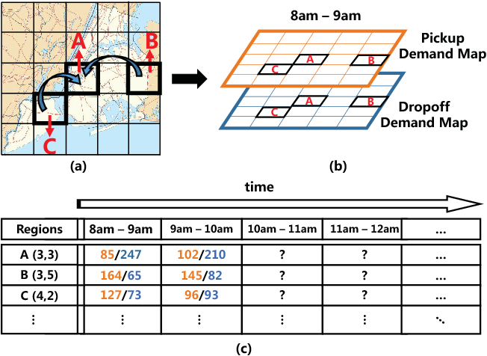
Architecture Diagram

Slide 10
SOFTWARE REQUIREMENTS:
Operating System : Windows 10
Platform : DOT NET TECHNOLOGY
Front End : ASP.Net 4.0
Back End : SQL SERVER 2014

Slide 11
HARDWARE REQUIREMENTS:
Keyboard
Mouse
Hard disk 500GB
Ram 4 Gb

Slide 12
REFERENCE
[1]L. Moreira-Matias, J. Gama, M. Ferreira, J. Mendes-Moreira, and L. Damas, “Predicting taxi–passenger demand using streaming data,” IEEE Transactions on Intelligent Transportation Systems, vol. 14, no. 3, pp. 1393–1402, 2013.
[2]H.-w. Chang, Y.-c. Tai, and J. Y.-j. Hsu, “Context-aware taxi de-mand hotspots prediction,” International Journal of Business Intelli-gence and Data Mining, vol. 5, no. 1, pp. 3–18, 2009.
[3]Y. Li, Y. Zheng, H. Zhang, and L. Chen, “Traffic prediction in a bike-sharing system,” in Proceedings of the 23rd SIGSPATIAL Inter-national Conference on Advances in Geographic Information Systems.ACM, 2015, p. 33.
[4]L. Chen, D. Zhang, L. Wang, D. Yang, X. Ma, S. Li, Z. Wu, G. Pan,T.-M.-T. Nguyen, and J. Jakubowicz, “Dynamic cluster-based over-demand prediction in bike sharing systems,” in Proceedings of the2016 ACM International Joint Conference on Pervasive and Ubiquitous Computing. ACM, 2016, pp. 841–852.
[5]S. Xingjian, Z. Chen, H. Wang, D.-Y. Yeung, W.-K. Wong, and W.-c.Woo, “Convolutional lstm network: A machine learning approach for precipitation now casting,” in Advances in Neural Information Processing Systems, 2015, pp. 802–810.

Slide 13
[6]J. Zhang, Y. Zheng, D. Qi, R. Li, and X. Yi, “Dnn-based prediction model for spatio-temporal data,” inSIGSPATIAL.ACM, 2016,p. 92.
[7]J. Zhang, Y. Zheng, and D. Qi, “Deep spatio-temporal residual networks for citywide crowd flows prediction,” in Thirty-First AAAI Conference on Artificial Intelligence, 2017.
[8]I. Sutskever, O. Vinyals, and Q. V. Le, “Sequence to sequence learning with neural networks,” in Advances in neural information processing systems, 2014, pp. 3104–3112.
[9]O. Vinyals, A. Toshev, S. Bengio, and D. Erhan, “Show and tell:A neural image caption generator,” in Proceedings of the IEEE Conference on Computer Vision and Pattern Recognition, 2015, pp.3156–3164.
[10] N. Srivastava, E. Mansimov, and R. Salakhudinov, “Unsupervised learning of video representations using lstms,” in International Conference on Machine Learning, 2015, pp. 843–852.

