Slide 1
Hostel Management System

Slide 2
Abstract
Hostel Management is an application developed to manage the various activities in hostel.
The particular project is deal with the problems on managing the a hostel and avoids the problem occurs when carried out manually.
Identification of the drawbacks of the existing system leads to the designing of computerized system that will be compatible to the existing system with the system which is more friendly and more GUI oriented.

Slide 3
The objective of this project is to present a design of Hostel Management System for SMA Pahang.
Our research is a comparative study of software design in development HMS for SMA Pahang.
The study is focusly on fully utilize the OO Diagram and functional-based diagram.
Our focus is comparing the utilization and significant of software design while developing the system using PHP for development of HMS.

Slide 4
Existing System
The existing system is manual based and need lot of efforts and consume enough time.
In the existing system we can apply for the hostels online but the allotment processes are done manually.
It may lead to corruptions in the allocation process as well as hostel fee calculation.
The existing system does not deals with mess calculation and complaint registration.

Slide 5
Disadvantage of Existing System
The drawbacks of the existing system:
More human power
More strength and strain of manual labour needed
Repetition of same procedure.
Low security.
Data redundancy.
Difficulty to handle
Difficulty to update data.
Record keeping is difficult.
Backup data can be easily generated.

Slide 6
PROPOSED SYSTEM :
The proposed system is having many advantages over the existing system.
It require less overhead and very efficient.
The proposed system deals with the mess calculation and allotment process efficiently.

Slide 7
ADVANTAGE
The purpose of a web browser is to read HTML documents and compose them into visible or audible web pages.
The browser doesn’t display the HTML tags, but uses the tags to interpret the concept of the page.
The hostel management needs to create the hostel management system (HMS) to organize the rooms, mess, students record and the other information about the students.

Slide 8
TITTLE | AUTHOR | DESCRIPTION
MySQL Tutorial, Database Commands, Beginners Guide | PerlScriptsJavaScripts.com. 2006. | MySQL is the most popular Open Source Relational SQL Database Management System. MySQL is one of the best RDBMS being used for developing various web-based software applications. MySQL is developed, marketed and supported by MySQL AB, which is a Swedish company
Development of an Automated Hostel Facility Management System | Segun O. Olatinwo and et al. 2014. | In this paper, the development of an automated hostel accommodation management system is proposed. The codes for the automated system were developed using Visual Basic and Microsoft Access was used to develop the underlying database

Slide 9
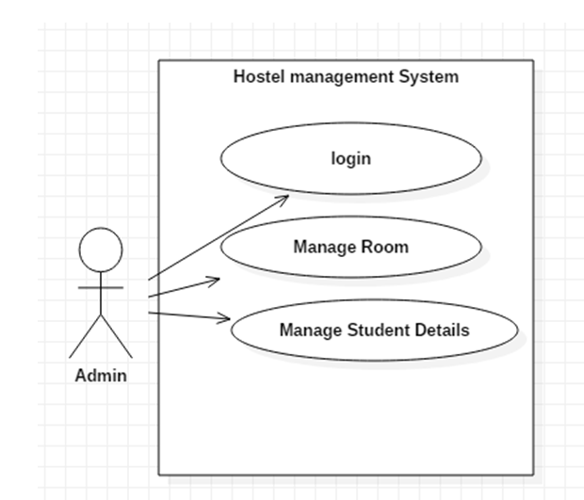
Architecture Diagram

Slide 10
SOFTWARE REQUIREMENTS:
Operating System : Windows 10
Platform : DOT NET TECHNOLOGY
Front End : ASP.Net 4.0
Back End : SQL SERVER 2014

Slide 11
HARDWARE REQUIREMENTS:
Keyboard
Mouse
Hard disk 500GB
Ram 4 Gb

Slide 12
REFERENCE
1. Whitten, Bentley, and Dustman. 2004. System Analysis and Design Methods (5th ed). Mc GrawHill: New York, NY.
2. PerlScriptsJavaScripts.com. 2006. “MySQL Tutorial, Database Commands, Beginners Guide”. http://www.perlscriptsjavascripts.com/tutorials/mys ql/index.html. Accessed 2/3/06.
3. HTML Elements. W3schools. Retrieved 3/16/15.
4. CSS Introduction. W3schools. Retrieved 3/16/15.
5. Xhtml.com. Retrieved on 5/16/12.
6. MySQL: Project Summary. Black Duck Software. Retrieved 9/17/12.
7. PHP Manual: www.php.net
8.PHP for Windows: php.net. Retrieved 10/29/13. https://wikipedia.org/wiki/PHP
9. https://wikipedia.org/wiki/HTML
10. https://wikipedia.org/wiki/CSS

