Slide 1
An Anonymous Authentication System for Pay-As-You-Go Cloud Computing

Slide 2
Abstract
Cloud computing offers on-demand availability of computing resources over the Internet. To attract users, cloud providers offer their resources as services at reasonable prices and provide various price models to reflect higher level of quality of service (QoS), which are referred as pricing schemes. k-times anonymous authentication (k-TAA) is an attractive approach to construct pricing schemes, providing access controllability, user anonymity and public traceability.
In k-TAA schemes, authenticated users are permitted to anonymously access services from a provider at most k times, while the ones whose the number of access times exceeds k can be publicly traded. That is, k-TAA schemes offer a prepaid plan that charges users based on the amount of access times. Alternatively, pay-as-you-go (PAYG) is a pricing strategy that allows users to be charged based on the amount of usage, reducing the costs on unnecessary resources.

Slide 3
. Adopting k-TAA schemes to PAYG model, th access bound k is decided by the prepayment amount and the service usage is tracked by the number of access times. However, this approach is impractical, since existing k-TAA schemes only allow an one-time access in an authentication. This work aims to bridge this gap in the literature by designing an efficient and secure authentication system for PAYG cloud computing, supporting flexible access controllability, user anonymity and public traceability.
To achieve this, we propose new k-TAA primitive, called k-times anonymous pay-as-you-go authentication (k-TAA-PAYG), that allows users to access services for multiple times in an authentication as long as the number of their access times does not exceed k. We first formalize the definition and security model for k-TAA-PAYG scheme. Subsequently, we present a concrete construction of k-TAA-PAYG scheme, with the computational complexity as O(1) and the constant communicational cost.

Slide 4
Finally, comparing with the most efficient k-TAA scheme proposed by Emura et al., the experimental results show that our k-TAA-PAYG scheme is 2.5 to 3 times faster and saves up to 66% storage in grant processes. The time cost of an authentication of our k-TAA-PAYG scheme is constant (1.4-2.4 ms), while Emura et al.’s scheme needs more than one second when the number of access time is greater than 1,000.

Slide 5
Existing System
To attract more users, cloud providers offer their computing resource as services at reasonable prices and provide various price models to reflect higher level of quality of service (QoS), which are referred as pricing schemes. But in existing system there is no proper storage based cost estimated .

Slide 6
Disadvantage of Existing System
Downtime: Good internet connectivity is a must in cloud computing. The cloud computing service provider may face power outage, internet connectivity loss, or service maintenance that might affect your process. If your internet speed is slow, it might affect the process adversely, since most of the services are online. Other than the internet, there is no other way to access data on the cloud, so there is a lot of dependency on internet connectivity. You must have a reliable and consistent internet service to operate smoothly with the cloud.
Lower bandwidth: Many cloud service providers limit the bandwidth range of usage. If the need occurs to expand the bandwidth, then it might increase the cost.
Limited control: Cloud services are completely managed and owned by service providers operating remotely. Hence the employees have limited control over backend features.

Slide 7
PROPOSED SYSTEM :
Public cloud resources approach and apply the PAYG model differently. For example, a user provisioning a dedicated cloud server is generally billed according to server power and usage and on a recurring basis. Software as a Service (SaaS) works similarly, where a user leases software and customized features. Storage as a Service (SaaS) billing rotates on a frequent basis because storage requirements increase are usually subject to gradually increased pricing. Pay as you go is a cost model for cloud services that encompasses both subscription-based and consumption-based models and memory usage and expiry date, in contrast to traditional IT cost model that requires cost based cloud usage in server.

Slide 8
ADVANTAGE
Such as higher availability, cost reduction, efficient billing, reduced traffic congestion, fast system response, helpful services and effective management. For vehicle detection, mostly IR sensors, ultrasonic sensors, RFID tags and simple light sensors are used.
The network load is reduced to the minimum, lowering the required number of gateways that must be placed across a certain area.

Slide 9
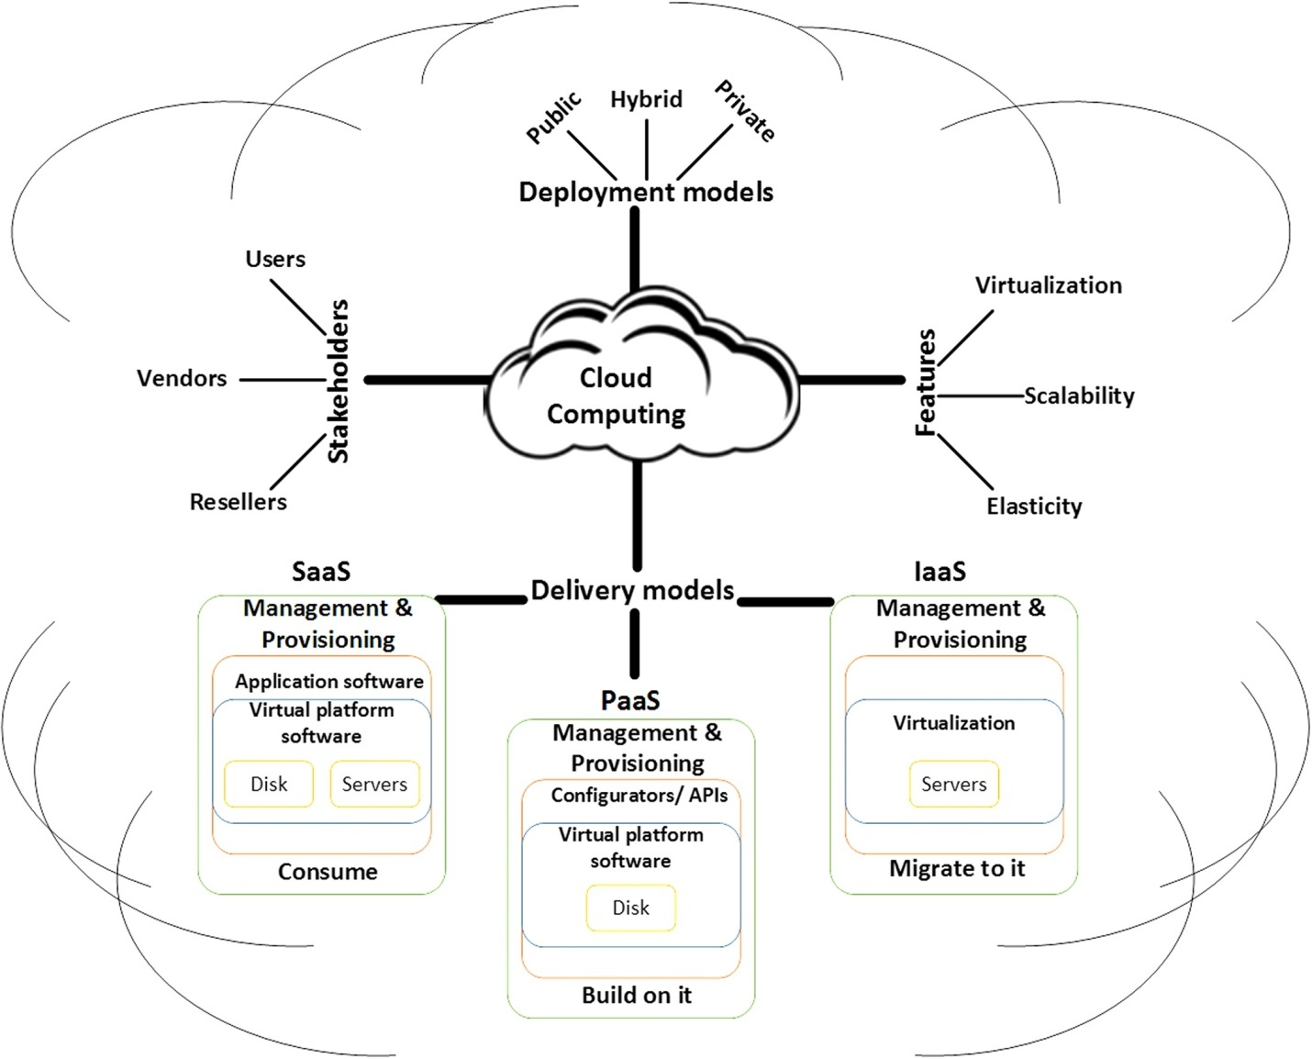
Architecture Diagram

Slide 10
Literature Survey
TITTLE | AUTHOR | CONCEPT
k-times anonymous authentication (extended abstract),” | I. Teranishi, J. Furukawa, and K. Sako | We propose an authentication scheme in which users can be authenticated anonymously so long as times that they are authenticated is within an allowable number.
Blind signature system,”“ | D. Chaum, | Blind digital signatures were introduced by Chaum. In this paper, we show how security and blindness properties for blind digital signatures, can be simultaneously defined and satisfied, assuming an arbitrary one-way trapdoor permutation family.

Slide 11
TITTLE | AUTHOR | CONCEPT
“Dynamic k-times anonymous authentication | L. Nguyen and R. Safavi-Naini | k-times anonymous authentication (k-TAA) schemes allow members of a group to be anonymously authenticated by application providers for a bounded number of times. k-TAA has application in e- voting, e-cash, electronic coupons and anonymous trial browsing of con- tent.
A verifiable random function with short proofs and keys,” | Y. Dodis and A. Yampolskiy, | We give a simple and efficient construction of a verifiable random function (VRF) on bilinear groups. Our construction is direct. In contrast to prior VRF constructions , it avoids using an inefficient Goldreich-Levin transformation, thereby saving several factors in security.

Slide 12
SOFTWARE REQUIREMENTS:
Operating System : Windows XP.
Platform : DOT NET TECHNOLOGY
Front End : ASP.Net 3.5
Back End : SQL SERVER 2005

Slide 13
HARDWARE REQUIREMENTS:
Keyboard
Mouse
Hard disk 500GB
Ram 4 Gb

Slide 14
REFERENCES
[1] I. Teranishi, J. Furukawa, and K. Sako, “k-times anonymous authentication (extended abstract),” in Advances in Cryptology ASIACRYPT 2004. Springer, 2004, pp. 308–322.
[2] D. Chaum, “Blind signature system,” in Advances in cryptology. Springer, 1984, pp. 153–153.
[3] G. Ateniese, J. Camenisch, M. Joye, and G. Tsudik, “A practical and provably secure coalition-resistant group signature scheme,” in Annual International Cryptology Conference. Springer, 2000, pp. 255–270.
[4] M. Bellare, D. Micciancio, and B. Warinschi, “Foundations of group signatures: Formal definitions, simplified requirements, and a construction based on general assumptions,” in International Conference on the Theory and Applications of Cryptographic Techniques.
Springer, 2003, pp. 614–629.
[5] Y. Dodis and A. Yampolskiy, “A verifiable random function with short proofs and keys,” in International Workshop on Public Key Cryptography. Springer, 2005, pp. 416–431.

Slide 15
[6] A. de Solages and J. Traor´e, “An efficient fair off-line electronic cash system with extensions to checks and wallets with observers,” in International Conference on Financial Cryptography. Springer, 1998, pp. 275–295.
[7] O. Bic¸er and A. K¨upc¸ ¨ u, “Versatile abs: Usage limited, revocable,
threshold traceable, authority hiding, decentralized attribute based signatures.” IACR Cryptology ePrint Archive, vol. 2019, p. 203, 2019.
[8] I. Teranishi and K. Sako, “k-times anonymous authentication with a constant proving cost,” in Public Key Cryptography - PKC 2006, M. Yung, Y. Dodis, A. Kiayias, and T. Malkin, Eds. Springer, 2006, pp. 525–542.
[9] L. Nguyen and R. Safavi-Naini, “Dynamic k-times anonymous authentication,” in Applied Cryptography and Network Security. Springer, 2005, pp. 318–333.
[10] L. Nguyen, “Efficient dynamic k-times anonymous authentication,”
in Progress in Cryptology - VIETCRYPT 2006. Springer, 2006,
pp. 81–98

