Slide 1
Smartphone based Real-Time Asst Tracking and Monitoring

Slide 2
Abstract
Today, the growth of technology is rapid and provides all necessary and effective solutions for the requirements. One of the most important areas of concern is security. In this scenario, IOT Asset tracking system is developed to increase the safety of women, children, people with mental disorder and any valuable items through the technology of Radio Frequency along with IOT.
Radio Frequency module consists of transmitter and receiver. The transmitter is placed with the object to be tracked which sends radio waves to the receiver. If the object being tracked moves out of frequency range, an alert message and call will be sent to specified guardians through Global System for Mobile communication.

Slide 3
Further the location of the object can be tracked whenever required through Global Positioning System. In addition, sound and vibration sensors are used to sense human behavior like loud voice and movement of human body. If the sensor reading exceeds threshold value, messages are sent to specified mobile numbers. The frequency range between transmitter and receiver and location of assets are displayed in ThingSpeak which is an open-source IOT platform.

Slide 4
Existing System
The wide spread of mobiles as handheld devices leads to various innovative applications that makes use of their ever-increasing presence in our daily life. One such application dislocation-tracking and monitoring.

Slide 5
Disadvantage of Existing System
This project supports the Android OS platform only and makes communication with the tracker through SMS messages only.
The architecture, security and accuracy of the tracking unit itself are beyond the scope of this project.

Slide 6
PROPOSED SYSTEM :
This paper proposes a prototype model for location tracking using Geographical Positioning System(GPS) and Global System for Mobile Communication technology.
The system displays the object moving path on the monitor and the same information can also be communicated to the user cell phone, on demand of the user by asking the specificinformation via SMS. This system is very useful for car theft situations, for adolescent drivers being watched and monitored by parents. The result shows that the object is being tracked with minimal tracking error.

Slide 7
ADVANTAGE
This system has also another facility to monitor the path along which the device moves. This is optional, when the user wants, to see the path it receives the entire information from the GPS antenna otherwise it only receives the desired information.
The tracking system can also be very useful forIntelligent Transportation System.
The major goal is to ensure maximum security and enable tracking by providing current location.

Slide 8
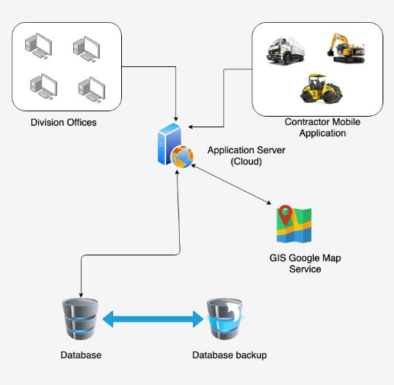
Architecture Diagram

Slide 9
Literature Survey
TITTLE | AUTHOR | CONCEPT
“RFID for personal asset tracking”. | Steven Chan, Adam Connell, Eribel Madrid, Dongkuk Park, Ridha Kamoua, | This paper presents an object tracking system to track the objects through GPS and Bluetooth technology. Objects are usually tracked by the implementation of signal strength based on GPS, GSM, RFID and Bluetooth. We make use of Global Positioning System (GPS) for tracking long range objects and Bluetooth technology for short range objects.
“Child Safety and Tracking Management System”. | Aditi Gupta, Vibhor Harit, | Today, the growth of technology is rapid and provides all necessary and effective solutions for the requirements. One of the most important areas of concern is security.

Slide 10
TITTLE | AUTHOR | CONCEPT
"Real Time Web based Vehicle Tracking using GPS | Muruganandham, P.R. Mukesh, | Tracking systems were first developed for the shipping industry because they wanted to determine where each vehicle was at any given time. Passive systems were developed in the beginning to fulfill these requirements.
"A Real-Time GPS Vehicle Tracking System Displayed on a Google-Map-Based Website” | Prawat Chaiprapa, Supaporn Kiattisin, Adisorn Leelasantitham, | Global Positioning Systems (GPS) are being used for a wide variety of applications. This paper mainly focuses on developing an enhancement of GPS based vehicle navigation system using Google Maps.

Slide 11
SOFTWARE REQUIREMENTS:
Operating System : Windows XP.
Platform : DOT NET TECHNOLOGY
Front End : ASP.Net 3.5
Back End : SQL SERVER 2005

Slide 12
HARDWARE REQUIREMENTS:
Keyboard
Mouse
Hard disk 500GB
Ram 4 Gb

Slide 13
REFERENCE
[1]Steven Chan, Adam Connell, Eribel Madrid, Dongkuk Park, Ridha Kamoua, “RFID for personal asset tracking”.
[2]Fatin Balkis Binti Alzahri, Maziani Sabudin, “Vehicle Tracking Device”.
[3]Aditi Gupta, Vibhor Harit, “Child Safety and Tracking Management System”.
[4]Daniel Patricko, Hendry Hendry, Jonathan Adiel Pranoto, Adi kurniawan, “Human tracking in certain indoor and outdoor area by combining the use of RFID and GPS”.
[5]Mohammad A. Al-Khedher, "Hybrid GPS-GSM Localization of Automobile Tracking system“

Slide 14
[6]A.T. Hapsari, E.Y. Syamsudin, I. Pramana, "Design of Automobile Position Tracking System Using Short Message Services And Its Implementation on FPGA“
[7]G.S. Prasanth, Ganesh, B. Balaji, T.A. Srinivasa Varadhan, "Anti-Theft Tracking System for Automobiles (AutoGSM)“
[8]Patel Krishna Harshadbhai, "Design of GPS and GSM Based Vehicle Location and Tracking System“
[9]Prawat Chaiprapa, Supaporn Kiattisin, Adisorn Leelasantitham, "A Real-Time GPS Vehicle Tracking System Displayed on a Google-Map-Based Website”
[10]Muruganandham, P.R. Mukesh, "Real Time Web based Vehicle Tracking using GPS

