Slide 1
Organ Donation

Slide 2
Abstract
The organ donation is currently increasing in our country. Organ donation leads to control death rate due to organ malfunction. The organ donor and recipient data bases are to be organized with our application. The lists of donors and required patients will be updated in the database with their necessary data like blood group, age, gender, etc from donor and age, blood group, gender, malfunctioned organ, etc. for required patients. When it is found that the organ will be able to donate by any donor, we can find the suitable patient according to that donor and we could prepare to transplant very sooner.

Slide 3
Existing System
In recent years, transplantation has assumed an important role in the treatment of patients with end-stage organ failure. With the passage of Transplantation of Human Organ Act by the Indian parliament, transplantation of organs from brain dead donors has become a reality. Although there are many issues in success of cadaver programmed, in tensivists can play a crucial role by converting a potential donor into an actual donor.

Slide 4
Disadvantage of Existing System
The predominant limitation to broader application of clinical transplantation is the inadequate number of donor organs available.
In a developing country like ours, slow growth of organ transplantation is due to high costs involved, lack of facilities in government hospitals, non-availability of a suitable donor from the family and lack of well-developed cadaver programme

Slide 5
PROPOSED SYSTEM :
This article reviews the identification of potential organ donor and path physiological changes surrounding brain death, with particular emphasis on management of the organ donor in the intensive care unit. With an increased awareness of donor management issues and the application of a rational physiological approach, the number of functional organs for transplantation can be increased.

Slide 6
ADVANTAGE
It is the aim of this review to provide insight into problems of brain dead donors, their etiology, path physiology and management.

Slide 7
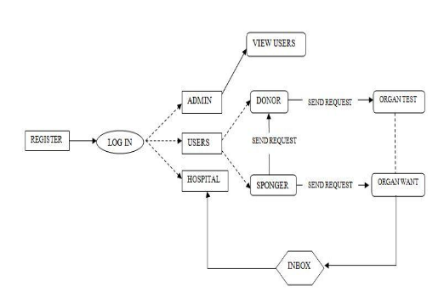
Architecture Diagram

Slide 8
Literature Survey
TITTLE | AUTHOR | CONCEPT

Slide 9
TITTLE | AUTHOR | CONCEPT

Slide 10
SOFTWARE REQUIREMENTS:
Operating System : Windows XP.
Platform : DOT NET TECHNOLOGY
Front End : ASP.Net 3.5
Back End : SQL SERVER 2005

Slide 11
HARDWARE REQUIREMENTS:
Keyboard
Mouse
Hard disk 500GB
Ram 4 Gb

Slide 12
REFERENCE
[1] Decker, K., Li, J. Coordinated Hospital Patient Scheduling. Proc. ICMAS’98.
[2] Informes y documentos de consenso. Organización Nacional de Trasplantes (Ed.), 2000.
[3] Keeney R.L., Raiffa, H. Decision with Multiple Ob-jectives: Preferences and Value Tradeoffs. Cambridge University Press, 1993.
[4] López-Navidad, A., Domingo, P., Viedma, M.A., Professional characteristics of the transplant coordina-tor. Transplantation Proceedings, 29, pp. 1607-1613, Elsevier Science Inc., 1997.
[5] López-Navidad, A., Kulisevsky, J., Caballero, F., El donante de órganos y tejidos. Evaluación y manejo. Springer-Verlag Ibérica, 1997.
[6]B. Bonet and H. Ge®ner. Arguing for decisions: A qual-
[7] itative model of decision making. In UAI-96, pages 98{105, San Francisco, CA, 1996. Morgan Kaufmann Pub-lishers.
[8]M. Caminada. Contamination in formal argumen-tation systems. In BNAIC 2005, Brussels, Belgium, Oc-tober17-18, pages 59{65, 2005.

