Slide 1
A Review on Computational Intelligence Techniques in Cloud and Edge Computing

Slide 2
Abstract
Cloud computing (CC) is a centralized computing paradigm that accumulates resources centrally and provides these resources to users through Internet. Although CC holds a large number of resources, it may not be acceptable by real-time mobile applications, as it is usually far away from users geographically.
On the other hand, edge computing (EC), which distributes resources to the network edge, enjoys increasing popularity in the applications with low-latency and high-reliability requirements. EC provides resources in a decentralized manner, which can respond to users’ requirements faster than the normal CC, but with limited computing capacities.

Slide 3
As both CC and EC are resource-sensitive, several big issues arise, such as how to conduct job scheduling, resource allocation, and task offloading, which significantly influence the performance of the whole system. To tackle these issues, many optimization problems have been formulated.
These optimization problems usually have complex properties, such as non-convexity and NP-hardness, which may not be addressed by the traditional convex optimization-based solutions. Computational intelligence (CI), consisting of a set of nature-inspired computational approaches, recently exhibits great potential in addressing these optimization problems in CC and EC. This article provides an overview of research problems in CCand EC and recent progresses in addressing them with the help of CI techniques. Informative discussions and future research trends are also presented, with the aim of offering insights to the readers and motivating new research directions.

Slide 4
Existing System
Cloud computing (CC) is a centralized computing paradigm that accumulates resources centrally and provides these resources to users through Internet. Although CC holds a large number of resources, it may not be acceptable by real-time mobile applications, as it is usually far away from users geographically.
On the other hand, edge computing (EC), which distributes resources to the network edge, enjoys increasing popularity in the applications with low-latency and high-reliability requirements. EC provides resources in a decentralized manner, which can respond to users’ requirements faster than the normal CC, but with limited computing capacities.

Slide 5
As both CC and EC are resource-sensitive, several big issues arise, such as how to conduct job scheduling, resource allocation, and task offloading, which signiﬁcantly impudence the performance of the whole system. To tackle these issues, many optimization problems have been formulated.
These optimization problems usually have complex properties, such as non-convexity and NP-hardness, which may not be addressed by the traditional convex optimization based solutions. Computational intelligence (CI), consisting of a set of nature-inspired computational approaches, recently exhibits great potential in addressing these optimization problems in CC and EC.

Slide 6
Disadvantage of Existing System
Metrics can be improved by considering job scheduling, resource allocation, and task offloading. To this end, many optimization problems have been formulated for tackling these issues.
Compared with optimization problems in other areas, these optimization problems are normally highly complex and NP-hard, which may include mixed/strongly coupled variables, nonlinear constraints, multiple objectives, and bi-level structures.

Slide 7
PROPOSED SYSTEM :
This paper provides an overview of research problems in CC and EC and recent progresses in addressing them with the help of CI techniques. Informative discussions and future research trends are also presented, with the aim of offering insights to the readers and motivating new research directions.

Slide 8
ADVANTAGE
Like extending battery lifetime.
Improving storage capacity and processing power, and
Providing computation intensive applications.

Slide 9
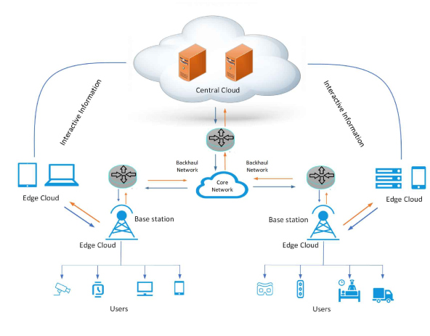
Architecture Diagram

Slide 10
Literature Survey
TITTLE | AUTHOR | CONCEPT
Cloud computing: State-of-the-art and research challenges | Q. Zhang, L. Cheng, and R. Boutaba | Cloud computing has recently emerged as a new paradigm for hosting and delivering services over the Inter-net.
“The NIST definition of cloud computing,” | P. Mell and T. Grance | Cloud computing has recently emerged as a new paradigm for hosting and delivering services over the Internet. Cloud computing is attractive to business owners as it eliminates the requirement for users to plan ahead for provisioning, and allows enterprises to start from the small and increase resources only when there is a rise in service demand.

Slide 11
TITTLE | AUTHOR | CONCEPT
A survey on mobile edge computing: The communication perspective | Y. Mao, C. You, J. Zhang, K. Huang, and K. B. Letaief | Driven by the visions of Internet of Things and 5G communications, recent years have seen a paradigm shift in mobile computing, from the centralized Mobile Cloud Computing towards Mobile Edge Computing (MEC).
“Analysis of cloud computing delivery architecture models. | I. Bojanova and A. Samba, | Cloud computing is one of the emerging technologies that will lead to the next generation of Internet. It provides optimized and efficient computing through enhanced collaboration, agility, scalability, and availability.

Slide 12
SOFTWARE REQUIREMENTS:
Operating System : Windows XP.
Platform : DOT NET TECHNOLOGY
Front End : ASP.Net 3.5
Back End : SQL SERVER 2005

Slide 13
HARDWARE REQUIREMENTS:
Keyboard
Mouse
Hard disk 500GB
Ram 4 Gb

Slide 14
REFERENCES
[1] M. Armbrust et al., “Above the clouds: A Berkeley view of cloud
computing,” EECS Department, University of California, Berkeley, CA,
USA, Tech. Rep. UCB/EECS-2009-28, Feb. 2009.
[2] Q. Zhang, L. Cheng, and R. Boutaba, “Cloud computing: State-of-the-art
and research challenges,” J. Internet Serv. Appl., vol. 1, no. 1, pp. 7–18,
May. 2010.
[3] P. Mell and T. Grance, “The NIST definition of cloud computing,”
National Institute of Standards and Technology (NIST), Gaithersburg,
MD, USA, Tech. Rep. 800-145, Sep. 2011.
[4] Y. Mao, C. You, J. Zhang, K. Huang, and K. B. Letaief, “A survey
on mobile edge computing: The communication perspective,” IEEE
Commun. Surv. Tut., vol. 19, no. 4, pp. 2322–2358, Oct.–Dec. 2017.

Slide 15
[5] N. Wingfield, “Amazon’s profits grow more than 800 percent, lifted
by cloud services,” New York Times, New York, NY, USA, Jul. 2016.
[Online]. Available: https://www.nytimes.com/2016/07/29/technology/
amazon-earnings-profit.html?_r=0
[6] I. Bojanova and A. Samba, “Analysis of cloud computing delivery architecture
models,” in Proc. IEEE Workshops Int. Conf. Adv. Inform. Netw.
Appl., 2011, pp. 453–458.
[7] X. Chen, “Decentralized computation offloading game for mobile
cloud computing,” IEEE Trans. Parallel Distrib. Syst., vol. 26, no. 4,
pp. 974–983, Apr. 2015.
[8] Y. Chen, Y. Zhang, S. Maharjan, M. Alam, and T.Wu, “Deep learning for
secure mobile edge computing in cyber-physical transportation systems,”
IEEE Netw., vol. 33, no. 4, pp. 36–41, Jul./Aug. 2019.

