Slide 1
Cyber Bidding

Slide 2
Abstract
This is an online auction web site aimed at taking the auction to the fingertips of aspiring bidders there by opening up the doors of the "OPEN Auction House' to a wider cross section of Art Lovers and Antique Collectors. This site also acts as an open forum where buyers and sellers can come together and exchange their products. The site makes sure that the sellers get a fair deal and buyers get a genuine product. The work will be done in ASP.Net and my sql.

Slide 3
Existing System
In this project, an online auction system is presented. It has a very large potential market of sellers and buyers. An On Line Transaction Processing(OLTP) database model structure is, therefore, desirable.

Slide 4
Disadvantage of Existing System
May be buyers don’t have time to go and waste their time to buy the product in market.
In manual auction the day of auction, venue and the items for auctions are told to the general public through electronic or print media. The people who wish to take part in the auction should first register himself and then arrive at the venue of the auction on the given date and time.

Slide 5
PROPOSED SYSTEM :
This project involves the design and implementation of an online auction system. The analysis stage is performed first for the case study. Project begins by analyzing and presenting the OLTP database model for the online auction house. Besides, the intention to establish what goes on operationally within the online auction house. It also defines the layout in and web application. In which many number of bidders bids the auction and final the auction won will store the result of the winning bidder details. And finally the shipment process will carried out.

Slide 6
ADVANTAGE
There is a chance of corruption and other factors for not providing transparent bidding.
Simply we can define auction as a process of buying and selling goods or services by offering up of them for bids, taking bids, and selling items to the highest bidders

Slide 7
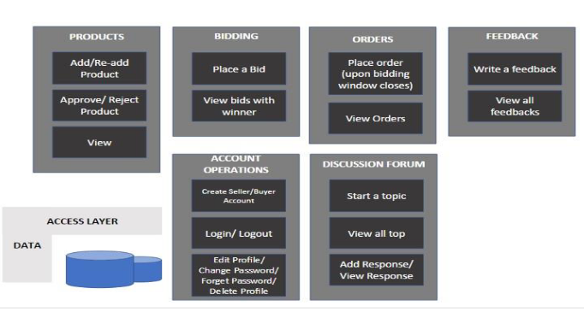
Architecture Diagram

Slide 8
Literature Survey
TITTLE | AUTHOR | CONCEPT
“Web Application Hosting in the AWS Cloud Best Practices”, | Matt Traci, | Agriculture is the backbone of India, saying this, many of the agriculturists face so many problems in the agriculture that includes improper value for the products they produce and thereare no proper discussion platforms where they could discuss or clarify their doubts regarding the agriculture.
“Agents for CloudResource Allocation: an Amazon EC2 Case Study”. | “Agents for CloudResource Allocation: an Amazon EC2 Case Study”. | Infrastructure-as-a-service consumers are presented with numerous Cloud providers with a wide variety of resources.

Slide 9
“Pricing Algorithms in Online Auctions,” | Sandeep Kumar, | Online auctions have become one of the fastest growing modes of online commerce transactions. eBay has 94 million active members buying and selling goods at a staggering rate. These auctions are also producing large amounts of data that can be utilized to provide services to the buyers and sellers, market research, and product development.
Kaleesari,NobleMary Juliet | “Dynamic Resource Allocation by usingElastic Compute Cloud Service” , | Cloud computing is on demand as it offers dynamic flexible resource allocation for reliable and guaranteed services in pay as-you-use manner to public.

Slide 10
SOFTWARE REQUIREMENTS:
Operating System : Windows XP.
Platform : DOT NET TECHNOLOGY
Front End : ASP.Net 3.5
Back End : SQL SERVER 2005

Slide 11
HARDWARE REQUIREMENTS:
Keyboard
Mouse
Hard disk 500GB
Ram 4 Gb

Slide 12
REFERENCE
[1] Matt Traci, “Web Application Hosting in the AWS Cloud Best Practices”, Philip Fitzsimons, 2012.
[2] Octavio Gutierrez-Garcia and KangMongSim, “Agents for CloudResource Allocation: an Amazon EC2 Case Study”.
[3] Kaleesari,NobleMary Juliet “Dynamic Resource Allocation by usingElastic Compute Cloud Service” , International journal of InnovativeResearch in Science Engineering and Technology, vol.3, pp. 1237-12379,2014.
[4] Sandeep Kumar, “Pricing Algorithms in Online Auctions,” ComputerEngineering Department, UIET, M.D.UniversityRohtak, Haryana, India
[5] Hemantha Kumar P., GautamBarua, “Design of Real Time AuctionSystem,” Dept. of Computer Science and Engineering, Guwahati.
[6] LuckingǦReiley, D. “Auctions on the Internet: What’s being auctioned,and how?”, The Journal of Industrial Economics, vol. 48 Issue 3, pp. 227

