Slide 1
Advanced Skin Diseases Diagnosis leveraging image Processing

Slide 2
Abstract
Air pollution affects human skin in many ways. Skin diseases are common in densely populated regions. These diseases have a devastating impact on people's lives by creating a huge need for the disease diagnosis. The proposed work on skin disease determination system aims for an accurate diagnosis leveraging image processing. The methodology outlined here aims to identify skin disease by scrutinizing the input image. The method involves filtering of the input provided to remove noise. Conversion of image to a grayscale image, and image segmentation. Feature extraction is used to minimize the amount of data to be processed by the classifier.

Slide 3
The SVM (Support Vector Machine) is then used in the image classification to identify the skin disease. The increased use of technology has led to an efficient and accurate way of diagnosis that aids in curing the disease more expeditiously. Using the proposed method skin diseases such as rosacea, melanoma, psoriasis and acne are identified with a high accuracy of 89%.

Slide 4
Existing System
Skin diseases such as Melanoma and Carcinoma are often quite hard to detect at an early stage and it is even harder to classify them separately. Recently, it is well known that, the most dangerous form of skin cancer among the other types of skin cancer is melanoma because it is much more likely to spread to other parts of the body if not diagnosed and treated early. In order to classify these skin diseases, “Support Vector Machine (SVM)” a Machine Learning Algorithm can be used.

Slide 5
Disadvantage of Existing System
.For a long time, algorithms for finding objects in images have been studied extensively. Numerous researches have been done in object detection, recognition, classification and discrimination.

Slide 6
PROPOSED SYSTEM :
In this paper, we propose a method to identify whether a given sample is affected with Melanoma or not. The steps involved in this study are collecting labeled data of images that are pre-processed, flattening those images and getting the pixel intensities of images into an array, appending all such arrays into a database, training the SVM with labeled data using a suitable kernel, and using the trained data to classify the samples successfully. The results show that the achieved accuracy of classification is about 90%.

Slide 7
ADVANTAGE
Experiments show that analyzing the shadow of the skin lesions can effectively detect and classify the lesion of concern.

Slide 8
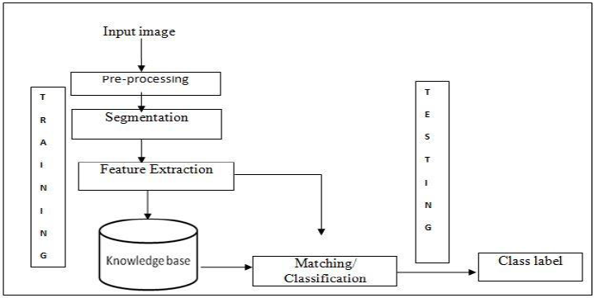
Architecture Diagram

Slide 9
Literature Survey
TITTLE | AUTHOR | CONCEPT
M. A. Sheha, M. S. Mabrouk, and A. Sharawy, “ | Automatic detection of melanoma skin cancer using texture analysis,” | Melanoma is considered the most dangerous type of skin cancer. Early and accurate diagnosis depends mainly on important issues, accuracy of feature extracted and efficiency of classifier method.
“Dermatological disease detection using image processing and artificial neural network,” | R. Yasir, M. A. Rahman, and N. Ahmed, | Skin diseases are among the most common health problems worldwide.In this article we proposed a method that uses computer vision based techniques to detect various kinds of dermatological skin diseases.

Slide 10
“Dermatological disease detection using image processing and artificial neural network,” | R. Yasir, M. A. Rahman, and N. Ahmed, | Skin diseases are among the most common health problems worldwide.In this article we proposed a method that uses computer vision based techniques to detect various kinds of dermatological skin diseases.
”Skin Disease Diagnosis Using Image Classification”. | Okuboyejo, Damilola A, et al. Automating | The modern leap of machines into smarter worlds has lead researchers to develop sophisticated systems that have the ability to diagnose human diseases through machine learning tools and techniques.

Slide 11
SOFTWARE REQUIREMENTS:
Operating System : Windows XP.
Platform : DOT NET TECHNOLOGY
Front End : ASP.Net 3.5
Back End : SQL SERVER 2005

Slide 12
HARDWARE REQUIREMENTS:
Keyboard
Mouse
Hard disk 500GB
Ram 4 Gb

Slide 13
REFERENCE
[1] M. A. Sheha, M. S. Mabrouk, and A. Sharawy, “Automatic detection of melanoma skin cancer using texture analysis,” International Journal of Computer Applications, vol. 42, no. 20, pp. 22–26, 2012.
[2] R. Yasir, M. A. Rahman, and N. Ahmed, “Dermatological disease detection using image processing and artificial neural network,” in 8th International Conference on Electrical and Computer Engineering: Advancing Technology for a Better Tomorrow, ICECE. Pan Pacific Sonarga on Dhaka, 2014, pp. 687–690.
[3] S. M. Jadhav, S. Nalbalwar, and A. Ghatol, “Artificial neural network based cardiac arrhythmia classification using ecg signal data,” in Electronics and Information Engineering (ICEIE), 2010 International ConferenceOn, vol. 1. IEEE, 2010, pp. V1–228.
[4] Okuboyejo, Damilola A, et al. ―Automating”Skin Disease Diagnosis Using Image Classification”. Proceedings of WCECS 2013, October 23 -25, 2013, San Francisco, USA, IAENG Open Access Publication, 24 Oct. 2013, www.iaeng.org/publication/WCECS2013/.
[5] Mrs. S.Kalaiarasi1, Harsh Kumar2, Sourav Patra3 “Dermatological Disease Detection using Image Processing and Neural Networks”.

Slide 14
[6] Vinayshekhar Bannihatti Kumar, S. Selvin Prem Kumar, Varun Saboo “Dermatological disease detection using image processing and machine learning”.
[7] Yuslinda Wati Mohamad Yusof, Hadzli Hashim, Khairul Anam Sulaiman, Suhaila Subahir, Noor Ezan Abdullah and Fairul Nazmie Osman “ Plaque Lesion Classification Fuzzy Model Based on Various Color Models”.
[8] Subrat Kumar Rath, Siddharth Swarup Rautaray “Performance Comparison of Min-Max Normalisation on Frontal Face Detection Using Haar Classifiers”.
[9]“Comparison of Machine Learning Algorithms for Skin Disease Classification Using Color and Texture Features”. ParameshwarR. Hegde Department of Dermatology and Yenepoya Research Center Yenepoya, Manjunath M. Shenoy Department of Dermatology Yenepoya, B.H. Shekar Department of Computer Science Mangalore University Mangalore, Karnataka, India.

