Slide 1
A Survey of Millimeter Wave (mmWave) Communications for 5G Opportunities and Challenges

Slide 2
Abstract
With the explosive growth of mobile data demand, the fifth generation (5G) mobile network would exploit the enormous amount of spectrum in the millimeter wave (mmWave) bands to greatly increase communication capacity. There are fundamental differences between mmWave communications and existing other communication systems, in terms of high propagation loss, directivity, and sensitivity to blockage. These characteristics of mmWave communications pose several challenges to fully exploit the potential of mmWave communications, including integrated circuits and system design, interference management, spatial reuse, anti-blockage, and dynamics control.

Slide 3
To address these challenges, we carry out a survey of existing solutions and standards, and propose design guidelines in architectures and protocols for mmWave communications. We also discuss the potential applications of mmWave communications in the 5G network, including the small cell access, the cellular access, and the wireless backhaul. Finally, we discuss relevant open research issues including the new physical layer technology, softwaredefined network architecture, measurements of network state information, efficient control mechanisms, and heterogeneous networking, which should be further investigated to facilitate the deployment of mmWave communication systems in the future 5G networks.

Slide 4
Existing System
This paper provides an overview of research challenges and opportunities on mm-wave communication in the fifth generation (5G) mobile broadband networks. More specifically, different challenges, i.e. spectrum, propagation channel, cost and energy efficient aspects, from the perspective of mm-wave communication are discussed. Furthermore, insights on research opportunities of mm-wave communication in heterogeneous net-works and multi-antenna transceiver technologies are provided. Based on provided overview, it can be concluded that mm-wave communication is a promising framework for further development and research towards next generation mobile broadband communication systems.

Slide 5
Disadvantage of Existing System
.
Existing spectrum for new mobile services becomes overcrowded. On contrary, mm-wave spectrum, i.e. 30-300 GHz, opens up an attractive opportunity to harvest large continuous chunks of spectrum with emerging mm-wave technologies for ultra-high data rate wireless communication.
Up to today, mm-wave spectrum has not been effectively leveraged for the use of mobile broadband systems.

Slide 6
PROPOSED SYSTEM :
The paper discusses fifth generation mobile communication and upcoming technologiesforsatisfying the customers need and changes in the network architecture. The main concern willbe on 5G network architecture, along with the exploitation of higher frequencies,mainlymillimeter wave (mmwave), one of the promising technologies for future 5G cellular networks. In comparison to existing communication technology, millimeter wave communication is different in terms of directivity, high propagation loss, sensitivity to blockage. To fully employ the characteristics of mmwave it has several technical challenges. Further research is to be done for 28GHz and 38 GHz band and above 60 GHz band.

Slide 7
This paper, we propose a multi-path wireless sensor network routing Ant Colony algorithm based on energy equalization. The algorithm uses forward ants to find the path from the source node to the destination node, and uses backward ants to update the pheromone on the path. In the route selection, we use the energy of the neighboring nodes as the parameter of the heuristic function.

Slide 8
ADVANTAGE
For next generation networks and devices, new challenging requirements, e.g., in terms of throughputs, latencies and reliability, will be imposed for a entire system design.

Slide 9
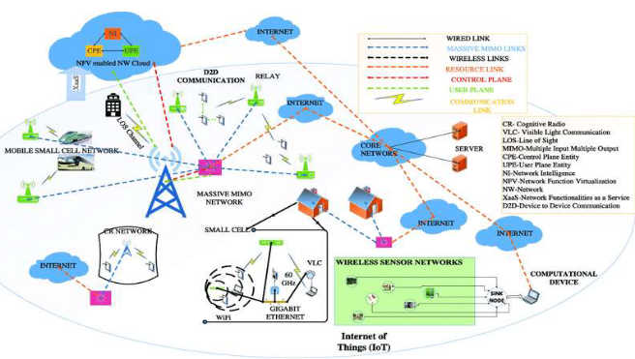
Architecture Diagram

Slide 10
Literature Survey
TITTLE | AUTHOR | CONCEPT
An introduction to millimeter wave mobile broadband | F. Khan and Z. Pi, | The global bandwidth shortage facing wireless carriers has motivated the exploration of the underutilized millimeter wave (mm-wave) frequency spectrum for future broadband cellular communication networks.
“State of the art in 60-GHz integrated circuits and systems for wireless communications,” | T. S. Rappaport, J. N. Murdock, F. Gutierrez, | This tutorial presents an overview of the technological advances in millimeter-wave (mm-wave) circuit components, antennas, and propagation that will soon allow 60-GHz transceivers to provide multigigabit per second (multi-Gb/s) wireless communication data transfers in the consumer marketplace.

Slide 11
TITTLE | AUTHOR | CONCEPT
“Design considerations for 60 GHz cmos radios,” | C. H. Doan, S. Emami, D. A. Sobel, A. M. Niknejad, and R. W. Brodersen, | With the availability of 7 GHz of unlicensed spectrum around 60 GHz, there is a growing interest in using this resource for new consumer applications requiring very high-data-rate wireless transmission.
“Millimeter wave and terahertz communications: feasibility and challenges | P. Pietraski, D. Britz, A. Roy, R. Pragada, and G. Charlton, | Fifth-generation (5G) cellular networks will almost certainly operate in the high-bandwidth, underutilized millimeter-wave (mmWave) frequency spectrum, which offers the potentiality of highcapacity wireless transmission of multi-gigabit-per-second (Gbps) data rates.

Slide 12
SOFTWARE REQUIREMENTS:
Operating System : Windows XP.
Platform : DOT NET TECHNOLOGY
Front End : ASP.Net 3.5
Back End : SQL SERVER 2005

Slide 13
HARDWARE REQUIREMENTS:
Keyboard
Mouse
Hard disk 500GB
Ram 4 Gb

Slide 14
REFERENCE
[1] M. Elkashlan, T. Q. Duong, H. -H. Chen, “Millimeter-wave communications for 5G: fundamentals: Part I [Guest Editorial],” IEEE Communications Magazine, vol. 52, no. 9, pp. 52–54, 2014.
[2] M. Elkashlan, T. Q. Duong, H. -H. Chen, “Millimeter-wave communications for 5G–Part 2: Applications,” IEEE Communications Magazine, vol. 53, no. 1, pp. 166–167, 2015.
[3] C. H. Doan, S. Emami, D. A. Sobel, A. M. Niknejad, and R. W. Brodersen,
“Design considerations for 60 GHz cmos radios,” IEEE Communications
Magazine, vol. 42, no. 12, pp. 132–140, Dec. 2004.
[4] F. Gutierrez, S. Agarwal, K. Parrish, and T. S. Rappaport, “On-chip
integrated antenna structures in CMOS for 60 GHz WPAN systems,” IEEE J. Selected Areas in Communications, vol. 27, no. 8, pp. 1367– 1378, Oct. 2009.

Slide 15
[5] T. S. Rappaport, J. N. Murdock, F. Gutierrez, “State of the art in 60-GHz integrated circuits and systems for wireless communications,” Proceedings of the IEEE, vol. 99, no. 8, pp. 1390–1436, Aug. 2011.
[6] ECMC TC48, ECMA standard 387, “High rate 60 GHz PHY, MAC and HDMI PAL,” Dec. 2008.
[7] H. Ajorloo, M. T. Manzuri-Shalmani, “Modeling beacon period length of the UWB and 60-GHz mmWave WPANs based on ECMA-368 and ECMA-387 standards,” IEEE Transactions on Mobile Computing,vol. 12, no. 6, pp. 1201–1213, June 2013.
[8] IEEE 802.15 WPAN Millimeter Wave Alternative PHY Task Group 3c(TG3c). Available: http://www.ieee802. org/15/pub/TG3c.html.

