Slide 1
A Dynamic Deep-learning-based Virtual Edge Node Placement Scheme for Edge Cloud Systems in Mobile Environment

Slide 2
Abstract
Edge node placement is a key topic to edge cloud systems for that it affects their service performances significantly. Previous solutions based on the existing information are not suitable for the mobile environment due to the mobility and random Internet access of end users. In this paper, we propose a dynamic virtual edge node placement scheme, in which the edge node placement strategy is generated based on the prediction information. Our placement scheme applies the pay-as-you-go and Spot Instance model of cloud computing, which may allocate the service resources with low cost conveniently and flexibly. What’s more Long Short-Term Memory (LSTM) is implemented to predict the information of end users’ requests and the resources’ prices, endowing the generated placement strategy with the adaptability to the change of end users.

Slide 3
At last, a set of hierarchical-clustering-based placement algorithms are proposed, which not only locate virtual edge nodes and allocate their corresponding service resources actively, but also guarantee the service quality of end users with low time complexity. The simulation with trace data shows that compared with K-means-clustering-based placement schemes, our virtual edge node placement scheme can provide users with high-quality service in terms of network delay with relatively low placement cost time-efficiently.

Slide 4
Existing System
The performance of mobile computing would be significantly improved by leveraging cloud computing and mi-grating mobile workloads for remote execution at the cloud. In this paper, to efficiently handle the peak load and satisfy the requirements of remote program execution, we propose to deploy cloud servers at the network edge and design the edge cloud as a tree hierarchy of geo-distributed servers, so as to efficiently utilize the cloud resources to serve the peak loads from mobile users.

Slide 5
Disadvantage of Existing System
When there is only one server at each tier of the edge cloud, we formulate the workload placement problem as a mixed nonlinear integer programming (MNIP) problem, with integer variables indicating the locations of workloads being placed and non-integer variables indicating the amount of capacity allocated to execute each workload.

Slide 6
PROPOSED SYSTEM :
The hierarchical architecture of edge cloud enables aggregation of the peak loads across different tiers of cloud servers to maximize the amount of mobile workloads being served.
To ensure efficient utilization of cloud resources, we further propose a workload placement algorithm that decides which edge cloud server’s mobile programs are placed on and how much computational capacity is provisioned to execute each program.
The performance of our proposed hierarchical edge cloud architecture on serving mobile workloads is evaluated by formal analysis, small-scale system experimentation, and large-scale trace-based simulations.

Slide 7
ADVANTAGE
To introduce a novel problem definition for two-level container allocation.
To develop a hybrid approach GPHH and human-designed rules.
To evaluate our proposed approach on benchmark datasets.

Slide 8
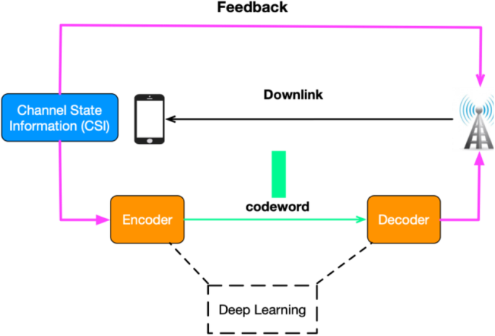
Architecture Diagram

Slide 9
Literature Survey
TITTLE | AUTHOR | CONCEPT
Classification of optimization problems in fog computing, Future Generation Computer Systems | Bellendorf, Z. A. Mann, , | Big data analytics with the cloud computing are one of the emerging area for processing and analytics. Fog computing is the paradigm where fog devices help to reduce latency and increase throughput for assisting at the edge of the client.
Price-Based Distributed Offloading for Mobile-Edge Computing With Computation Capacity Constraints | M. Liu and Y. Liu, | Mobile-edge computing (MEC) is a promising technology to enable real-time information transmission and com-putting by offloading computation tasks from wireless devices to network edge. In this study, we propose a price-based distributed method to manage the offloaded computation tasks from users.

Slide 10
TITTLE | AUTHOR | CONCEPT
Live migration of virtual network functions in cloud-based edge networks | W. Cerroni, F. Callegati, | While relocation of bi-directional service flows immobile services with computation offloading, round trip delay of in-flight service packets should be kept short to provide swift responses in the services.
Cost Aware cloudlet Placement for big data processing at the edge. | Q. Fan and N. Ansari, | As accessing computing resources from the remote cloud inherently incurs high end-to-end (E2E) delay for mobile users, cloudlets, which are deployed at the edge of a network, can potentially mitigate this problem.

Slide 11
SOFTWARE REQUIREMENTS:
Operating System : Windows XP.
Platform : DOT NET TECHNOLOGY
Front End : ASP.Net 3.5
Back End : SQL SERVER 2005

Slide 12
HARDWARE REQUIREMENTS:
Keyboard
Mouse
Hard disk 500GB
Ram 4 Gb

Slide 13
REFERENCES
1.Z. Sanaei, S. Abolfazli, A. Gani, and R. Buyya, Heterogeneity in Mobile Cloud Computing: Taxonomy and Open Challenges, .
2. L. Tong, Y. Li, and W. Gao, A hierarchical edge cloud architecture for mobile computing.
3. F. Bonomi, R. Milito, J. Zhu, and S. Addepalli, Fog Computing and Its Role in the Internet of Things.
4. J. Bellendorf, Z. A. Mann, Classification of optimization problems in fog computing, Future Generation Computer Systems.
5. W. Yu, F. Liang, X. He, W. G. Hatcger, C. Lu, J. Lin and X. Yang, A Survey on the Edge Computing for the Internet of Things.

Slide 14
6. Z. Xu, W. Liang, W. Xu, M. Jia, and S. Guo Capacitated Cloudlet Placements in Wireless Metropolitan Area Networks.
7. Q. Fan and N. Ansari, Cost Aware cloudlet Placement for big data processing at the edge.
8. ] M. Liu and Y. Liu, Price-Based Distributed Offloading for Mobile-Edge Computing With Computation Capacity Constraints.
9. M. Liu and Y. Liu, Price-Based Distributed Offloading for Mobile-Edge Computing With Computation Capacity Constraints.
10. W. Cerroni, F. Callegati, Live migration of virtual network functions in cloud-based edge networks.

