Slide 1
Road accident analysis and prediction of accident severity by using machine learning

Slide 2
Abstract

Slide 3
Existing System

Slide 4
Disadvantage of Existing System
The required precautions against potential accidents may be taken by reckoning the risks for road accidents.

Slide 5
PROPOSED SYSTEM :
Large calibrated data agglomerations have increased by the reasons of the technological improvements and data storage with low cost. Arising the need of accession to information from this large calibrated data obtained the corner stone of the data mining.
In this study, assignment of the most compatible machine learning classification techniques for road accidents estimation by data mining has been intended

Slide 6
ADVANTAGE
machine learning algorithm, which is much acceptable for road accident assumption by the data mining method attaining from road accident data was studied to be found.
It is observed that 854.000 road accidents happened in general of the country in 2013 on the study by TRAMER. %34 of these accidents happened in Istanbul.

Slide 7
MODULE
Data Set Selection
Data is the most import part when you work on prediction systems. It plays a very vital role your whole project i.e., you system depends on that data. So selection of data is the first and the critical step which should be performed properly, For our project we got the data from the government website. These datasets were available for all. There are other tons of websites who provide such data. The dataset we choose wad selected based on the various factors and constraints we were going to take under the consideration for our prediction system.
Data Cleaning and Data Transformation
After we have selected the dataset. The next step is to clean the data and transform it into the desired format as it is possible the dataset we use may be of different format. It is also possible that we may use multiple datasets from different sources which may be in different file formats. So to use them we need to convert them into the format we want to or the type that type prediction system supports. The reason behind this step is that it is possible that the data set contains the constraints which are not needed by the prediction system and including them makes the system complicated and may extend the processing time. Another reason behind data cleaning is the dataset may contain null value and garbage values too. So the solution to this issue is when the data is transformed the garbage values are replaced. There are many methods to perform that.

Slide 8
Data Processing and Algorithm Implementation
After the data is been cleaned and transformed it’s ready to process further. After the data has been cleaned and we have taken the required constraints. We divide the whole dataset int o the two parts that can be either 70-30 or 80-20. The larger portion of the data is for the processing. The algorithm is applied on that part of data. Which helps the algorithm to learn on its own and make prediction for the future data or the unknown data. The algorithm is executed in which we take only the required constraints from the cleaned data. The output of the algorithm is in ‘yes’ and ‘no’. It gives the error rate and the success rate.
Output and User Side Experience
After the prediction system is ready to use. The Website is developed for the user. The user just has to fill a form which consists of different options they need to select. They are like the type of climate, the type of vehicle and so on. Once the user submits the form the algorithm is triggered and the input given by the user is passed to the prediction system. The user is given how accident prone the road can be in percentage.

Slide 9
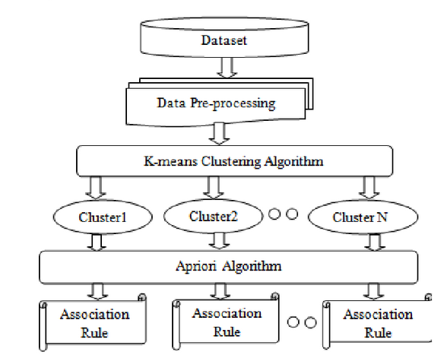
Architecture Diagram

Slide 10
Literature Survey
TITTLE | AUTHOR | CONCEPT
"Road Accidents in Bangladesh: An Alarming Issue", | T. Rahman, | This paper discusses the involvement of Non-Motorized Vehicles(NMVs) in road traffic system and accidents with particular context of Bangladesh. Considering all forms of NMVs, rickshaws are the most popular mode.
, "Mining traffic accident data of N5 national highway in Bangladesh employing decision trees," | M. S. Satu, S. Ahamed, F. Hossain, T. Akter and D. M. Farid | Mining traffic accident data is necessary for accident free smart cities, as traffic accidents causes harmful injuries, loss of lives and damages properties of people. N5 National Highway in Bangladesh is the largest highway, where a large number of accidents occur in every year.

Slide 11
TITTLE | AUTHOR | CONCEPT
"A data mining approach to characterize road accident locations," | S. Kumar and D. Toshniwal, | Data mining has been proven as a reliable technique to analyze road accidents and provide productive results. Most of the road accident data analysis use data mining techniques, focusing on identifying factors that affect the severity of an accident.
“Mining Road Traffic Accident Data to Improve Safety: Role of Road-Related Factors on Accident Severity in Ethiopia,” | Beshah, Tibebe, and Shawndra Hill, | Road traffic accidents (RTAs) are a major public health concern, resulting in an estimated 1.2 million deaths and 50 million injuries worldwide each year. In the developing world, RTAs are among the leading cause of death and injury; Ethiopia in particular experiences the highest rate of such accidents.

Slide 12
SOFTWARE REQUIREMENTS:
Operating System : Windows XP.
Platform : DOT NET TECHNOLOGY
Front End : ASP.Net 3.5
Back End : SQL SERVER 2005

Slide 13
HARDWARE REQUIREMENTS:
Keyboard
Mouse
Hard disk 500GB
Ram 4 Gb

Slide 14
REFERENCES
[1] T. Rahman, "Road Accidents in Bangladesh: An Alarming Issue", The World Bank, 2012. [Online]
[2] K. M. Habibullah, A. Alam, S. Saha, A. Amin and A. K. Das, " A Driver-Centric Carpooling: Optimal Route-Finding Model using Heuristic Multi–Objective Search," 2019 4th International Conference on Computer and Communication Systems (ICCCS), Singapore, 2019.
[3] M. M. L. Elahi, R. Yasir, M. A. Syrus, M. S. Q. Z. Nine, I. Hossain and N. Ahmed, "Computer vision based road traffic accident and anomaly detection in the context of Bangladesh," 2014 International Conference on Informatics, Electronics & Vision (ICIEV), Dhaka, 2014, pp. 1-6.
[4] M. S. Satu, S. Ahamed, F. Hossain, T. Akter and D. M. Farid, "Mining traffic accident data
of N5 national highway in Bangladesh employing decision trees," 2017 IEEE Region 10 Humanitarian Technology Conference (R10-HTC), Dhaka, 2017, pp. 722-725.
[5] H. İ. Bülbül, T. Kaya and Y. Tulgar, "Analysis for Status of the Road Accident Occurrence and Determination of the Risk of Accident by Machine Learning in Istanbul," 2016 15th IEEE International Conference on Machine Learning and Applications (ICMLA), Anaheim, CA, 2016, pp. 426-430.

Slide 15
[6] S. Kumar and D. Toshniwal, "A data mining approach to characterize road accident locations," Journal of Modern Transportation(2016), vol. 24, issue no. 1, pp. 62-72.
[7] Beshah, Tibebe, and Shawndra Hill, “Mining Road Traffic Accident Data to Improve Safety: Role of Road-Related Factors on Accident Severity in Ethiopia,” AAAI Spring Symposium: Artificial Intelligence for Development (2010).
[8] A. Esmaeili, M. Khalili and A. Pakgohar, "Determining the road defects impact on accident severity; based on vehicle situation after accident, an approach of logistic regression," 2012 International Conference on Statistics in Science, Business and Engineering (ICSSBE), Langkawi, 2012, pp. 1-4.
[9] M. A. A. Mamun, J. A. Puspo and A. K. Das, “An intelligent smartphone based approach using IoT for ensuring safe driving,” 2017 International Conference on Electrical Engineering and Computer Science (ICECOS), Palembang, 2017, pp. 217-223.
[10] T. Adhikary, A. K. Das, M. A. Razzaque, A. Almogren, M. Alrubaian, and M. M. Hassan, “Quality of Service Aware Reliable Task Scheduling in Vehicular Cloud Computing,” Mobile Networks and Applications, Volume 21, Issue 3, pp 482-493, June 2016

