Slide 1
Automatic detection of tuberculosis related abnormalities in Chest X-ray
Images using hierarchical feature extraction scheme

Slide 2
Abstract
Machine learning techniques have been widely used for abnormality detection in medical images. Chest X-ray images (CXR) are among the non-invasive diagnostic tools used to detect various disease pathologies. The ambiguous anatomical structure of soft tissues is one of the major challenges for segregating normal and abnormal images.
The main objective of this study is to mimic the expert radiologist’s interpretation procedure in computer-aided diagnosis (CAD) systems. We propose an automatic technique for detection of abnormal CXR images containing one or more pathologies like pleural effusion, infiltration, fibrosis, hila enlargement, dense consolidation, etc. due to tuberculosis (TB).
The proposed abnormality detection technique is based on the hierarchical feature extraction scheme in which the features are usedin two-level of hierarchy to categorize healthy and unhealthy groups. In level one the handcrafted geometrical features like shape, size, eccentricity, perimeter, etc. and in level 2 traditional first order statistical feature along with texture features like energy, entropy, contrast, correlation, etc. are extracted from segmented lung-fields. Further, a supervised classification approach is employed on the extracted features to detect normal and abnormal CXR images. The performance of the algorithm is validated on a total of 800 CXR images from two public datasets, namely the Montgomery set and Shenzhen set. The obtained results (accuracy = 95.60 ± 5.07% and area under curve (AUC) = 0.95 ± 0.06 for Montgomery collection, and accuracy = 99.40 ± 1.05% and AUC = 0.99 ± 0.01 for Shenzhen collection) shows the promising performance of the proposed technique for TB detection compared to the existing state of the art approaches. Further, the obtained results are statistically validated using Friedman post-hoc multiple comparison methods, which confirms the significance of the proposed method.

Slide 3
The proposed abnormality detection technique is based on the hierarchical feature extraction scheme in which the features are usedin two-level of hierarchy to categorize healthy and unhealthy groups. In level one the handcrafted geometrical features like shape, size, eccentricity, perimeter, etc. and in level 2 traditional first order statistical feature along with texture features like energy, entropy, contrast, correlation, etc. are extracted from segmented lung-fields. Further, a supervised classification approach is employed on the extracted features to detect normal and abnormal CXR images. The performance of the algorithm is validated on a total of 800 CXR images from two public datasets, namely the Montgomery set and Shenzhen set.
The obtained results (accuracy = 95.60 ± 5.07% and area under curve (AUC) = 0.95 ± 0.06 for Montgomery collection, and accuracy = 99.40 ± 1.05% and AUC = 0.99 ± 0.01 for Shenzhen collection) shows the promising performance of the proposed technique for TB detection compared to the existing state of the art approaches. Further, the obtained results are statistically validated using Friedman post-hoc multiple comparison methods, which confirms the significance of the proposed method.

Slide 4
Existing System
The use of Image Net pre-trained networks is becoming widespread in the medical imaging community. It enables training on small datasets, commonly available in medical imaging tasks. The recent emergence of a large ChestX-ray dataset opened the possibility for learning features that are specific to the X-ray analysis task.

Slide 5
Disadvantage of Existing System
These CAD systems have limited clinical acceptability due to low accuracy.
Further, the CAD system, which has the capability of providing accurate pathological decisions and can detect multiple pathologies, is required.

Slide 6
PROPOSED SYSTEM :
In this work, we demonstrate that the features learned allow for better classification results for the problem of Tuberculosis detection and enable generalization to an unseen dataset. To accomplish the task of feature learning, we train aDenseNet-121 CNN on 112K images from the ChestXray14dataset which includes labels of 14 common thoracic pathologies.
In addition to the pathology labels, we incorporate meta-data which is available in the dataset: Patient Positioning, Gen-der and Patient Age. We term this architecture Meta Chex Net.As a by-product of the feature learning, we demonstrate state of the art performance on the task of patient Age & Gender estimation using CNN’s. Finally, we show the features learned using ChestXray14 allow for better transfer learning on small scale datasets for Tuberculosis.

Slide 7
ADVANTAGE
TB detection network is constructed on top of Meta Chexnet or ChexNet feature layer. We use a single sigmoid activated neuron for the TB class. During the training for TB detection, we fine tune the entire network with the same hyper-parameters as used.
This is because the automatic chest x-ray analysis needs highly accurate techniques. Higher the accuracy in segmentation of the lungs, higher is the accuracy in classification and detection of diseases like cardiomegaly, pneumonia and other lung related diseases. In recent times, hybrid techniques are being investigated to improve the accuracy of segmentation of lungs.

Slide 8
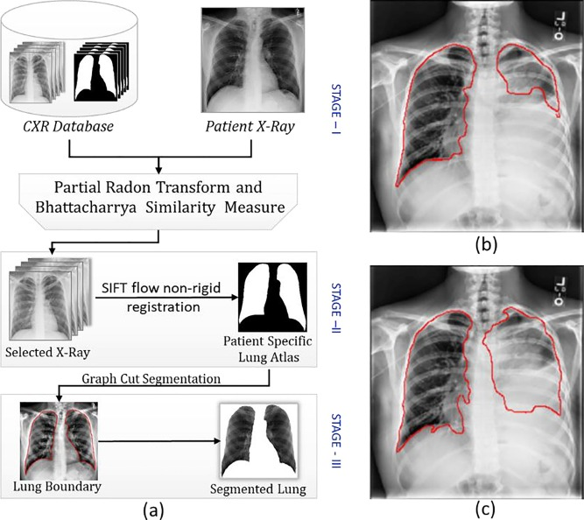
Architecture Diagram

Slide 9
Literature Survey
TITTLE | AUTHOR | CONCEPT
Lung boundary detection in pediatric chest X-rays. Medical Imaging 2015: Pacs And Imaging Informatics: Next Generation And Innovations, | S., Antani, S., Jaeger, S., Browning, R., & Thoma, G. (2015). | Chest radiography is an important diagnostic tool for chest-related diseases. Medical imaging research is currently embracing the automatic detection techniques used in computer vision.
Lung segmentation in chest radiographs using | S., Jaeger, S., Palaniappan, K., Musco, J. P., Singh, R. K., Xue, Z., . | Segmentation of lungs from chest radiographs (CXRs) is an essential pre-processing step performed for disease detection. Numerous techniques were proposed by the researchers to segment lung regions from the chest x-rays.

Slide 10
TITTLE | AUTHOR | CONCEPT
Segmented lung boundary correction in chest radiograph using context-aware adaptive scan algorithm. | T. B., Verma, K., Jain, D., & Netam, S. S. (in press). | General radiographs are an initial diagnostic tool for a variety of clinical conditions such as lung disease detection. The size, shape and texture of a lung field are key parameters for X-ray radiographs based lung disease diagnosis in which the lung field segmentation is a significant step.
Analysis of quantum noise-reducing filters on | Chandra, T. B., & Verma, K. | Medical X-ray images are prevalent and are the least expensive diagnostic imaging method available widely. The handling of film processing and digitization introduces noise in X-ray images and suppressing such noise is an important step in medical image analysis.

Slide 11
SOFTWARE REQUIREMENTS:
Operating System : Windows XP.
Platform : DOT NET TECHNOLOGY
Front End : ASP.Net 3.5
Back End : SQL SERVER 2005

Slide 12
HARDWARE REQUIREMENTS:
Keyboard
Mouse
Hard disk 500GB
Ram 4 Gb

Slide 13
REFERENCE
1.Chandra, T. B., & Verma, K. (2020a). Analysis of quantum noise-reducing filters onchest X-ray images: A review. Measurement,.
2. Chondro, P., Yao, C. Y., Ruan, S. J., & Chien, L. C. (2018). Low order adaptive regiongrowing for lung segmentation on plain chest radiographs. Neurocomputing,
3. Chan, Y., Zeng, Y., Wu, H.-C., Wu, M., & Sun, H. (2018). Effective pneumothorax detection for chest X-Ray images using local binary pattern and support vector machine. Journal of Healthcare Engineering, 2018.
4. Chondro, P., Yao, C. Y., Ruan, S. J., & Chien, L. C. (2018). Low order adaptive region growing for lung segmentation on plain chest radiographs. Neurocomputing, .
5. Nóbrega, R. V. M., Rebouças Filho, P. P., Rodrigues, M. B., da Silva, S. P. P., DouradoJúnior, C. M. J. M., & de Albuquerque, V. H. C. (2018). Lung nodule malignancy classification in chest computed tomography images using transfer learning and convolutional neural networks.

Slide 14
6. Kirti, T., Jitendra, K., & Ashok, S. (2017). Poisson noise reduction from X-ray images by region classification and response median filtering. Sadhana, .
7. A., Siegelman, J., Tzortzis, D., Jaeger, S., Candemir, S., Xue, Z., ... Thoma, G.R. (2016). Combination of texture and shape features to detect pulmonary
abnormalities in digital chest X-rays. International Journal of Computer Assisted Radiology and Surgery,.
8. Santosh, K. C., & Antani, S. (2018). Automated chest x-ray screening: Can lung region symmetry help detect pulmonary abnormalities? IEEE Transactions onMedical Imaging,.
9. X., Peng, Y., Lu, L., Lu, Z., Bagheri, M., & Summers, R. M. (2017). ChestX-ray8:Hospital-scale chest X-ray database and benchmarks on weakly-supervisedclassification and localization of common thorax diseases. In 2017 IEEEconference on computer vision and pattern recognition (CVPR) .
10. M., Połap, D., Capizzi, G., Sciuto, G. Lo, Kos´mider, L., & Frankiewicz, K. (2018). Small lung nodules detection based on local variance analysis and probabilistic neural network. Computer Methods and Programs in Biomedicine.

