Slide 1
Less is More Service Profit Maximization inGeo-Distributed Clouds

Slide 2
Abstract
Nowadays cloud providers purchase a good deal of bandwidth from Internet service providers to satisfy the growing requests from corporate customers for the exclusive use of inter-datacenter bandwidth. For exclusive bandwidth services, neither maximizing the revenue nor minimizing the cost can bring the maximal profit to cloud providers. The diversity of bandwidth prices and the random arrival time of user requests further increase the difficulty in economically scheduling the services to meet user requests from cloud providers. In this paper, we propose to help cloud providers maximize their service profits by properly selecting user requests to serve rather than satisfying them all. We formulate the problem of service profit maximization and prove its NP-hardness.
To handle offline request submission, we propose a solution that maximizes the service profit by alternately maximizing the service revenue and minimizing the service cost. To maximize service profit under online request submission, we propose an online scheduling algorithm that carefully handles the risk of not being able to pay off the incremental service cost and makes scheduling decisions in real time. Our extensive evaluations demonstrate that our solutions can achieve more than 1.6x the service profits of existing solutions.

Slide 3
Existing System
The proliferation of cloud computing relied on the virtualization of the compute and storage resources and provisioning them dynamically according to users’ needs on a pay-per-use model. Massive cloud providers have geo-distributed cloud data centers to ensure service reliability, availability and satisfy user’s need. Therefore, cloud management systems are necessary to increase the profit of cloud providers and to improve the quality-of service demanded by users.

Slide 4
Disadvantage of Existing System
The problem of allocating data-intensive bagof-tasks BoT workloads is formulated as a nonlinear optimization problem taking into consideration the network’s delay times to minimize the make span of the workload, i.e., enhance the users QoS
The extensive growth of cloud systems has led to the construction of geo-distributed Data Centers (DCs) worldwide with thousands of computing, networking and storage nodes. Consequently, this led to a drastic increase in the DCs energy consumption, that directly affect cloud providers profit and leads to serious environmental issues (high carbon emission) that affect cloud computing sustainability

Slide 5
PROPOSED SYSTEM :
This paper focuses on an energy-efficient method to solve the problem of allocating data-intensive workloads in geographically distributed data centers. The workload’s tasks are characterized by large data transfer times than their execution times. The problem formulated as a nonlinear programming optimization problem. Then, to find an optimal solution to the problem, meta-heuristic genetic algorithm is proposed.
The designed heuristic takes into account the cost of the data transfer time from the storage location to the computer servers as well as the workload make span on the available hosts. Extensive simulations using the Clouds simulator are conducted to evaluate the efficacy of the proposed allocation method and how it performs with respect to other methods in the literature. Our results show significant enhancements in energy consumption while respecting the user’s QoS.

Slide 6
ADVANTAGE
The proposed method improved the net profit due to energy efficient using of computing resources.
The minimization of energy consumption and improving the QoS. However, they do not consider the problem of transmission delay and cost in selecting the most suitable computing resources for workload execution.

Slide 7
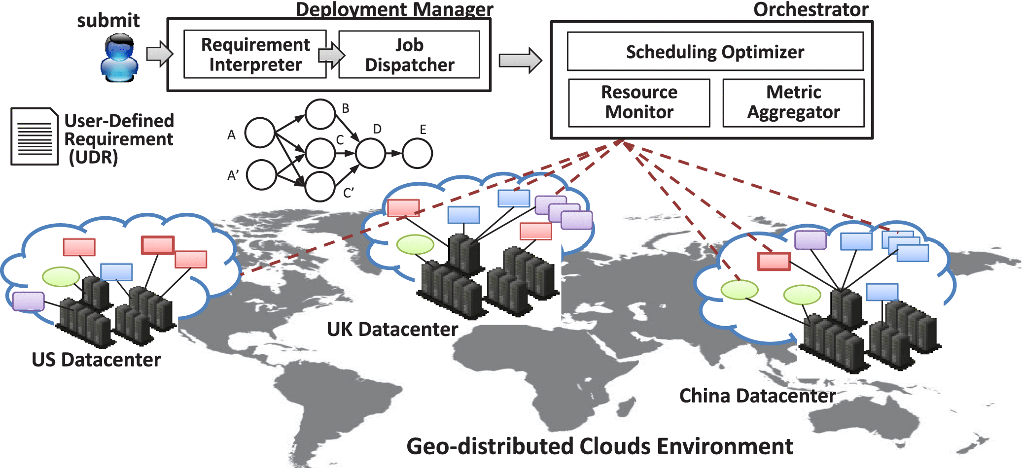
Architecture Diagram

Slide 8
Literature Survey
TITTLE | AUTHOR | CONCEPT
“Gaia: Geo-Distributed Machine LearningApproaching LAN Speeds,” | K. Hsieh, A. Harlap, N. Vijaykumar, D. Konomis, G. R. Ganger, P. B.Gibbons, and O. Mutlu | Machine learning (ML) is widely used to derive useful information from large-scale data (such as user activities, pictures, and videos) generated at increasingly rapid rates, all over the world.
“Cost-Minimizing Bandwidth Guarantee for Inter-Datacenter Traffic,. | W. Li, K. Li, D. Guo, G. Min, H. Qi, and J. Zhang, | It is typical for cloud providers to operate a number of geographically distributed datacenters, where inter-datacenter traffic constitutes a large portion of a cloud provider’s traffic demand over the Internet

Slide 9
TITTLE | AUTHOR | CONCEPT
“Effective Capacity Modulation as An Explicit ControlKnob for Public Cloud Profitability,. | G. Kesidis, A. Gupta, L. Y. Chen, andR. Birke | We explore the efficacy of dynamic effective capacitymodulation (i.e., using virtualization techniques to offer lower resource capacity than that advertised by the cloud provider)as an explicit control knob for a cloud provider’s profit max-imitation complementing the more well-studied approach of dynamic pricing.
, “Postcard: Minimizing Costs on Inter-Datacenter Traffic with Store-and-Forward. | Y. Feng, B. Li, and B. Li | It is typical for cloud providers to operate a number of geographically distributed data centers, where inter-data center traffic constitutes a large portion of a cloud provider's traffic demand over the Internet.

Slide 10
SOFTWARE REQUIREMENTS:
Operating System : Windows XP.
Platform : DOT NET TECHNOLOGY
Front End : ASP.Net 3.5
Back End : SQL SERVER 2005

Slide 11
HARDWARE REQUIREMENTS:
Keyboard
Mouse
Hard disk 500GB
Ram 4 Gb

Slide 12
REFERENCES
1.K. Hsieh, A. Harlap, N. Vijaykumar, D. Konomis, G. R. Ganger, P. B.Gibbons, and O. Mutlu, “Gaia: Geo-Distributed Machine LearningApproaching LAN Speeds,” inUSENIX NSDI, 2017
2.Z. Zhang, M. Zhang, A. G. Greenberg, Y. C. Hu, R. Mahajan, andB. Christian, “Optimizing Cost and Performance in Online ServiceProvider Networks,” inUSENIX NSDI, 2010
3.Z. Xu, C. Stewart, N. Deng, and X. Wang, “Blending On-demandand Spot Instances to Lower Costs for In-memory Storage,” inIEEEINFOCOM 2016, 2016.
4.C. Wang, B. Urgaonkar, G. Kesidis, A. Gupta, L. Y. Chen, andR. Birke, “Effective Capacity Modulation as An Explicit ControlKnob for Public Cloud Profitability,”ACM Transactions on Au-tonomous and Adaptive Systems (TAAS), vol. 13, no. 1, pp. 1–25,2018
5.W. Li, K. Li, D. Guo, G. Min, H. Qi, and J. Zhang, “Cost-Minimizing Bandwidth Guarantee for Inter-Datacenter Traffic,”IEEE Transactions on Cloud Computing, 2016.

Slide 13
6.Yang, Y. Cui, S. Xiao, X. Wang, M. Li, C. Li, and Y. Liu, “AchievingEfficient Routing in Reconfigurable DCNs,”Proceedings of the ACMon Measurement and Analysis of Computing Systems, vol. 3, no. 3, pp.1–30, 2019.
7.Z. Zheng, R. Srikant, and G. Chen, “Pricing for Revenue Maximiza-tion in Inter-DataCenter Networks,” inIEEE INFOCOM, 2018.
8.Y. Feng, B. Li, and B. Li, “Postcard: Minimizing Costs on Inter-Datacenter Traffic with Store-and-Forward,” inIEEE ICDCSW,2012.

