Slide 1
LayerChainA Hierarchical Edge-Cloud Blockchainfor Large-Scale Low-Delay IIoT Applications

Slide 2
Abstract
The combination of pervasive edge computing and block chain technologies opens up significant possibilities for Industrial Internet of Things (IIoT) applications, but there are several critical limitations regarding efficient storage and rapid response for large-scale low-delay IIoT scenarios. To address these limitations, we propose a hierarchical edge-cloud block chain called Layer Chain. Specifically, to promote scalability, we design layered structure to hierarchically store the block chain data in multiple distributed clouds and edge nodes.
Next, we propose anode classification method to accommodate differences between the edge nodes when deploying the block chain. Moreover, to mitigate lengthy delays during block propagation, we proposea treebased clustering algorithm where blocks are propagated through different clusters with a compressed tree depth. Simulation results show that our Layer Chain efficiently reduces the system’s resource requirements and block propagation time, making it well-suited for large-scale low-delay IIoT applications

Slide 3
Existing System
The integration of Industrial Internet of Things(IIoT)-based technologies with the existing industrial manufacturing processes help to improve on-site safety of workers, reduce downtime of machines, improve productivity rate, and minimize near-miss incidents and casualties. However, prior intimation of the various safety related information may minimize the probability of accidents on the factory floor and casualty rates.
Typically, the safety-as-a-service (Safe-aaS) infrastructure provides customized safety-related decisions to the registered end users. However, there exist certain problems associated with the privacy of the information provided by end-users during registration, decision parameters requested by end-users, and data sensed by the sensor nodes

Slide 4
Disadvantage of Existing System
The number of nodes acting as miners is restricted, the permission consensus process in the blockchain-enabled Safe-aaS caters to the needs for scaling the miners’ resources.
He permission consensus process in the block chain-enabled Safe-aaS caters to the needs for scaling theminers’ resources. Therefore, miners gain incentives. Further, the amount of resources required increases with the increase in the number of transactions.

Slide 5
PROPOSED SYSTEM :
In this work, we provide architecture of Block chain integration into the Safe-aaS infrastructure. Additionally, we discuss the implementation and management of the Block chain enabled Safe-aaS architecture. Extensive analytical results show that the profit of the safety service provider (SSP) improves with the adoption of block chain technology into the Safe-aaS architecture.
On the other hand, the overall throughput in our proposed architecture follows an increasing trend, with the increase in the number of decisions successfully delivered. Additionally, the throughput decreases with the increase in the number of registered end-users.

Slide 6
ADVANTAGE
The integration of block chain improves the privacy for identity management of end-users and provides secure decisions to the end-users in Safe-aaS.
This idea puts forth the re-architecting of a distributed block chain-enabled decision virtualization layer, wherein the decisions are processed.

Slide 7
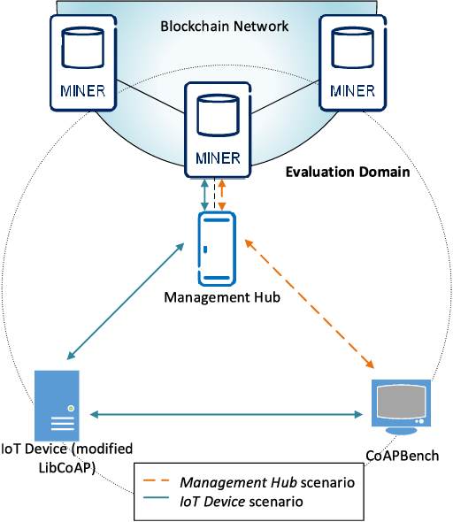
Architecture Diagram

Slide 8
Literature Survey
TITTLE | AUTHOR | CONCEPT
“BuildingRedactable Consortium Blockchain for Industrial Internet-of-Things. | K. Huang, X. Zhang, Y. Mu, X. Wang, G. Yang and X. Du, | Applying consortium block chain as a trust layer for heterogeneous industrial Internet-of-Things devices is cost-effective. However, with an increase in computing power, some powerful attacks (e.g., the 51% attack) are inevitable and will cause severe consequences.
A Light weight Blockchain System for Industrial Internet of Things | Y. Liu, K. Wang, Y. Lin and W. Xu, “LightChain | While the intersection of blockchain and Industrial Internet of Things (IIoT) has received considerable research interest lately, the convict between the high resource requirements of block chain and the generallyinadequate performance of IIoT devices has not been well tackled.

Slide 9
TITTLE | AUTHOR | CONCEPT
“Performance Optimiza-tion for Blockchain-enabled Industrial Internet of Ihings (IIoT) Systems. | M. Liu, R. Yu, Y. Teng, V. Leung and M. Song, | The emerging block chain technology shows promising potential to enhance industrial systems and the Internet of things (IoT) by providing applications with redundancy, immutable storage, and encryption.
“Integrated Block chain and Edge Computing Systems: A Survey, Some Research Issues and Challenges,. | R. F. Yang, R. Yu, P. Si, Z. Yang and Y. Zhang, | Block chain, as the underlying technology of crypto-currencies, has attracted significant attention. It has been adopted in numerous applications, such as smart grid and Internet-of-Things.

Slide 10
SOFTWARE REQUIREMENTS:
Operating System : Windows XP.
Platform : DOT NET TECHNOLOGY
Front End : ASP.Net 3.5
Back End : SQL SERVER 2005

Slide 11
HARDWARE REQUIREMENTS:
Keyboard
Mouse
Hard disk 500GB
Ram 4 Gb

Slide 12
REFERENCES

