Slide 1
HyCloud Tweaking Hybrid Cloud Storage Services for Cost-efficient Filesystem Hosting

Slide 2
Abstract
Today’s cloud storage infrastructures typically pro-vide two distinct types of services for hosting files:object storage like Amazon S3 and file system storage like Amazon EFS. The former supports simple, flat object operations with a low unit storage price, while the latter supports complex, hierarchicalfilesystem operations with a high unit storage price. In practice, however, a cloud storage user often desires the advantages of both—efficient file system operations with a low unit storage price.
An intuitive approach to achieving this goal is to combine the two types of services, e.g.,by hosting large files in S3 and small files together with directory structures in EFS. Unfortunately, our benchmark experiments indicate that the clients’ download performance for large files becomes a severe system bottleneck. In this paper, we attempt to address the bottleneck with little overhead by carefully tweaking the usages of S3 and EFS.

Slide 3
This attempt is enabled by two key observations. First, since S3and EFS have the same unit network-traffic price and the data transfer between S3 and EFS is free of charge, we can employers as a relay for the clients’ quickly downloading large files. Second, noticing that significant similarity exists between the files hosted at the cloud and its users, in most times we can convert large size file downloads into small-size file synchronizations(through delta encoding and data compression).
Guided by the observations, we design and implement an open-source system called HyCloud. It automatically invokes the data APIs of S3 and EFS on behalf of users, and handles the data transfer among S3,EFS and the clients. Real-world evaluations demonstrate that the unit storage price of HyCloud is close to that of S3, and the file system operations are executed as quickly as in EFS in most times (sometimes even more quickly than in EFS).

Slide 4
Existing System
Recently the number of cloud storage users has increased abundantly. The reason is that the Cloud Storage system reduces the burden of maintenance andit has less storage cost compared with other storage methods. It also provides high availability, reliability and also it is most suitable for high volume of data storage.
In order to provide high availability and reliability, the systems introduce redundancy. In replicated systems, the objects are copied several times and each copy residing on different locations in distributed computing. Therefore, the Data Replication is rendering little bit threat about the Cloud Storage System for the users and for the providers it is a big challenge to provide efficient Data Storage.

Slide 5
Disadvantage of Existing System
There are two major strategies used to obtain a replication system in cloud storage. They are Static mechanism and Dynamic mechanism. In static method of replication the availability and reliability is high.
Unwanted use of storage, no flexibility, no scalability and high amount of cost received from the user for storage.
There is number of dynamic heuristic methods used to reduce the percentages.

Slide 6
PROPOSED SYSTEM :
This paper analyzed the various existing data replication strategies and pointed out the major issues affected by the Data Replication. In future, the direction of this research work is aimed to reduce the number of replication without affecting the availability and reliability of the data.

Slide 7
ADVANTAGE
High Availability: Data availability is one of the important key factors for cloud storage system. Data replication has been commonly used for increasing the availability in distributed storage
High Reliability: In distributed storage systems, failures of services are treated as reliability issue. It is clear that the reliability of a system will generally increase as the number of replication. Since more replicas will be able to mask more failures.
Minimum Data Loss: If there is any technical problem or inconvenience in provider side the user can loss their information or go for offline. The replication system overcomes the above stated problem.

Slide 8
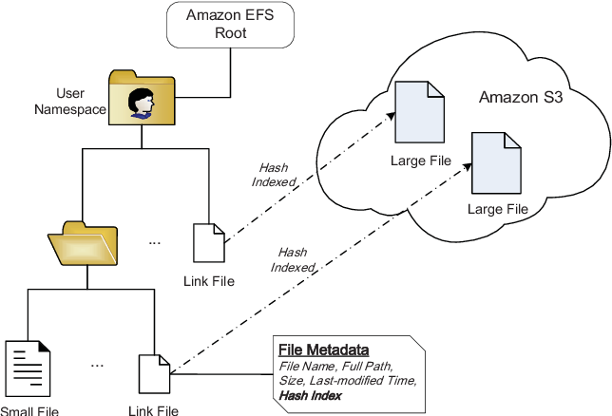
Architecture Diagram

Slide 9
Literature Survey
TITTLE | AUTHOR | CONCEPT
“CloudCmp: ComparingPublic Cloud Providers,” | A. Li, X. Yang, S. Kandula, and M. Zhang, | While many public cloud providers offer pay-as-you-go computing, their varying approaches to infrastructure, virtualization, and software services lead to a problem of plenty.
“DepSky:Dependable and Secure Storage in a Cloud-of-Clouds,” | A. Bessani, M. Correia, B. Quaresma, F. Andr ́e, and P. Sousa, | The increasing popularity of cloud storage services has lead companies that handle critical data to think about using these services for their storage needs.

Slide 10
TITTLE | AUTHOR | CONCEPT
“Benchmark-ing Personal Cloud Storage,” | I. Drago, E. Bocchi, M. Mellia, H. Slatman, and A. Pras, | The large amount of space offered by personal cloud storage services (e.g., Drop box and One Drive), together with the possibility of synchronizing devices seamlessly, keep attracting customers to the cloud.
“QuickSync: ImprovingSynchronization Efficiency for Mobile Cloud Storage Services,” | Y. Cui, Z. Lai, X. Wang, N. Dai, and C. Miao,. | Mobile cloud storage services have gained phenomenal success in recent few years. In this paper, we identify, analyze and address the synchronization (sync) inefficiency problem of modern mobile cloud storage services.

Slide 11
SOFTWARE REQUIREMENTS:
Operating System : Windows XP.
Platform : DOT NET TECHNOLOGY
Front End : ASP.Net 3.5
Back End : SQL SERVER 2005

Slide 12
HARDWARE REQUIREMENTS:
Keyboard
Mouse
Hard disk 500GB
Ram 4 Gb

Slide 13
REFERENCES
[1] A. Li, X. Yang, S. Kandula, and M. Zhang, “CloudCmp: ComparingPublic Cloud Providers,” inProc. of ACM Internet Measurement Con-ference (IMC), 2010, pp. 1–14
[2] Y. Cui, Z. Lai, X. Wang, N. Dai, and C. Miao, “QuickSync: Improving Synchronization Efficiency for Mobile Cloud Storage Services,” inProc.of ACM International Conference on Mobile Computing and Networking(MobiCom), 2015, pp. 592–603.
[3] Z. Li, C. Jin, T. Xu, C. Wilson, Y. Liu, L. Cheng, Y. Liu, Y. Dai,and Z.-L. Zhang, “Towards Network-level Efficiency for Cloud StorageServices,” inProc. of ACM Internet Measurement Conference (IMC),2014, pp. 115–128
[4] A. Bessani, M. Correia, B. Quaresma, F. Andr ́e, and P. Sousa, “DepSky:Dependable and Secure Storage in a Cloud-of-Clouds,” inProc. of ACMEuropean Conference on Computer Systems (EuroSys), 2011, pp. 31–46.
[5] J. Y. Chung, C. Joe-Wong, S. Ha, J. W.-K. Hong, and M. Chiang,“CYRUS: Towards Client-Defined Cloud Storage,” inProc. of ACMEuropean Conference on Computer Systems (EuroSys), 2015, pp. 1–16.

Slide 14
[ 6] Z. Li, C. Wilson, Z. Jiang, Y. Liu, B. Y. Zhao, C. Jin, Z.-L. Zhang, andY. Dai, “Efficient Batched Synchronization in Dropbox-like Cloud Stor-age Services,” inProc. of ACM International Middleware Conference(Middleware), 2013, pp. 307–327
[7] B. Calder, J. Wang, A. Ogus, and N. Nilakantan, “Windows AzureStorage: A Highly Available Cloud Storage Service with Strong Con-sistency,” inProc. of ACM Symposium on Operating Systems Principles(SOSP), 2011, pp. 143–157
[8] I. Drago, E. Bocchi, M. Mellia, H. Slatman, and A. Pras, “Benchmark-ing Personal Cloud Storage,” inProc. of ACM Internet MeasurementConference (IMC), 2013, pp. 205–212.
[9] Y. Hua, X. Liu, and D. Feng, “Neptune: Efficient Remote Commu-nication Services for Cloud Backups,” inProc. of IEEE InternationalConference on Computer Communications (INFOCOM), 2014, pp. 844–852

