Slide 1
DATA LEAKAGE DETECTION USING CYBER SECURITY

Slide 2
Abstract
The concept of sharing of personal health data over cloud storage in a healthcare-cyber physical system has become popular in recent times as it improves access quality.
The privacy of health data can only be preserved by keeping it in an encrypted form, but it affects usability and flexibility in terms of effective search. Attribute-based searchable encryption (ABSE) has proven its worth by providing fine-grained searching capabilities in the shared cloud storage.
However, it is not practical to apply this scheme to the devices with limited resources and storage capacity because a typical ABSE involves serious computations.
In a healthcare cloud-based cyber-physical system (CCPS), the data is often collected by resource-constraint devices; therefore, here also, we cannot directly apply ABSE schemes..

Slide 3
Existing System
The existing systems are poor in processing large volumes of multi-structured healthcare data with less security using AES Algorithum and not providing accurate health recommendation data

Slide 4
Disadvantage of Existing System
Problem transformation method ﬁrst transforms one multilabel dataset into multiple single-label datasets, and then exploits existing single-label learning algorithm to process each single-label dataset.

Slide 5
PROPOSED SYSTEM :
The main aim of this research is to provide secure management in accessing the medical records using block chain technology by unique identification of the data security.
Using Block Chain Crypto System Algorithm the laboratory test data and basic information of patients are Encrypted.
The clinical dataset is an information system that offers knowledge and personalized information to users in enhancing health and healthcare outcomes .

Slide 6
ADVANTAGE
Instead, it is managed by theconsensus nodes,andthat to is done only when the consensus nodes receive asearch token generation request from the end-users.
For remaining algorithms, storage and computational cost isdependent upon the number of attributes. However, the proposed scheme is genuinely decentralized and more securedue to the application of blockchain technology.
Furtherthesearch token needs not be stored by the user; it can becomputed on-demand with consensus nodes. Consensusnodesgenerate a partial search token, upon which the user will perform some exponent and multiplication operations(minimal cost operations) to compute the complete searchtoken.

Slide 7
TITTLE | AUTHOR | DESCRIPTION
‘Medical cyber physical systems | Lee and O. Sokolsky | A medical cyber–physical system (MCPS) is a unique cyber–physical system (CPS), which combines embedded software control devices, networking capabilities, and complex physiological dynamics of patients in the modern medical field.
“Cyber-physical systems: The next computing revolution, | R. Rajkumar, I. Lee, L. Sha, and J. Stankovic, | Cyber-physical systems (CPS) are complex systems with organic integration and in-depth collaboration of computation, communications and control (3C) technology

Slide 8
TITTLE | AUTHOR | DESCRIPTION
“Medical cyber-physical systems: A survey,” | N. Dey, A. S. Ashour, F. Shi, S. J. Fong, and J. M. R. Tavares | The first notion of CPS takes us back to 1941 when, soon after the invention of Z3, the first fully functional program-controlled computation machine was developed by Konrad Zuse for the survey ofaircraft wings
“Cyber-physical systems clouds: A survey,” | R. Chaari et al., | This paper investigates resource provisioning in cyber-physical systems (CPSs) by developing a new definition of anelasticity. A flat semi-dormant multicontroller (FSDMC) model is established on a special type of CPS platform named arbitrated networked control system with dual communication channels.

Slide 9
OVERVIEW
CYBER-PHYSICAL systems (CPS) tightly intertwine software and physical components that can have applications in nearly any field we can think of, including healthcare, energy conservation, environment protection, defense, agriculture and many more.
CPS tirelessly produce huge silos of data, and to ensure scalability and efficient storage, large companies like Microsoft and Honeywell, etc., are moving towards cloud-based solutions.
Cloud-based CPS (CCPS) improves existing CPS functionalities, but at the same time, presents security challenges.

Slide 10
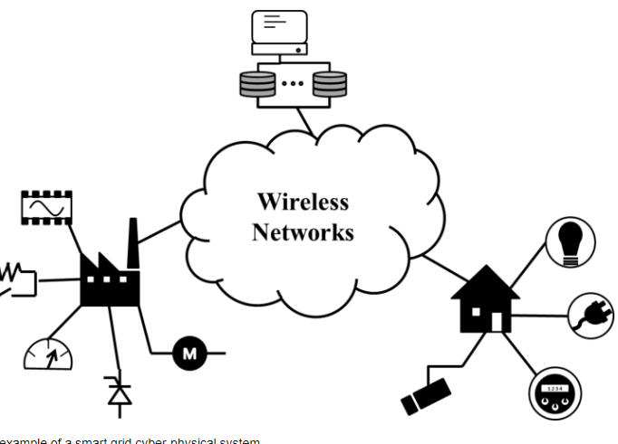
Block Diagram

Slide 11
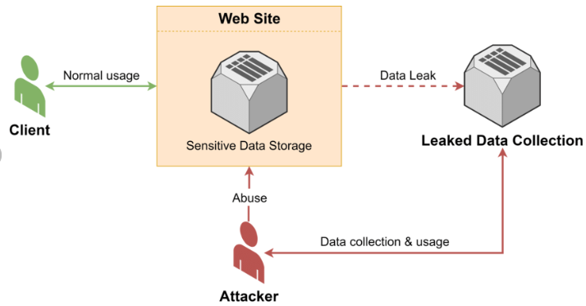
Architecture Diagram

Slide 12
SOFTWARE REQUIREMENTS:
Operating System : Windows 10
Platform : python

Slide 13
HARDWARE REQUIREMENTS:
Keyboard
Mouse
Hard disk 500GB
Ram 4 Gb

Slide 14
CONCLUTION
In this paper, we have proposed a truly decentralized, robustand computationally efficient ABSE scheme for healthcareCCPS with the assistance of consortium blockchain.
Thedevices involved in a typical healthcare CCPS are resourceconstrained. Further, the users in a healthcare CCPS may belong from a variety of domains, and to manage such a largenumber of diverse users,asingleauthoritisnot sufficient.
Keeping that in mind, we have proposed a scheme wherecomputationally intensive tasks are delegated to the consensusnodes in the blockchain network to increase efficiency and toavoid single point failure.

Slide 15
REFERENCE
[1] . Zheng, S. Xu, and G. Ateniese, “VABKS: Verifiable attribute-basedkeyword search over outsourced encrypted data,” inProc. IEEE Infoco, 2014, pp. 522–530
[2]W. Sun, S. Yu, W. Lou, Y. T. Hou, and H. Li, “Protecting your right:Attribute-based keyword search with fine-grained owner-enforcedsearch authorization in the cloud,” in Proc. IEEE Infocom Conf.Computer Communications, 2014, pp. 226–23
[3]Mamta and B. B. Gupta, “An efficient KP design framework of attribute-based searchable encryption for user level revocation in cloud,”Concurr Comput. Pract. Exp., p. e5291

Slide 16
[4]Mamta and B. B. Gupta, “Secure fine-grained keyword search withefficient user revocation and traitor tracing in the cloud,” J. Organ. End User Comput.vol32, no.4, pp 112–137, 2020.
[5]Y. Miao, J. Ma, X. Liu, F. Wei, Z. Liu, and X. A. Wang, “m 2-ABKS:Attributebased multikeyword search over encrypted personal healthrecords in multi-owner setting,” J. Med. Syst ., vol. 40, no. 11, p. 246,2016
[6] C. Guo, R. Zhuang, Y. Jie, Y. Ren, T. Wu, and K.-K. R. Choo, “Fine-grained database field search using attribute-based encryption for e-healthcare clouds,” J. Med. Syst., vol. 40, no. 11, p. 235, 2016

Slide 17
[7]Z. Chen, F. Zhang, P. Zhang, et al “Verifiable keyword search for secure big data-based mobile healthcare networks with fine-grainedauthorization control,”Futur. Gener. Comput Syst., vol. 87, pp.712–724, 2018.DOI:10.1016/j.future.2017.10.022.[7]
[8] Mamta and B. B. Gupta, “An attribute-based keyword search for m-health networks, J. Comput. Virol. Hacking Tech., pp.1–16, 2020.
[10]Miao, R. Deng, X. Liu, K.-K. R. Choo, H. Wu, and H. Li, “Multi-authority attribute-based keyword search over encrypted cloud data,” IEEE Trans. Dependable Secur. Comput., 2019.DOI: 10.1109/TDSC.2019.2935044

Slide 18
[11] L. Chen, W.-K. Lee, C.-C. Chang, K.-K. R. Choo, and N. Zhang,“Blockchain based searchable encryption for recordsharing, Futur. Gener. Comput. Syst., vol. 95, pp 420–429, 2019.
[12]S. Cao, G. Zhang, P. Liu, X. Zhang, and F. Neri, “Cloud-assistesecureeHealth systems for tampeproofing EHR via blockchain,” Inf. Sci.., vol.485, pp.427–440, 2019.
[13]Y. Wang, A. Zhang, P. Zhang, and H. Wang, “Cloud-assisted EHR sharing with security and R. Guo, H. Shi, Q. Zhao, and D. Zheng, “Secure attribute-basedsignature scheme with multiple authorities for blockchain in electronichealth records systems IEEE Access, vol. 6, pp.11676–11686, 2018.

Slide 19
[14]C. Esposito, M. Ficco, and B. B. Gupta, “Blockchain-basedauthentication and authorization for smart city applications,” Inf. Process. Manag., vol. 58, no. 2, p. 102468, 2021DOI:10.1016/j.ipm.2020.102468
[15]B. Waters, “Ciphertext-policy attribute-based encryption: Anexpressive, efficient, and provably secure realization,” in Int. Workshopon Public Key Cryptography, 2011, pp. 53–70

