Slide 1
CYBER-SECURITY OF INDUSTRIAL INTERNET OF THINGS IN ELECTRIC POWER SYSTEMS

Slide 2
Abstract
Electric Power Systems (EPSs) are among the most critical infrastructures of any society, since they significantly impact other infrastructures. Recently, there has been a trend toward implementing modern technologies, such as Industrial Internet of Things (IIoT), in EPSs to enhance their real-time monitoring, control, situational awareness, and intelligence.
This movement, however, has exposed EPSs to various cyber intrusions that originate from the IIoT ecosystem. Statistics show that 38% of reported attacks have been against power and water infrastructure, and so far at least 91% of power utilities have experienced a cyberattack.
The cyber-security problem is even more severe for IIoT applications in EPSs due to the vulnerabilities and resource limitations of such applications.

Slide 3
Existing System
IIoT devices are built to provide their users with data on equipment, and these devices are integrated with the existing equipment, instead of working alone.
Existing transmission systems are faced with challenges, such as slow reaction to outages, high power losses, data theft, and poor monitoring of transmission lines and other components
An attacker can perform a device capture/node replication attack, in which a malicious node is added to an existing network by adapting the ID number of a legitimate node in the system

Slide 4
Disadvantage of Existing System
The cyber-security problem is even more severe for IIoT applications in EPSs due to the vulnerabilities and resource limitations of such applications.
Given that IIoT is a natural transition from IoT, it inherits some of the IoT’s security problems.
As an IoT ecosystem deals with consumer-oriented end devices, their cyber-security is a fundamental problem, since this technology comes with cost limitations that pre vent deployment of cyber-security measures

Slide 5
PROPOSED SYSTEM :
Several practical solutions—such as anonymization, pseudo-random number generators, block ciphers, and stream ciphers have been proposed to deal with individuals’ privacy, which is important in some of IIoT applications, such as power mar kets.
The proposed authentication mechanism is performed in two steps: the registration phase, in which each smart sen- sor registers with an authentication server and the routers are given secure pre-shared keys issued by the server
For instance, researchers have proposed an anonymous lightweight user authentic tion approach for IIoT paradigms

Slide 6
ADVANTAGE
IIoT devices, are made more durable and reliable, since they are primarily used in harsher environments, like factories, energy plants, and oil refineries.
The data collected through an IIoT network is used to make an efficient decision, which is transmitted to theIndustrial Control System (ICS) via the organization’s IT network
This data is then used to operate the grid more efficiently, and to serve the customers better.
IIoT-based embedded systems can be used for monitoring harmful gas emissions from thermal power plants by measur ing the Carbon Monoxide (CO) and Particulate Matter (PM) concentrations emitted by them

Slide 7
TITTLE | AUTHOR | DESCRIPTION
‘‘Internet of Things (IoT): A vision, architectural elements, and future directions, | J. Gubbi, R. Buyya, S. Marusic, and M. Palaniswami | Ubiquitous sensing enabled by Wireless Sensor Network (WSN) technologies cuts across many areas of modern day living.
Internet of Things in industries: A survey, | L. Da Xu, W. He, and S. L | Ubiquitous sensing enabled by Wireless Sensor Network (WSN) technologies cuts across many areas of modern day living.

Slide 8
TITTLE | AUTHOR | DESCRIPTION
‘‘Security of the Internet of Things: Perspectives and challenges,’ | Q. Jing, A. V. Vasilakos, J. Wan, J. Lu, and D. Qiu, | Internet of Things (IoT) is playing a more and more important role after its showing up, it covers from traditional equipment to general household objects such as WSNs and RFID.
‘‘‘Anatomy of threats to the Internet of Things, | I. Makhdoom, M. Abolhasan, J. Lipman, R. P. Liu, and W. Ni | The world is resorting to the Internet of Things (IoT) for ease of control and monitoring of smart devices.

Slide 9
OVERVIEW
IIoT networks in EPSs use smart devices to collect data from the grid through a cyber layer.
This data is then used to operate the grid more efficiently, and to serve the customers better.
Thus, connectivity and interoperability are two important features of IIoT networks, which lead to higher standard procedures and services.
The following subsections elaborate on major applications of IIoT systems in EPSs,

Slide 10
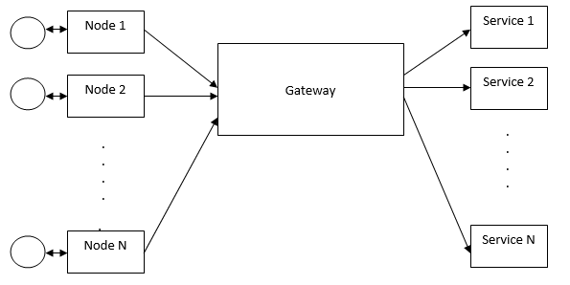
Block Diagram

Slide 11
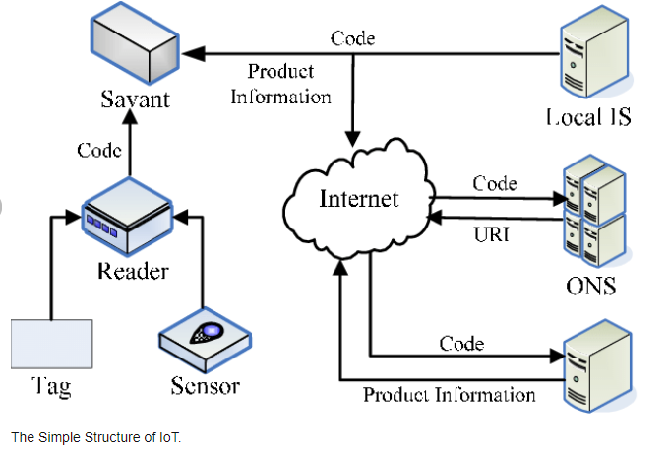
Architecture Diagram

Slide 12
SOFTWARE REQUIREMENTS:
Operating System : Windows 10
Platform : python

Slide 13
HARDWARE REQUIREMENTS:
Keyboard
Mouse
Hard disk 500GB
Ram 4 Gb

Slide 14
CONCLUTION
IIoT deployment has brought about various opportunities for EPSs, such as enhancing asset visibility, energy man agement, and control of distributed generation, as well as reducing energy losses. However, the security challenges of IIoT systems have barricaded large-scale deployment of IIoT- based applications in EPSs.
This paper, first elaborated on IIoT-based applications in EPSs, and discussed the most com- mon IIoT architectures for implementing these applications. It also highlighted the major security requirements of IIoT- based systems.
Afterwards, the vulnerabilities of IIoT sys- tems were explained, and the attacks that can take advantage of such vulnerabilities were classified based on their entry layer

Slide 15
REFERENCE
[1] J. Gubbi, R. Buyya, S. Marusic, and M. Palaniswami, ‘‘Internet of Things (IoT): A vision, architectural elements, and future directions,’’ 1553 Future Generat. Comput. Syst., vol. 29, no. 7, pp. 1645–1660, 2013.
[2] L. Da Xu, W. He, and S. Li, ‘‘Internet of Things in industries: A survey,’’ IEEE Trans. Ind. Informat., vol. 10, no. 4, pp. 2233–2243, Nov. 2014.
[3] IoT Connections Outlook. Accessed: Jul. 20, 2022. [Online]. Available:https://www.ericsson.com/en/mobilityreport/dataforecasts/iot- connections-outlook

Slide 16
[4] Q. Jing, A. V. Vasilakos, J. Wan, J. Lu, and D. Qiu, ‘‘Security of the Internet of Things: Perspectives and challenges,’’ Wireless Netw., vol. 20, no. 8, pp. 2481–2501, Nov. 2014.
[5] I. Makhdoom, M. Abolhasan, J. Lipman, R. P. Liu, and W. Ni, ‘‘Anatomy of threats to the Internet of Things,’’ IEEE Commun. Surveys Tuts., vol. 21, no. 2, pp. 1636–1675, 2nd Quart., 2018.
[6] T. Yu, V. Sekar, S. Seshan, Y. Agarwal, and C. Xu, ‘‘Handling a trillion (unfixable) flaws on a billion devices: Rethinking network security for the Internet-of-Things,’’ in Proc. 14th ACM Workshop Hot Topics Netw., 1568 Nov. 2015, pp. 1–7.

Slide 17
[7] K. Henning, ‘‘Recommendations for implementing the strategic initiative industrie 4.0,’’ Industrie 4.0 Work. Group, Munich, Germany, Final Rep., 2013.
[8] Q. Zhang, C. Zhu, L. T. Yang, Z. Chen, L. Zhao, and P. Li, ‘‘An incremental CFS algorithm for clustering large data in industrial Internet of Things,’’ IEEE Trans. Ind. Informat., vol. 13, no. 3, pp. 1193–1201, Jun. 2017.
[9] H. Jaidka, N. Sharma, and R. Singh, ‘‘Evolution of IoT to IIOT: Applications & challenges,’’ in Proc. Int. Conf. Innov. Comput. Commun. (ICICC), 2020, pp. 1–6

Slide 18
[10] A. Sajid, H. Abbas, and K. Saleem, ‘‘Cloud-assisted IoT-based SCADA systems security: A review of the state of the art and future challenges,’’ IEEE Access, vol. 4, pp. 1375–1384, 2016.
[11] P. Mathur, ‘‘Overview of IoT and IIoT,’’ in IoT Machine Learning Appli cations in Telecom, Energy, and Agriculture. Berkeley, CA, USA: Apress, 2020, pp. 19–43.
[12] J. Sengupta, S. Ruj, and S. D. Bit, ‘‘A comprehensive survey on attacks, security issues and blockchain solutions for IoT and IIoT,’’ J. Netw. Comput. Appl., vol. 149, Jan. 2020, Art. no.

Slide 19
[13] B. Cao, X. Wang, W. Zhang, H. Song, and Z. Lv, ‘‘A many-objective optimization model of industrial Internet of Things based on private blockchain,’’ IEEE Network, vol. 34, no. 5, pp. 78–83, Sep./Oct. 2020.
[14] S. Mumtaz, A. Alsohaily, Z. Pang, A. Rayes, K. F. Tsang, and J. Rodriguez, ‘‘Massive Internet of Things for industrial applications: Addressing wireless IIoT connectivity challenges and ecosystem frag mentation,’’ IEEE Ind. Electron. Mag., vol. 11, no. 1, pp. 28–33, Mar. 2017.
[15] M. Yonezawa, ‘‘Application of the IIOT to equipment maintenance,’’ Yokogawa Tech. Rep. English Ed., Musashino, Japan, Tech. Rep., 2018, vol. 61, no. 1

