Slide 1
DeepDiabetic An Identification System of Diabetic Eye Diseases Using Deep Neural Networks

Slide 2
Abstract
Diabetic retinopathy (DR) produces bleeding, exudation, and new blood vessel formation conditions. DR can damage the retinal blood vessels and cause vision loss or even blindness.
If DR is detected early, ophthalmologists can use lasers to create tiny burns around the retinal tears to inhibit bleeding and prevent the formation of new blood vessels, in order to prevent deterioration of the disease.
The rapid improvement of deep learning has made image recognition an effective technology; it can avoid misjudgments caused by different doctors’ evaluations and help doctors to predict the condition quickly. The aim of this paper is to adopt visualization and preprocessing in the ResNet-50 model to improve module calibration, to enable the model to predict DR accurately.

Slide 3
Objective
Diabetic retinopathy (DR) is a diabetic eye disease that can lead to blindness if not detected and treated in time. Early detection and diagnosis of DR are critical for preventing vision loss.
Convolutional neural networks (CNNs) like ResNet-50 have shown promising results in detecting and diagnosing DR from retinal fundus images, which is an essential task in modern ophthalmology.

Slide 4
Existing System
The survey of various existing techniques provides a platform for the development of the novel techniques in this area as future work.
Existing Diabetic Eye recognition systems are heavily dependent on specific conditions, such as the distance of image acquisition and the stop-and-stare environment, which require significant user cooperation.
Most existing Diabetic Eye recognition algorithms are designed for highly controlled cooperative environments, which is the cause of their failure in non-cooperative environments, i.e., those that include noise, off-angles, motion blurs, glasses, hairs, specular reflection (SR), eyelids and eyelashes incorporation, and partially open eyes.

Slide 5
If the dark pixel exists inside the box because the dark pupil can be included in the box, the box position is adaptively moved into the lower direction until it does not include the dark pixel, and the average RGB value is extracted box.
When applying Machine Learning, false positive errors (non-Diabetic Eye pixel is incorrectly classified into Diabetic Eye pixel) exist in the pupil area.

Slide 6
Disadvantage
Diabetic Eye DenseNet is an end-to-end segmentation network that uses the complete image without prior pre-processing or other conventional image processing techniques with the best information gradient flow, which prevents the network from overfitting and vanishing gradient problem.
To address the issues of accurate segmentation without prior pre-processing and to develop a robust scheme for all types of environments, this study presents a densely connected fully convolutional network (Diabetic EyeDenseNet)-based approach to detect an accurate Diabetic Eye boundary with better information gradient flow due to dense connectivity.
To address the Diabetic Eye segmentation issues in challenging situations by visible light and near-infrared light camera sensors, this paper proposes a densely connected fully convolutional network (Diabetic EyeDenseNet), which can determine the true Diabetic Eye boundary even with inferior-quality images by using better information gradient flow between the dense blocks.

Slide 7
PROPOSED SYSTEM :
Diabetic Retinopathy (DR) is a leading cause of blindness among adults, and its early detection is essential for preventing irreversible vision loss. Manual screening for DR is time-consuming, requiring highly trained professionals to examine retinal images. Artificial Intelligence (AI), particularly Deep Learning (DL) models, offers an opportunity to automate this process, enabling faster and more accurate diagnosis.
ResNet-50 (Residual Network with 50 layers) is one of the most successful deep learning architectures used for image classification tasks. Its deep residual structure helps in mitigating the vanishing gradient problem, making it well-suited for training on large-scale image datasets like those used for DR detection.

Slide 8
Advantage
Interpretable models allow users and stakeholders to understand how decisions are made, which builds trust and facilitates validation of the model’s results.
In fields like healthcare and finance, interpretable models help meet regulatory requirements that demand explainability in automated decision-making processes.
High accuracy ensures that the framework provides dependable and precise diagnoses, which is critical in high-stakes applications such as medical diagnosis.
Accurate diagnoses can lead to better decision-making and improved outcomes, whether in healthcare, predictive maintenance, or other applications.

Slide 9
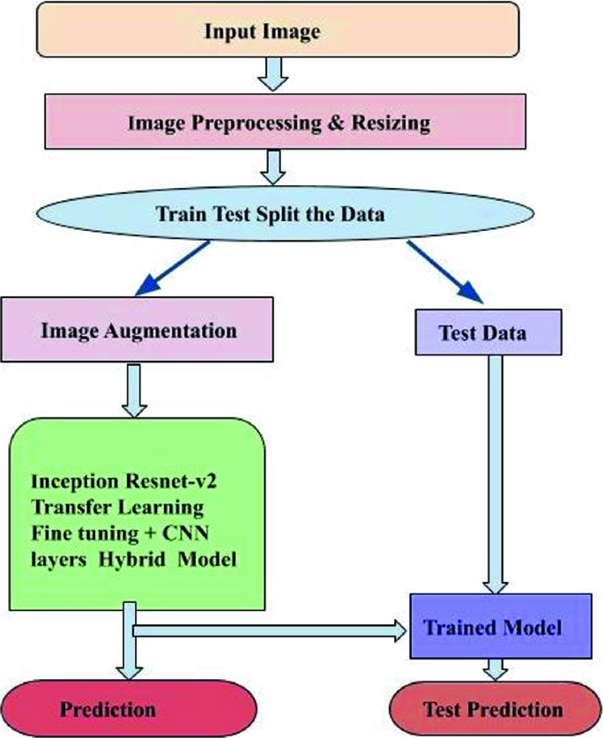
Block diagram

Slide 10
Methodology
Data Collection
Data Preprocessing
ResNet-50
Model Training
Model Tuning and Optimization

Slide 11
Data Collection
The first step is to collect the dataset for Diabetic Retinopathy detection.
A popular dataset is the Kaggle Diabetic Retinopathy Detection dataset, which consists of retinal fundus images labeled with the severity of DR

Slide 12
Data Preprocessing
Preprocessing is a critical step to prepare the dataset for training the model. This includes tasks such as resizing, normalization, and augmentation to improve model performance.
ResNet-50 requires input images to be of size 224x224 pixels.
Images need to be normalized so that pixel values fall within a specific range (usually [0, 1] or standardized using the mean and standard deviation of ImageNet).
Augmentation techniques like flipping, rotation, and zoom are applied to improve generalization, especially for imbalanced datasets.

Slide 13
ResNet-50
In this step, we will use ResNet-50 as the backbone for feature extraction and fine-tune it for the task of DR classification. ResNet-50 is pre-trained on ImageNet, and we will adapt the top layer for 5-class classification (representing the different stages of DR).
Load the ResNet-50 model, excluding its top layer (since we'll add a custom output layer for DR classification).
Freeze the initial layers of ResNet-50 to preserve the learned features, and fine-tune the last few layers to adapt the model to DR detection.
Add a few fully connected (dense) layers and a final softmax output layer for multi-class classification.

Slide 14
Model Training
Now that the model is built, we proceed with training it using the preprocessed dataset.
Choose an appropriate batch size (e.g., 32 or 64)
Set a reasonable number of epochs (e.g., 10-20) for training.
Use callbacks such as EarlyStopping to stop training when the model’s performance stops improving.
Make sure to use a validation dataset to evaluate performance during training.

Slide 15
Model Tuning and Optimization
Fine-tuning the ResNet-50 layers after freezing the initial layers, unfreezing some of the deeper layers, and training them.
Adjusting Learning Rate: Fine-tune the learning rate using learning rate schedulers.
Increasing Data Augmentation: Add more diverse augmentations or collect more data.

Slide 16
Literature Review
Author’s Name | Title | Description
Y. LeCun, Y. Bengio, G. Hinton | Deep learning | A method in artificial intelligence (AI) that teaches computers to process data in a way that is inspired by the human brain.
L. Fang, D. Cunefare, C. Wang | Automatic segmentation of nine retinal layer bou- ndaries in OCT images. | We first decompose training OCT images into patches.
G. Carneiro, J. Nascimento, A. P. Bradley | Automated analysis of unregistered multi-view mammograms with deep learning. | The main innovation behind this methodology lies in the use of deep learning models for the problem of jointly classifying unregistered mammogram views and respective segmentation maps of breast lesions

Slide 17
SOFTWARE REQUIREMENTS:
Operating System : Windows 10
Language :PYTHON Google Colab

Slide 18
HARDWARE REQUIREMENTS:
Keyboard
Mouse
Harddisk
Ram

Slide 19
CONCLUSION
This study proposed two approaches to designing the DR grading system: a standard operation procedure (SOP) for preprocessing the fundus image, and a revised structure of ResNet-50, including an adaptive learning rating to adjust the weight of layers, regularization and change the structure of ResNet-50.
which was selected for its suitable features. It is worth noting that the purpose of this study was not to design the most accurate DR screening network, but to demonstrate the effect of the SOP of DR and the visualization of the revised ResNet-50 model. The results provided an insight to revise the structure of CNNs using the visualization tool

Slide 20
REFERENCE
[1] Heath grades, “Eye Cancer”, available: http://www.healthgrades.com/conditions/eye-cancer.
[2] Richard D Grutzmacher, Thomas D Lindquist, Mark E Chittum, Ann H Bunt-Milam, And Robert E Kalina,” Congenital Diabetic Eye cysts”. British Journal of Ophthalmology, 1987, 71, p.p. 227-234H.
[3] Cancer Research UK, available: http://www.cancerresearchuk.org/about-cancer/type/eyecancer/about/types-of-eye-cancer#mel
[4] The Eye Cancer Foundation Eye Cancer Network Education and Support for Eye Diseases Patients and Their Families, available: http://www.eyecancer.com/conditions/34/Diabetic Eyemelanoma
[5] Miles Research, available: http://www.milesresearch.com/main/links.htm.
[6] Digital image processing, available: http://www.tutorialspoint.com/dip/Grayscale_to_RGB_Conversio n.html.

Slide 21
[7] James Church, Dr. Yixin Chen, and Dr. Stephen Rice, “A Spatial Median Filter for Noise Removal in Digital Images”. Southeastcon, 2008. IEEE, p.p.618 – 623.
[8] R.Radha and Bijee Lakshman, “Retinal Image Analysis Using Morphological Process and Clustering Technique”. Signal & Image Processing: An International Journal (SIPIJ) Vol.4, No.6, December 2013.
[9] Ms. M. Parisa Beham, Ms.A.B.Gurulakshmi, Morphological Image Processing Approach on The Detection of Diseases and Cancer Cells. Devices, Circuits and Systems (ICDCS), 2012 International Conference, 2012, p.p. 350 – 354.
[10] Gonzalez and Woods, Digital Image Processing, Second Edition, PrenticeHall, pp. 108-120, 2002

Slide 22
[11] Khashman, A., Al-Zgoul, E., “Image Segmentation of Blood Cells in Leukemia Patients”. Recent Advances in Computer Engineering and Application, 2010 pp. 104–109.
[12] Xie Mei, Zhen Zheng, Wu Bingrong, Li Guo, The Edge Detection ofBrain Diseases. “Communications, Circuits and Systems”. ICCCAS 2009. International Conference. 2009.pp. 477-479.
[13] Lijun Ding, Ardeshir Goshtasby, “On the Canny edge detector”. Pattern Recognition Society, 2001. p.p.721-725.
[14] Z. Zhang and R. S. Blum, “Region-Based Image Fusion Scheme for Concealed Weapon Detection”. Proceedings of the 31st Annual Conference on Information Sciences and Systems, 1995.
[15] J. Lanir, et al., “Comparing multispectral image fusion methods for a target detection task”. Optical Engineering, vol. 46, pp. 66402-1, 2007.

