Slide 1
Breast cancer detection using Resnet50

Slide 2
Abstract
Breast cancer is one of the leading causes of death in women. Early detection through breast ultrasound images is important and can be improved using machine learning models, which are more accurate and faster than manual methods.
Previous research has shown that the use of the logistic regression, svm and random forest algorithms in breast cancer detection still does not achieve high accuracy.
This study aims to improve the accuracy of breast cancer detection using the Inception ResNet v2 transfer learning method and data augmentation.

Slide 3
The data is divided into training, validation and testing data consisting of 3 classes, namely Benign, Malignant and Normal. The augmentation process includes rotation, zoom, and rescale.
The model trained using CNN and Inception ResNet v2 showed good performance by producing the highest accuracy of 89.72% in the training data evaluation data and getting 90% accuracy in the prediction test stage with data testing.
This study shows that the combination of data augmentation and the Inception ResNet v2 architecture can improve the accuracy of breast cancer detection in CNN models.

Slide 4
Existing System
The performance classification accuracy has been encouraging comparison with various existing classifiers implemented in the literature. As expected the proposed model classifies diagnosis cases into either cancerous or non cancerous with high amount of accuracy.
Even if technology has developed, still lots of people are facing many issues with modern age diseases. Breast cancer has become one of the most common deadliest diseases rising over days among all countries in world.
Ratio of this disease increases due to lack of awareness and late identification. Our result reveals ANN (machine learning) plays measure factor for detection of cancer diagnosis to save the human life from the dangerous disease.

Slide 5
Disadvantage of Existing System
Previous researches reveal the increasing threats of breast cancer which drive to delve into unsolved and problematic issue, which is the main reason for the work reported in this paper. In the early stage of the breast cancer it appear as a malevolent lump and later stage it growths uncontrolled and variable manner.
By the help of the feature selector the datasets is free from ambiguity and dimension of data is also reduced. It solves the over fitting problem of dataset
The no of stages varies within the problem description of BPNN (Back Propagation Neural Network) is a gradient descent algorithm used in various domains

Slide 6
PROPOSED SYSTEM :
The proposed system of the InceptionResNet-v2 architecture method is its ability to recognize objects with high accuracy and handle unstructured data by extracting relevant features from images using convolution.
Where Convolution is the act of image extraction to obtain a model in the form of a kernel matrix. In this process, filtering is carried out that shifts with a certain "step value" on an image input.
Or a process to look at the value of a parameter that determines how much the filter shifts in the input image. Furthermore, the results of the convolution become inputs for the fully connected parts for the classification process.

Slide 7
ADVANTAGE
Some cases CAD (Computer Aided Tool) is also used by the physicians.
Various machine learning methods are used to detect whether the cancer gene is benign (or) malignant.
Then reduced data are used for ANN and classification has been performed
For classification radial basic function (RBF), General Regression Neural Network (GRNN) and Probabilistic Neural Network (PNN) were used.

Slide 8
TITTLE | AUTHOR | DESCRIPTION
A Combo Feature Selection Method (Filter+ Wrapper) for Microarray Gene Classification | Sahu, B | In this world cancer is the most dangerous diseases. So cancer diagnosis is most challenging and promising in case of clinical applications using microarray gene expression datasets.
‘‘Feature selection methods and algorithms | Ladha, L., & Deepa, T | As a data scientist working with Python, it’s crucial to understand the importance of feature selection when building a machine learning model. .

Slide 9
TITTLE | AUTHOR | DESCRIPTION
Combination of PCA with SMOTE resampling to boost the prediction rate in lung cancer dataset | ] Naseriparsa, M., & Kashani, M. M. R | These datasets contain many irrelevant and redundant features that mislead the classifiers. Furthermore, many huge datasets have imbalanced class distribution which leads to bias over majority class in the classification process.
new method for dimensionality reduction using kmeans clustering algorithm for high dimensional data set., | Napoleon, D., & Pavalakodi, S | Dimensionality reduction is the transformation of high-dimensional data into a meaningful representation of reduced dimensionality that corresponds to the intrinsic dimensionality of the data.

Slide 10
OVERVIEW
In the present generation, breast cancer has become most common disease occurring in females and becomes the reason for death. Early detection and diagnosis of cancer is needed to save the human life.
As per the data in 2012 1.7 million women have suffered by cancer
[1]. As any healthcare people are unable to identify the disease at early stage which impacts the death rate day by day
[2]. Report available at www.breastcanerindia.net, 144937 numbers of women were detected and 70218 numbers have died with breast cancer
[3]. Even if different test are done, still it is a difficult to detect the exact diagnosis. So many researchers have identified different automate diagnosis methods to detect the breast cancer.

Slide 11
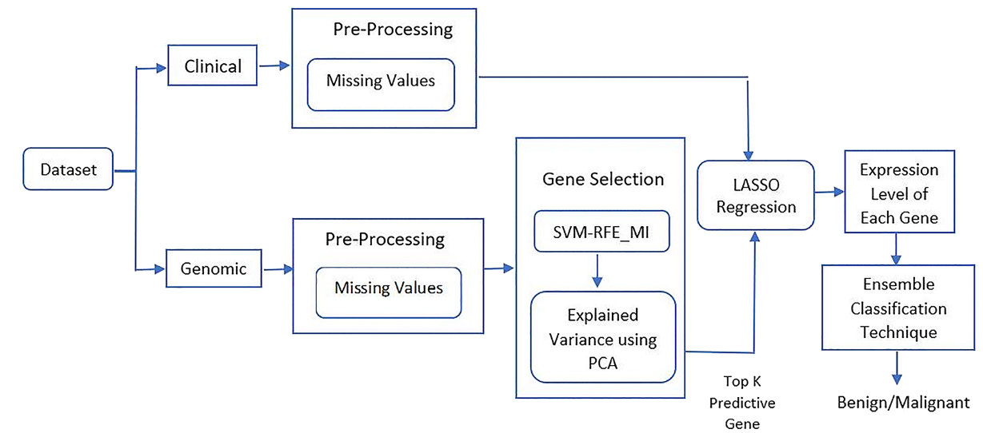
Block Diagram

Slide 12
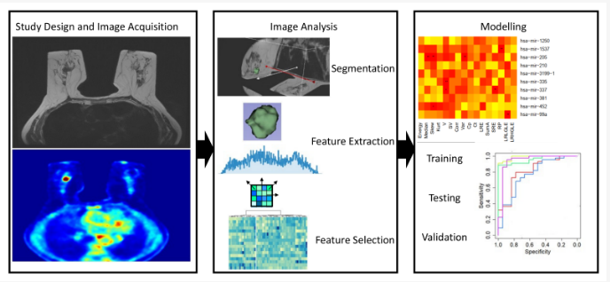
Architecture Diagram

Slide 13
SOFTWARE REQUIREMENTS:
Operating System : Windows 10
Platform : python

Slide 14
HARDWARE REQUIREMENTS:
Keyboard
Mouse
Hard disk 500GB
Ram 4 Gb

Slide 15
CONCLUTION
This study discusses the process of developing and evaluating a logistic regression, svm and random forest algorithms that uses the Inception ResNet v2 architecture to classify medical images.
The data augmentation process is carried out to produce data variations to help the model recognize patterns better. The model is trained using CNN algorithms and Inception ResNet v2 which provides a solid foundation for complex pattern recognition.
The highest accuracy value was recorded in the 5th epoch with a score of 89.72%, indicating that the model was able to learn and generalize patterns from the training data effectively

Slide 16
After training, the model was tested using test data and the results showed 90% accuracy.
Overall, this study shows that the use of data augmentation and the Inception ResNet v2 architecture provide good performance. The use of other pre-trained models can be done to obtain higher accuracy in future studies.

Slide 17
REFERENCE
[1] Sahu, B. (2018). A Combo Feature Selection Method (Filter+ Wrapper) for Microarray Gene Classification. International Journal of Pure and Applied Mathematics, 118(16), 389-401.
[2] www.breastcancerindia.net, Statistics of Breast Cancer in India.
[3] Ladha, L., & Deepa, T. (2011). Feature selection methods and algorithms. International journal on computer science and engineering, 3(5), 1787- 1797.

Slide 18
[4] Naseriparsa, M., & Kashani, M. M. R. (2014). Combination of PCA with SMOTE resampling to boost the prediction rate in lung cancer dataset. arXiv preprint arXiv:1403.1949.
[5] Napoleon, D., & Pavalakodi, S. (2011). A new method for dimensionality reduction using kmeans clustering algorithm for high dimensional data set. International Journal of Computer Applications, 13(7), 41-46.
[6] Raschka Sebastian and Mirjalili (2017),”Python Machine Learning”,2nd edition, Packt Publishing Ltd.,ISBN:978-1-78712-593-3.

Slide 19
[7] Kara, S., Güven, A., & İçer, S. (2007). Classification of macular and optic nerve disease by principal component analysis. Computers in Biology and Medicine, 37(6), 836-841.
[8] Kiyan, T., & Yildirim, T. (2004). Breast cancer diagnosis using statistical neural networks. IUJournal of Electrical & Electronics Engineering, 4(2), 1149-1153.
[9] Paulin, F., & Santhakumaran, A. (2011). Classification of breast cancer by comparing back propagation training algorithms. International Journal on Computer Science and Engineering, 3(1), 327–332.

Slide 20
[10]Karabatak, M., & Ince, M. C. (2009). An expert system for detection of breast cancer based on association rules and neural network. Expert Systems with Applications, 36(2), 3465–3469.
[11]Azar, A. T., & El-Said, S. A. (2014). Performance analysis of support vector machines classifiers in breast cancer mammography recognition. Neural Computing and Applications,24(5), 1163–1177.
[12]Jhajharia, S., Varshney, H. K., Verma, S., & Kumar, R. (2016). A neural network based breast cancer prognosis model with pca processed features. In: 2016 International Conference on Advances in Computing, Communications and Informatics (ICACCI), pp. 1896–1901

Slide 21
[13]Nayak, T., Dash, T., Rao, D. C., & Sahu, P. K. (2016, August). Evolutionary neural networks versus adaptive resonance theory net for breast cancer diagnosis. In Proceedings of the International Conference on Informatics and Analytics (p. 97). ACM.
[14]Nilashi, M., Ibrahim, O., Ahmadi, H., & Shahmoradi, L. (2017). A knowledge-based system for breast cancer classification using fuzzy logic method. Telematics and Informatics, 34(4), 133–144.
[15]Virmani, J., Dey, N., & Kumar, V. (2016). PCAPNN and PCA-SVM based CAD systems for breast density classification. In Applications of intelligent optimization in biology and medicine(pp. 159-180). Springer, Cham.

