Slide 1
IOT-based Fall Detection for Elderly Care

Slide 2
Abstract
This paper presents an IoT based fall detection monitoring and alarm system for the elderly using 3-axis Accelerometer. In elderly, injuries induced by fall, becomes fatal sometimes, if timely medical interventions do not take place.
Therefore, we aim to design a system to detect the fall and alert the medical experts about the incidents of distress. In the proposed system for detection of falling, the elderly patient's acceleration data are continuously acquired by using a wearable sensor and stored on a cloud server, using an IoT board.
To access the stored data, an android application is designed for the medical expert to examine the fall in the elderly patient and provide the desired assistance, if needed. A threshold-based approach for the fall detection has been used to get the sensor data and set the threshold on accelerometer readings. A complete algorithm has been designed for the detection of genuine fall.

Slide 3
Existing System
The sensors of the last method are attached to the subject of interest. The wearable sensor-based method usually depends on accelerometer sensors, which are connected to the body and provide an extraordinary level of obtrusiveness. Accelerometers are popular wearable sensors embedded in FDSs to detect the position and movement of the subject. The advantages of wearable accelerometer sensors are their small size, lower cost than external sensors, ability to be easily carried by the body , and ability to measure acceleration in three coordinates or angles of incidence. Thus, among the above three methods, the wearable sensor-based method using accelerometer sensors is considered in this study.

Slide 4
Disadvantage of Existing System
Fall detection of elderly people is accurately detected based on FDS carried by the patient
The location of the fall is determined with minimum localization error based on GSM technique in indoor environments for LOS and NLOS scenarios.
The power consumption of the FDS carried by the subject is minimized based on DDA.
Fall detection accuracy achieved using sensor-based fall detection algorithm (S-BFDA), localization error based on ANN technique, and FDS power consumption based on DDA are compared with those of state-of-the-art systems.

Slide 5
PROPOSED SYSTEM :
Smart IoT Gateway is the key component for fall detection and consists of four modules: interoperability, data transformation, big data analyzer, emergency alerts handler.
This project proposed a fall detection system which is cost effective and reliable to detect fall and alert relatives for help and support. For fall detection, accelerometer and gyroscope was used to detect acceleration and body tilt angle of the faller respectively.
By coupling accelerometer with gyroscope, the accuracy of the system was improved due to reducing in false positives and true negatives... Alert system in form of Short IOT was transmitted to the concerned authorities.

Slide 6
ADVANTAGE
The system can detect falls instantly and notify caregivers or emergency services, ensuring timely assistance.
Quick detection of falls reduces the risk of serious injuries and complications from delayed help.
Continuous monitoring allows for analysis of movement patterns, helping identify risks and improve overall health management.
Compact and portable designs (e.g., wristbands or pendants) make it easy for seniors to wear without feeling cumbersome.

Slide 7
TITTLE | AUTHOR | DESCRIPTION
Radar signal processing for elderly fall detection: The future for in-home monitoring | Amin, M.G.; Zhang, Y.D.; Ahmad, F.; Ho, K.D. | These signals are nonstationary in nature, inviting time-frequency analysis in both its linear and bilinear aspects, to play a fundamental role in motion identification, including fall features determination and classification.
Energy-efficient architecture for wireless sensor networks in healthcare applications | Saleh, N.; Kassem, A.; Haidar, A.M. | The system will reduce the consumption of energy in the transmission phase due to the increased bits transmitted per symbol. Moreover, a neural network static random access memory (NN-SRAM) implementation in a clustering-based system for energy-constrained wireless sensor networks is proposed.

Slide 8
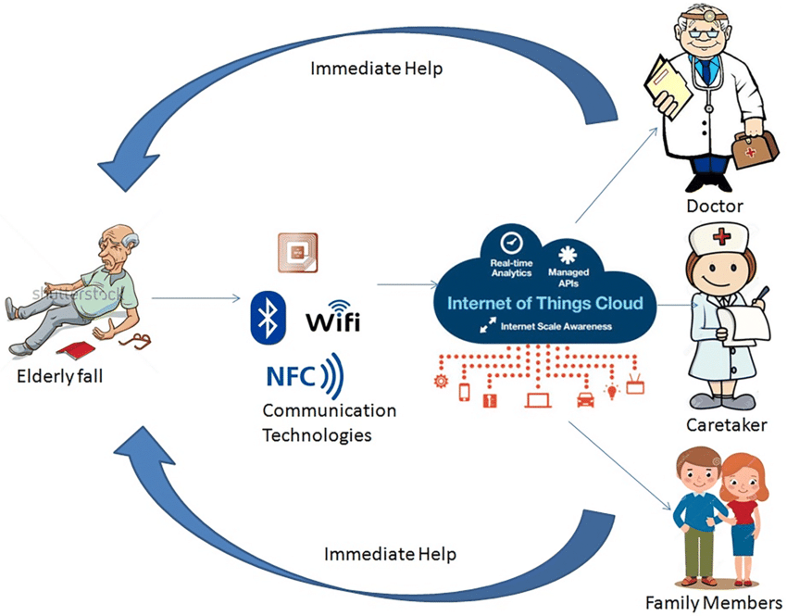
Block Diagram

Slide 9
SOFTWARE REQUIREMENTS:
Operating System : Windows 10
Platform : DOT NET TECHNOLOGY
Front End : ASP.Net 4.0
Back End : SQL SERVER 2014

Slide 10
HARDWARE REQUIREMENTS:
NODEMCU IOT MODULE
POWER SUPPLY UNIT
ACCELEROMETER
TEMPERATURE SENSOR
LCD DISPLAY

Slide 11
CONCLUTION
There is various fall detection systems detect effectively, but not Suitable for real time application. The proposed system will be a portable device mounted on the waist of user, having sensors consisting of accelerometer. The propose fall detection system can be regarded as alternative device to the existing detection approaches, since the device provides the comfortable wearing, is less complex as compared to other devices, fast fall response and will be more accurate and economical. These systems overcome the limitation of limited range of object tracking.

Slide 12
REFERENCE
1. Amin, M.G.; Zhang, Y.D.; Ahmad, F.; Ho, K.D. Radar signal processing for elderly fall detection: The future for in-home monitoring. IEEE Signal Process. Mag. 2016, 33, 71–80. [CrossRef]
2. Shinmoto Torres, R.L.; Visvanathan, R.; Hoskins, S.; van den Hengel, A.; Ranasinghe, D.C. Effectiveness of a batteryless and wireless wearable sensor system for identifying bed and chair exits in healthy older people. Sensors 2016, 16, 546. [CrossRef] [PubMed]
3. Chen, M.-C.; Chiu, Y.-W.; Chen, C.-H.; Chen, E.-J. Implementation of fall detection and localized caring system. Math. Probl. Eng. 2013, 2013, 217286. [CrossRef]
4. Naranjo, P.G.V.; Shojafar, M.; Mostafaei, H.; Pooranian, Z.; Baccarelli, E. P-sep: A prolong stable election routing algorithm for energy-limited heterogeneous fog-supported wireless sensor networks. J. Supercomput. 2017, 73, 733–755. [CrossRef]
5. Saleh, N.; Kassem, A.; Haidar, A.M. Energy-efficient architecture for wireless sensor networks in healthcare applications. IEEE Access 2018

