Slide 1
TOWARDS A SMART SUSTAINABLE CITY AIR POLLUTION DETECTION AND CONTROL USING INTERNET OF THINGS

Slide 2
DOMAIN
An embedded system is a controller with a dedicated function within a larger mechanical or electrical system, often with real-time computing constraints.
It isembedded as part of a complete device often including hardware and mechanical parts. Embedded systemscontrol many devices in common use today.

Slide 3
ABSTRACT
The air quality in cities is degrading as a result of a complex interaction between natural and artificial environmental conditions.
With the increase in urbanization and industrialization and lack of control on emissions and use of catalytic converters, a great amount of particulate and toxic gases are produced.
The objective of this project is to monitor air pollution on roads and track vehicles which cause pollution over a specified limit.
Increased use of automobiles is a serious problem that has been around for a very long time.
This paper gives survey of different systems used to monitor vehicular pollution and proposes use IOT to address this problem.
Air purf

Slide 4
PROBLEM STATEMENT
Environmental problems in Delhi, India, are a threat to the well-being of the city's and area's inhabitants as well as the flora and fauna.
The city suffers from air pollution caused by road dust and industry with comparatively smaller contributions from unclean engines in transportation, especially diesel-powered city buses and trucks, and 2-wheelers and 3-wheelers with two-stroke engines.
To tackle rising air pollution in Delhi, the Government of Delhi has come up with a controversial odd-even traffic scheme.
So because of that new rule people suffers a lot in their daily work plan schedule. This decision will never give the permanent solution against the air pollution.

Slide 5
EXISTING
Our air pollution monitoring System is an automated version of monitoring the quality of air and sending the information to a distant database wirelessly.
Our system has got almost all things automated so that we get an advantage of this concept ie the real time direct measurement of the parameters (here air quality) through GSM/PC.
Maintaining backup of sent data is easy and can be done within a few seconds.

Slide 6
EXISTING BLOCK DIAGRAM
Power
Supply
LCD
Pic
16f877a
GSM
co2

Slide 7
PROPOSED SYSTEMS
Power
Supply
12v dc
LCD
12v dc
Atmag
328p_pu
LCD
O2
O2
Atmag
328p_pu
Relay
deriver
Relay
deriver
Relay
Derive
GPS
Relay
Derive
Relay
GPS
Relay
Fan
Fan
Co2
motor
Co2
motor
IOT
IOT
lm35
lm35

Slide 8
BLOCK DIAGRAM 1
Power
Supply
LCD
12v dc
Atmag
328p_pu
LCD
O2
O2
Atmag
328p_pu
Relay
deriver
Relay
Derive
GPS
Relay
Derive
GPS
Relay
Fan
Fan
Co2
motor
IOT
IOT
lm35
lm35

Slide 9
Power
Supply
BLOCK DIAGRAM 2
12v dc
LCD
12v dc
Atmag
328p_pu
LCD
O2
Atmag
328p_pu
Relay
deriver
Relay
deriver
Relay
Derive
GPS
Relay
Derive
Relay
GPS
Relay
Fan
Co2
motor
Co2
motor
IOT
IOT
lm35

Slide 10
BLOCK DIAGRAM EXPLANATION
In this project we are going to design the new ECU (Engine Control Unit) device which consist of CO2 sensor, micro controller, LCD display, IOT and accelerometer.
All the things will be monitored through IOT. We are going fix this ECU device, all upcoming vehicles. Where co2 sensor continuously measures the co2 level exhausted from the vehicles.
Along with the polluted information about vehicle will be transmitted to RTO via IOT.
Whenever that level crossed the threshold limit, it will intimate the person to rectify the problem like by doing Service maintenance.
If the person ignores the process RTO will gives the warning message to the particular person.
Ari pollution control in public place this method using water

Slide 11
Again he doesn’t take care means, they will deactivate you vehicle ECU wirelessly.
Once they locked ECU unit we can’t run our vehicles whatever situation may appear, if we did any malfunction means our system will helps the RTO to find out the vehicle.
After correcting the pollution level we need to get the certificate from RTO.
Then only they will unlock your vehicles without their permission we can’t access our vehicles.

Slide 12
Difference
Exisiting
Proposed
Using GSM
Monitoring only
Co2 only sensing
Using IOT
Monitoring & controlling
Air purifier & limiting
Co2, o2, etc… sensing
Water pumping method using
Weather mentoring

Slide 13
COMPOUND
Atmag 328p-pu
Lcd
Esp8266
Gsm
Gas sensor
Lm35
Relay
Fan
7805
Diode
Dc motor

Slide 14
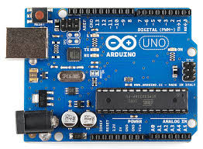
ARDUINO
The Arduino board is connected to a computer via USB, where it connects with the Arduino development environment (IDE). The user writes the Arduino code in the IDE, then uploads it to the microcontroller which executes the code, interacting with inputs and outputs such as sensors, motors, and lights.

Slide 15
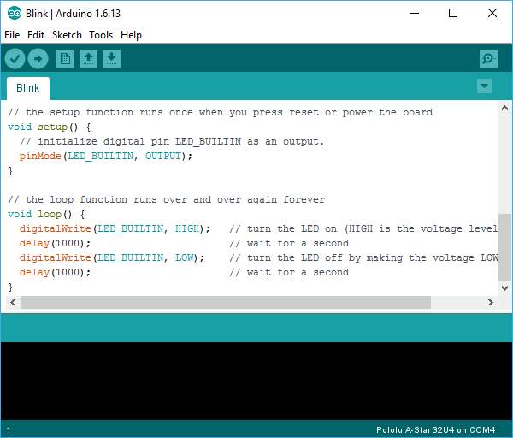
ARDUINO IDE
The Arduino integrated development environment (IDE) is a cross-platform application (for Windows, macOS, Linux) that is written in the programming language Java. It is used to write and upload programs to Arduino compatible boards, but also, with the help of 3rd party cores, other vendor development boards.

Slide 16
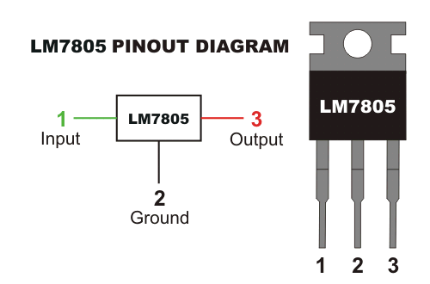
VOLTAGE REGULATORS
The purpose of a voltage regulator is to keep the voltage in a circuit relatively close to a desired value. Voltage regulators are one of the most common electronic components, since a power supply frequently produces raw current that would otherwise damage one of the components in the circuit.

Slide 17
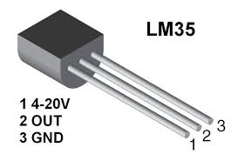
LM35
It can measure temperature more correctly compare with a thermistor. This sensor generates a high output voltage than thermocouples and may not need that the output voltage is amplified. The LM35 has an output voltage that is proportional to the Celsius temperature. The scale factor is .01V/°C.

Slide 18
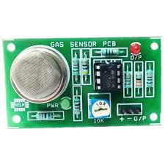
CO2
The carbon dioxide gas sensor measures gaseous carbon dioxide levels by detecting the quantity of IR radiation absorbed by carbon dioxide molecules. The sensor employs a hot metal filament that acts as an IR source to generate IR radiation

Slide 19
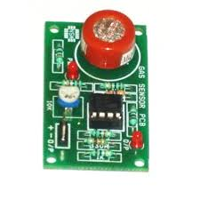
O2
Working principle: Gas analyzers work on the principle of absorption of light by the gas under test. Absorption analyzers need only shine a beam of light through an unheated sample chamber, then measure how much of specific wavelengths were absorbed by the sample.

Slide 20
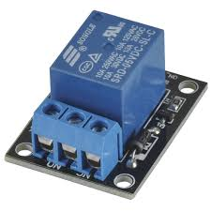
RELAYS
Relays are switches that open and close circuits electromechanically or electronically. Relays control one electrical circuit by opening and closing contacts in another circuit. As relay diagrams show, when a relay contact is normally open (NO), there is an open contact when the relay is not energized

Slide 21
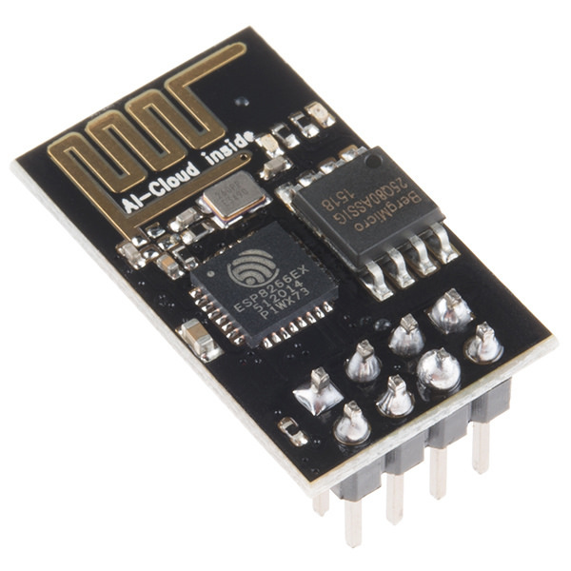
ESP8266
The ESP8266 can be controlled from your local Wi-Fi network or from the internet (after port forwarding). The ESP-01 module has GPIO pins that can be programmed to turn an LED or a relay ON/OFF through the internet. The module can be programmed using an Arduino/USB-to-TTL converter through the serial pins (RX,TX)

Slide 22
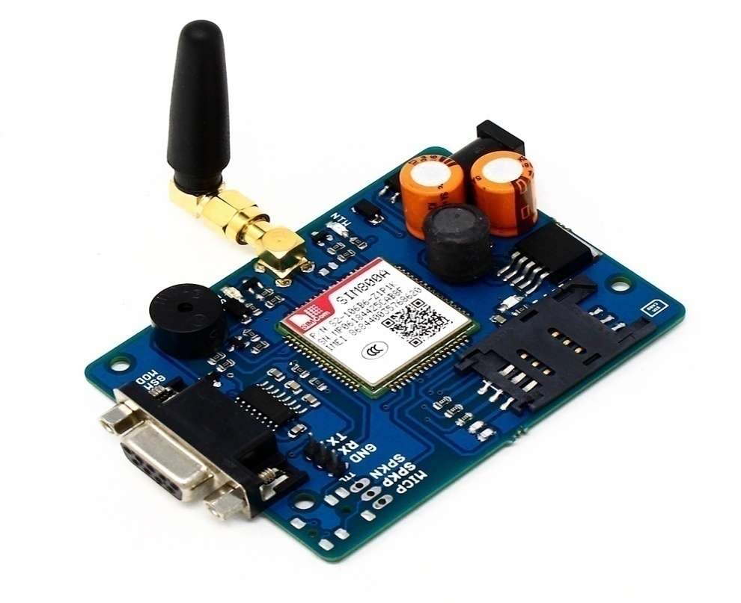
GSM
GSM is a mobile communication modem; it is stands for global system for mobile communication (GSM). ... A GSM digitizes and reduces the data, then sends it down through a channel with two different streams of client data, each in its own particular time slot

Slide 23
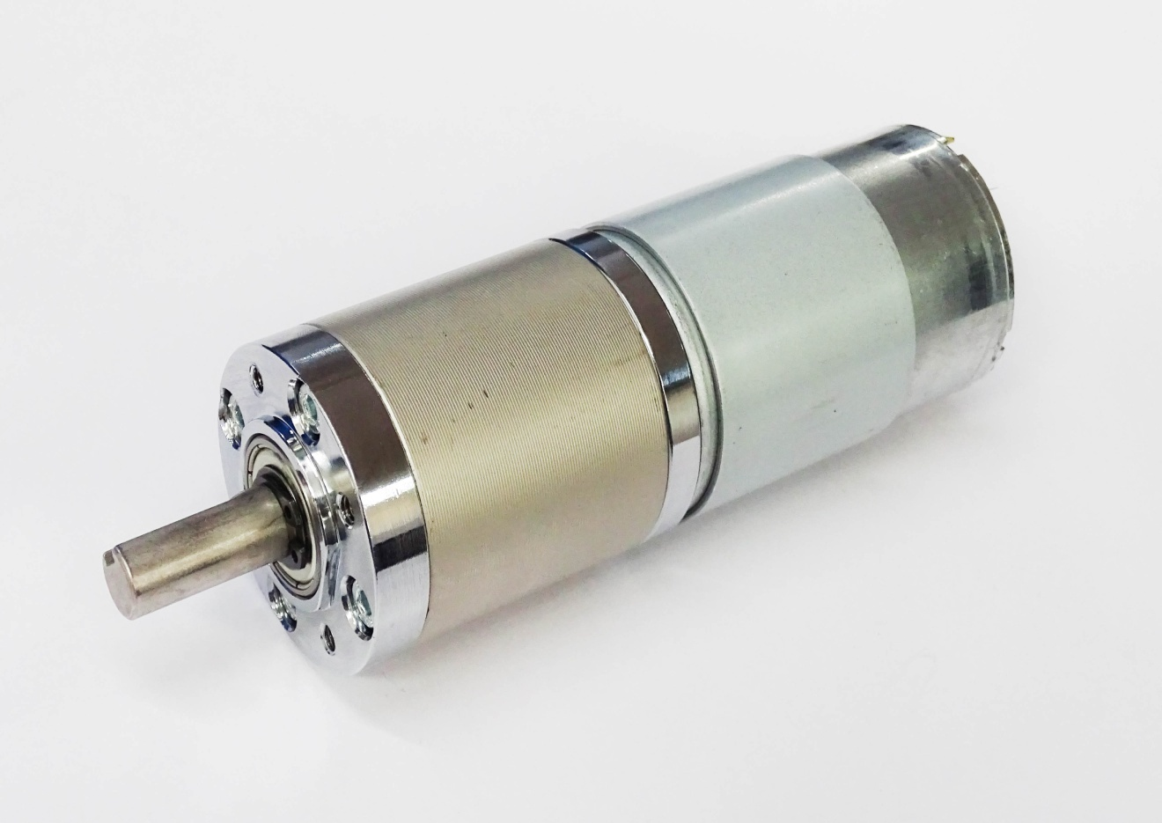
DC MOTOR
Working Principle of DC Motor. A DC motor is an electrical machine that converts electrical energy into mechanical energy. The working of DC motor is based on the principle that when a current carrying conductor is placed in a magnetic field, it experiences a mechanical force

Slide 24
ADVANTAGES
Artificial automation based on scheduling.
Easily monitoring and reporting air pollution and drunk and drive.
Avoid the crime activities for license check up.
Check the weather condition.
Speed control for vehicles in traffic places such as schools, hospitals and industries.
Highly secure and safe.

Slide 25
APPLICATION
Ceramic Tile Manufacturing.
Chemical, Mineral and Pharmaceutical Processing.
Ethanol Production.
Geothermal Power Generation.
Lab Scrubbers.
Medical Waste Incineration.
Mineral Wool Fiber and Glass Fiber Production.

Slide 26
FUTURE SCOPE
This smart vehicle tracking and pollution control system consists of many advantages like tracking, pollution control, accident prevention.
Future work includes a touch screen based smart license and antitheft system. It will make the system more smarter.

Slide 27
CONCLUSION
The project deals with designing a simple and low cost air pollution monitoring system using gas sensors, LCD ,CO2 ,GPS,IOT and Atmag328p-pu microcontroller unit to monitor the quality of air of the desired location and transmit it to a distant location wirelessly.
The designed product module is at prelim stage and designed only for air quality monitoring but can be enhanced for monitoring other different type of environmental and climatic behavior of a location, which also can be cost effective.

Slide 28
REFERENCES
[1] Shital Y. Gaikwad and Maheshwari “V. C, Security System for Car using RFID, Thumb Impression, Steering wheel Lock Based on ARM 7” International Journal of Current Engineering and Technology Vol.4, No.3 (June 2014)
[2] PriyaDarshini and Prasannabalaje S.M , “Multilevel Security System for Automotives using RFID and Biometric Techniques in Lab view” International Journal of Advanced Research in Electrical, Electronics and Instrumentation Engineering Vol. 2, Issue 4, April 2013
[3]Amol S. Dhotre, Abhishek S. Chandurkar& S. S. Jadhav, “Design of a GSM Cell – Phone based Vehicle Monitoring & Theft Security System “International Journal of Electrical and Electronics Engineering (IJEEE) ISSN (PRINT): 2231 – 5284, Vol-1, Iss-3, 2012

