Slide 1
POWER QUALITY IMPROVEMENT WITH REDUCED NO OF COMPONENTS FOR STAND ALONE APPLICATIONS

Slide 2
ABSTRACT
Voltage regulation is a main key factor for stable power system. Recent years the electronics equipment growth is rapidly increase. These electronics devices are voltage sensitive devices.
To maintain the grid system voltage equal or near to nominal level, the DVR plays major roll.
The 31 level inverter is proposed in this study to reduce number of switches and maintain constant voltage profile with low current distortion.

Slide 3
OBJECTIVE
To implement grid tied PV system to maintain stable voltage profile with reduced no of switches and low THD.
The need of multilevel converter is to give a high output power from medium voltage source. Sources like batteries, super capacitors, solar panel are medium voltage sources.

Slide 4
EXISTING SYSTEM
The objective of the existing system is to study the system behavior, which allows the renewable energy sources for mitigating voltage disturbances.
This exertion explains the built-in photovoltaic based dynamic voltage restorer (DVR) for alleviation of voltage hang down and engorge mitigation.
The cascaded H-bridge multilevel inverter is used for exchange of real and reactive power to the sensitive load from PV system.
The need of multilevel converter is to give a high output power from medium voltage source. Sources like batteries, super capacitors, solar panel are medium voltage sources.

Slide 5
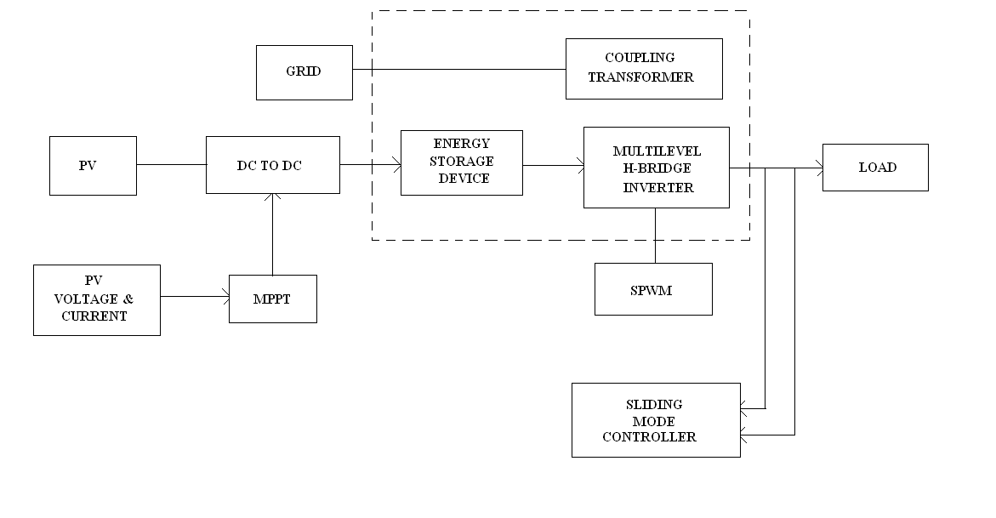
EXISTING BLOCK DIAGRAM

Slide 6
Existing system disadvantage
In cascaded MLI structure, dc sources can be added or subtracted which can increase the number of output levels.
But it needed separate H-bridge according to the increase in output voltage levels. So the number of switching devices required is more.
The switching losses are more, efficiency is reduced, and expense and complexity is increased.

Slide 7
PROPOSED SYSTEM
In this paper we propose a high efficiency grid-tied photovoltaic system using a hybrid multilevel inverter.
POD modulation technique is proposed.
The proposed MLI can achieve high efficiency and low harmonics and it can reduce the voltage stress on the power switches and also reduces the no of switches.

Slide 8
In addition to reducing voltage dip and engorge, DVR can also ensure of ephemeral in voltage, line voltage harmonics mitigation and fault current margins.
The main concept of this inverter is to use diodes and provides the multiple voltage levels through the different phases to the capacitor banks which are in series. A diode transfers a limited amount of voltage, thereby reducing the stress on other electrical devices.

Slide 9
BLOCK DIAGRAM

Slide 10
CIRCUIT DIAGRAM

Slide 11
explanation
The main concept of this inverter is to use diodes and provides the multiple voltage levels through the different phases to the capacitor banks which are in series. A diode transfers a limited amount of voltage, thereby reducing the stress on other electrical devices.
The maximum output voltage is half of the input DC voltage. It is the main drawback of the diode clamped multilevel inverter. This problem can be solved by increasing the switches, diodes, capacitors. Due to the capacitor balancing issues, these are limited to the three levels. This type of inverters provides the high efficiency because the fundamental frequency used for all the switching devices and it is a simple method of the back to back power transfer systems.

Slide 12
ADVANTAGES
Malfunction of any module section will not affect the entire system.
Device count reduced and hence total system cost reduced.
THD content reduced to low value.
Using for all stand-alone applications.

Slide 13
Application
Power grid primary distribution
Micro grid voltage stabilizer
Steel industries

Slide 14
METHODOLOGY
HYBRID MLI
POD MODULATION TECHNIQUE
FUZZY OR PID CONTROLLER

Slide 15
conclusion
In this paper a high efficiency 31 level inverter is proposed.
Modular configuration is proposed in this paper. Due to its modular structure, malfunctioning of any module section will not affect the entire system.
POD modulation technique is proposed.
The proposed MLI can achieved high efficiency and low harmonics and it can reduce the voltage stress on the power switches and also reduces the no of switches.
In addition to reducing voltage dip and engorge, DVR can also ensure of ephemeral in voltage, line voltage harmonics mitigation and fault current margins.

Slide 16
REFERENCE
Power quality enhancement using custom power devices
Voltage quality improvement using DVR
PV based DVR for voltage sag mitigation
Performance analysis of PV based single phase grid tied system

