Slide 1
Phishing Web Sites Features Classification Based on Extreme Learning Machine

Slide 2
Abstract
Phishing is the act of attempting to acquire information such as usernames, passwords, and credit card details by masquerading as a trust worth entity in an electronic communication there are several different techniques to control phishing, including legislation and technology created specifically to protect against phishing.
This project provides the anti-phishing technique in the form of browser where a webpage is filtered at three levels, as URL filtering, server address is filtering and action content filtering which may provide more accuracy in identifying phishing pages and to block it.

Slide 3
Existing System
The most of the anti-phishing techniques focus on contents of web age, URL and email. Character based anti-phishing approach may result in false positive but content based approach never results in false positive.
Attribute based approach consider almost all major areas vulnerable to phishing so it can be best anti-phishing approach that can detect known as well as unknown phishing attack.
Identity based anti-phishing approach may fails if phisher gets physical access to client’s computer In Content Based Anti-Phishing Approach GoldPhish tool implements this technique and uses google as its search engine.
This mechanism gives higher rank to well-established web sites. It has been observed that phishing web pages are active only for short period of time and therefore will acquire low rank during internet search and this becomes basis for content based anti-phishing approach.

Slide 4
Disadvantage of Existing System
Gold Phish delays the rendering of a webpage.
It is also vulnerable to attacks on Google’s Page Rank algorithm and Google’s search service.

Slide 5
PROPOSED SYSTEM :
In this project to overcome the disadvantages in existing system an browser will be created to reduce the usage of plug-in so anti phishing technique will be included as default one and the browser will include user authentication for making authenticated users to access the resources .browser also includes various application which may helps in LAN communication .
In phishing filter method there will be three level of filtering which may prevent from various methods of phishing attacks.

Slide 6
ADVANTAGE
The filtering methods are URL filtering which may verify the domain is genuine.
In server address matching they verify the domain matches to the server address and third level filtering is server address filtering which may verify any threatening link or page routing is found they will block the site from usage .

Slide 7
TITTLE | AUTHOR | DESCRIPTION
Phishpin: An identity-based anti-phishing approach | Hicham Tout, William Hafner | This paper presents Phishpin, an approach that leverages the concepts of mutual authentication to require online entities to prove their identities
Attribute-based prevention of phishing attacks | Michael Atighetchi, Partha Pal | To assess the effectiveness and applicability of this prototype,we performed extensive experimental testing.

Slide 8
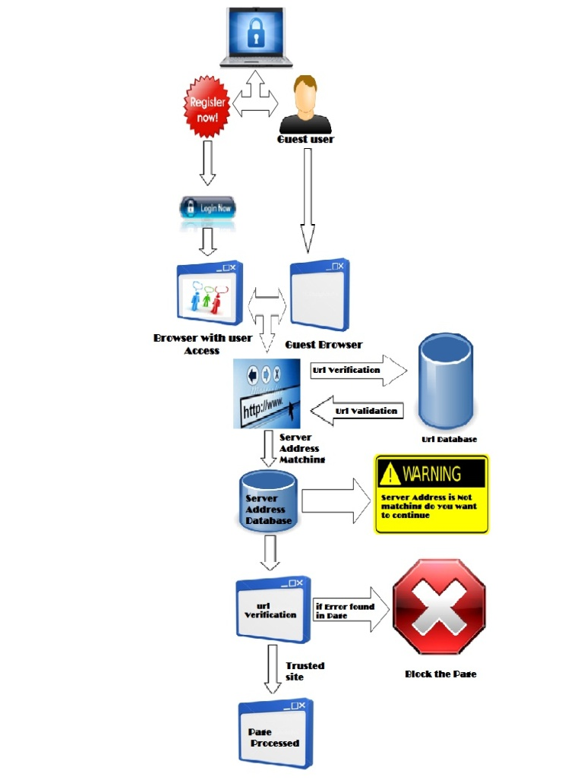
Block Diagram

Slide 9
SOFTWARE REQUIREMENTS:
Operating System : Windows 10
Platform : DOT NET TECHNOLOGY
Front End : ASP.Net 4.0
Back End : SQL SERVER 2014

Slide 10
HARDWARE REQUIREMENTS:
Keyboard
Mouse
Hard disk 500GB
Ram 4 Gb

Slide 11
CONCLUTION
This project has been developed to browser communication and to prevent and protect from phishing sites. To prevent from the various phishing techniques three level filtering has to be done. Browser and url filtering method has been created so that database will been created which may verify as the first level. In the future work server address filtering , server address database and matching will been processed so that report analysis can be done so they may provide more accuracy from preventing from the phishing sites.

Slide 12
REFERENCE
Hicham Tout, William Hafner “Phishpin: An identity-based anti-phishing approach” in proceedings of international conference on computational science and engineering, Vancouver, BC, pages 347-352, 2009 .
Phishing activity trend report 1st half /2011,http://www.antiphishing.org.
Mather Aburrous, M.A. Hossain, Keshav Dahal, Fadi Thabtah “Prediction phishing websites using classification mining techniques with experimental case studies” in proceedings of Seventh International Conference on Information Technology, Las Vegas, NV, pages 176-181, 2010.
Michael Atighetchi, Partha Pal “Attribute-based prevention of phishing attacks” Eighth IEEE international symposium on network computing and application, 2009.
V.Shreeram, M.Suban, P.Shanthi, K.Manjula “Anti-phishing detection of phishing attacks using genetic algorithm” in proceedings of Communication control and computing technology(ICCCCT),IEEE international conference, Ramanathapuram , pages 447-450, 2010.

