Slide 1
Multicarrier Approaches for High-baudrate Optical-Fiber Transmission Systems with a Single Coherent Receiver

Slide 2
Abstract
In this paper, we show the remarkable timing error (TE) and residual chromatic dispersion (CD) tolerance improvements of the filter bank multicarrier (FBMC) over orthogonal frequency division multiplexing (OFDM) for high-baudrate spectral slicing transmitter and single coherent receiver transmissions. For a 512 Gb/s 16 quadrature amplitude modulated (16QAM) spectrum slicing system at 1600 km of fiber transmission, the FBMC-based system reduces TE and residual CD penalties by more than 1.5 dB and 3 dB, in comparison to the OFDM-based system, respectively.

Slide 3
Existing System
Multi carrier modulation formats, such as orthogonal frequency division multiplexing (OFDM), have been considered as potential techniques for the application of high speed, long-haul, and multi-wavelength optical networks due to the capability of inter-symbol interference (ISI) mitigation using simple digital signal processing (DSP) techniques

Slide 4
Disadvantage of Existing System
Delay lines (DLs) were required to keep the timing mismatch below 1 ps for the Nyquist-pulse shaping.
Such timing-mismatch requirement is very challenging for practical implementation and thus, alternative modulation formats with higher tolerance to timing mismatch among optical paths are highly desirable for high baud rate super channel transmissions

Slide 5
PROPOSED SYSTEM :
we have implemented the multicarrier-based 128 Gbaud 16QAM spectrum slicing systems for the long-haul transmission distance. Remarkable timing error (TE) and residual chromatic dispersion (CD) tolerance improvements of the filter bank multicarrier (FBMC) over orthogonal frequency division multiplexing (OFDM) for such system were revealed by numerical simulations. FBMC, therefore, would be a very potential candidate for spectral slice engineering applications in the future.

Slide 6
ADVANTAGE
The FBMC SS system was also more robust to the residual CD than OFDMs by 3 dB and 4 dB at 1% and 3% of the residual CD, respectively.
This comes from the fact that the FBMC PFs impulse response is four times longer than the OFDMs.

Slide 7
TITTLE | AUTHOR | DESCRIPTION
OFDM based superchannel transmission technology | S. Chandrasekhar and X. Liu, | This paper reviews recent advances in the generation, detection and transmission of orthogonal-frequency-division-multiplexing (OFDM) based superchannels, enabled by efficient and powerful digital signal processors.
Design of a 1 Tb/s superchannel coherent receiver | D. S. Millar et al., | We describe the design of a trained and pilot-aided digital coherent receiver, capable of detecting a 1 Tb/s superchannel with a single optical front-end.

Slide 8
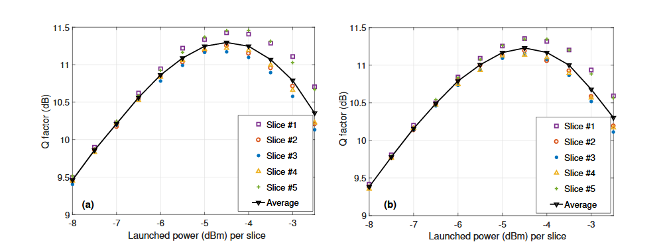
Block Diagram

Slide 9
SOFTWARE REQUIREMENTS:
Operating System : Windows 10
Platform : DOT NET TECHNOLOGY
Front End : ASP.Net 4.0
Back End : SQL SERVER 2014

Slide 10
HARDWARE REQUIREMENTS:
Keyboard
Mouse
Hard disk 500GB
Ram 4 Gb

Slide 11
CONCLUTION
we have implemented the multicarrier-based 128 Gbaud 16QAM SS systems for the long-haul transmission distance. We evaluated and compared the performance of the SS system with OFDM and FBCM in different configurations by numerical simulations. The results showed that the FBMC-based SS system was superior to the OFDM based SS system in terms of robustness to the timing errors and delay spreads at the cost of slightly increasing the complexity. FBMC, therefore, would be a very potential candidate for spectral slice engineering applications in the future.

Slide 12
REFERENCE
[1] S. Chandrasekhar and X. Liu, “OFDM based superchannel transmission technology,” J. Lightw. Technol., vol. 30, no. 24, pp. 3816–3823, Dec. 2012.
[2] H. Mardoyan, M. A. Mestre, P. Jenneve, L. Schmalen, A. Ghazisaeidi, and P. Tran, “Transmission of single-carrier ´ Nyquist-shaped 1-Tb/s line-rate signal over 3,000 km,” in Proc. Opt. Fiber Commun. Conf., no. 1, 2015, pp. 3–5.
[3] J. Renaudier, P. Brindel, H. Mardoyan, P. Jenneve, L. Schmalen, and G. Charlet, “1-Terabit/s net data-rate transceiver ´ based on single-carrier Nyquist-shaped 124 GBaud PDM-32QAM,” in Proc. Opt. Fiber Commun., no. 1, pp. 1–3, 2015.
[4] D. S. Millar et al., “Design of a 1 Tb/s superchannel coherent receiver,” J. Lightw. Technol., vol. 34, no. 6, pp. 1453–1463, Mar. 2016.
[5] Y. Zhu et al., “Experimental comparison of Terabit Nyquist superchannel transmissions based on high and low baud rates,” in Proc. Opt. Fiber Commun. Conf./Nat. Fiber Opt. Eng. Conf. 2013, 2013, Paper JW2A.37

