Slide 1
The Quantum Path Kernel: A Generalized Neural Tangent Kernel for Deep Quantum Machine Learning

Slide 2
Abstract
Building a quantum analog of classical deep neural networks represents a fundamental challenge in quantum computing.
A key issue is how to address the inherent non-linearity of classical deep learning, a problem in the quantum domain due to the fact that the composition of an arbitrary number of quantum gates, consisting of a series of sequential unitary transformations, is intrinsically linear.
This problem has been variously approached in the literature, principally via the introduction of measurements between layers of unitary transformations.
We introduce the Quantum Path Kernel, a formulation of quantum machine learning capable of replicating those aspects of deep machine learning typically associated with superior generalization performance in the classical domain, specifically, hierarchical feature learning.

Slide 3
Objective
Bridging classical deep neural networks and quantum computing represents a key research challenge in the ﬁeld of quantum machine learning .
The potential for improvement offered by quantum computing in the machine learning domain may be characterized in terms of its impact
on algorithmic efﬁciency, generalization error, or else its capacity for
treating quantum data.
A notable recent result in the ﬁeld has been the introduction of the concept of variational quantum algorithms and the related neural network analog referred to as the quantum neural network (QNN).

Slide 4
Existing System
Neural Tangent Kernels are a recent development in the theory of neural networks. They describe the behavior of infinitely wide neural networks during training.
NTK helps in understanding the dynamics of gradient descent and the generalization properties of neural networks.
QML is an interdisciplinary area combining quantum physics and machine learning, aiming to leverage quantum computing to enhance ML algorithms.

Slide 5
Disadvantage
Quantum algorithms and systems are inherently more complex to design, implement, and maintain compared to classical algorithms.
Requires expertise in both quantum computing and machine learning, which can be a barrier for many researchers and practitioners.
Current quantum hardware is still in the early stages of development, with limitations in terms of qubit count, coherence time, and error rates.
Noise and errors in quantum computations can affect the reliability and accuracy of QPK-based models.

Slide 6
PROPOSED SYSTEM :
The proposed Quantum Path Kernel (QPK) aims to address these limitations by extending the concept of neural tangent kernels into the quantum domain, creating a more generalized framework for deep quantum machine learning.
By leveraging quantum computing, QPK can provide more efficient training dynamics and improved generalization.
QPK might be better suited for handling larger and more complex neural network architectures.
Improved robustness to noise and errors in quantum computations, making it more practical for real-world applications.

Slide 7
Advantage
By leveraging the principles of quantum computing, QPK can potentially offer exponential speedups for certain machine learning tasks compared to classical approaches.
Improved training dynamics and generalization capabilities, particularly for complex datasets and deep learning models.
QPK is designed to handle larger and more complex neural network architectures more efficiently than classical Neural Tangent Kernels (NTKs).
Better suited for high-dimensional data and large-scale problems that are computationally prohibitive for classical methods.

Slide 8
Literature Review
Author’s Name | Title | Description
P. Wittek | Quantum machine learning: what quantum computing means to data mining. | Quantum Machine Learning bridges the gap between abstract developments in quant- um computing and the applied research on machine learning.
M. Schuld, I. Sinayskiy, F. Petruccione | An introduction to quantum machine learning. | Uses algorithms run on quantum devices, such as quantum computers, to supplement, expedite, or support the work performed by a classical machine learning program.

Slide 9
Literature Review
Author’s Name | Title | Description
H.-Y. Huang, M. Broughton, M. Mohseni. | Power of data in quantum machine learning. | In the classical case the data is the n-dimensional input vector, and the quantum case uses a given circuit to embed the n-dimensional vector into the space of n qubits.
A. Abbas, D. Sutter, C. Zoufal. | The power of quantum neural networks. | Quantum neural networks can possess a desirable Fisher infor- mation spectrum that enables them to train faster and express more functions than comparable classical and quantum models.

Slide 10
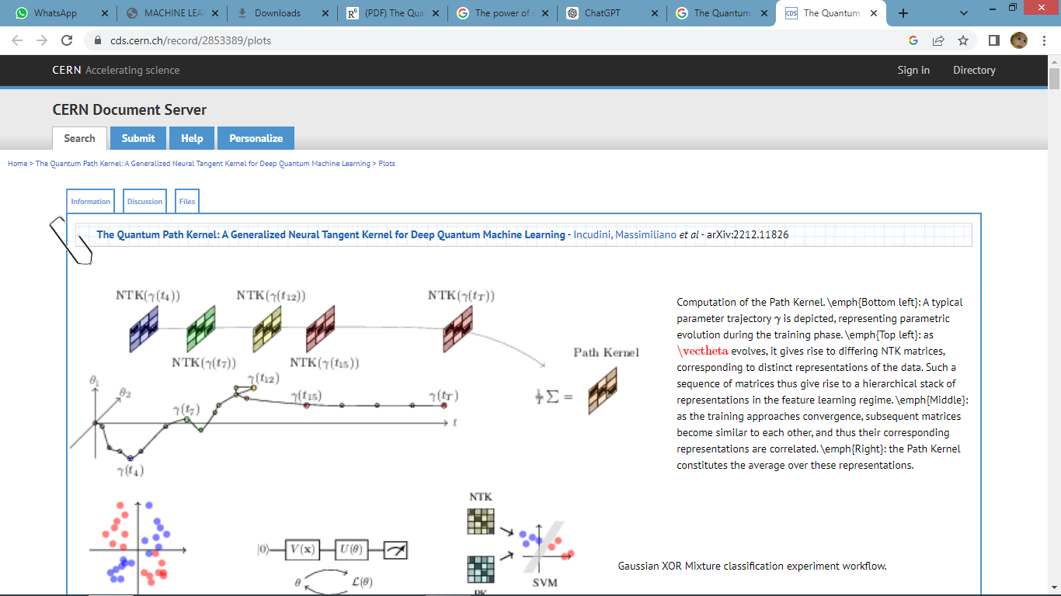
Block Diagram

Slide 11
SOFTWARE REQUIREMENTS:
Operating System : Windows 10
Language :PYTHON Google Colab

Slide 12
HARDWARE REQUIREMENTS:
Keyboard
Mouse
Harddisk
Ram

Slide 13
CONCLUSION
We have introduced the Quantum Path Kernel as a mechanism for incorporating key complex classical multi-layer network learning behaviors, in particular hierarchical feature learning, within quantum neural networks via an appropriately expressive kernelization of the training process.
We evaluate our approach on the Gaussian XOR mixture classiﬁcation problem, a straightforward benchmark of multilayer learning capacity that requires a minimum two-layer solution in order to approach Bayes optimally.
Experimental results indicate superior generalization performance relative to the Quantum NTK, an advantage which is especially pronounced in high-depth, low signal-to-noise settings.
We have shown theoretically that the Quantum Path Kernel converges to the Quantum NTK only in the lazy training regime, i.e.

Slide 14
When the training loss decreases to zero exponentially fast whilst model parameters stay close to their initializations across training.
Such behaviour is classically seen in inﬁnite-wide neural networks, whose behaviour is then close to that of a linear model.
Our experiments, by contrast, indicate that QNNs do not operate in the linear regime.
We have discussed, though do not evaluate in the current paper, the potential for using stochastic, noisy or non-gradient descent based optimization techniques to artiﬁcially perturb parameter paths within the QPK in order to implicate more decorrelated feature representations.

Slide 15
REFERENCE
P. Wittek, Quantum Machine Learning: What Quantum Computing Means to Data Mining. Cambridge, MA, USA: Academic, 2014.
M. Schuld, I. Sinayskiy, and F. Petruccione, “An introduction to quantum machine learning,” Contemporary Phys., vol. 56, no. 2, pp. 172–185, 2015.
H.-Y. Huang et al., “Power of data in quantum machine learning,” Nature Commun., vol. 12, no. 1, 2021.
A. Abbas, D. Sutter, C. Zoufal, A. Lucchi, A. Figalli, and S. Woerner, “The power of quantum neural networks,” Nature Comput. Sci., vol. 1, no. 6, pp. 403–409, 2021.

Slide 16
Y. Liu, S. Arunachalam, and K. Temme, “A rigorous and robust quantum speed-up in supervised machine learning,” Nature Phys., vol. 17, no. 9, pp. 1013–1017, 2021.
H.-Y. Huang et al., “Quantum advantage in learning from experiments,” Science, vol. 376, no. 6598, pp. 1182–1186, 2022.
J. R. McClean, S. Boixo, V. N. Smelyanskiy, R. Babbush, and H. Neven, “Barren plateaus in quantum neural network training landscapes,” Nature Commun., vol. 9, no. 1, 2018.

Slide 17
Z. Holmes, K. Sharma, M. Cerezo, and P. J. Coles, “Connecting ansatz expressibility to gradient magnitudes and barren plateaus,” PRX Quantum, vol. 3, no. 1, 2022.
A. Skolik, J. R. McClean, M. Mohseni, P. van der Smagt, and M. Leib, “Layerwise learning for quantum neural networks,” Quantum Mach. Intell., vol. 3, no. 1, Jan. 2021.
J. Liu, F. Tacchino, J. R. Glick, L. Jiang, and A. Mezzacapo, “Representation learning via quantum neural tangent kernels,” PRX Quantum, vol. 3, no. 3, 2022.

