Slide 1
Production-Level Machine Learning Using in Innovations in Stroke Identification

Slide 2
Abstract
Cerebrovascular diseases such as stroke are among the most common causes of death and disability worldwide and are preventable and treatable.
Early detection of strokes and their rapid intervention play an important role in reducing the burden of disease and improving clinical outcomes.
In recent years, machine learning methods have attracted a lot of attention as they can be used to detect strokes.
The aim of this study is to identify reliable methods, algorithms, and features that help medical professionals make informed decisions about stroke treatment and prevention.

Slide 3
Objective
A stroke occurs when the blood supply to the brain is blocked or a blood vessel in the brain bursts. It is the most common cause of death worldwide, causing over 6.2 million deaths annually.
Survivors often suffer from disabilities that severely impair their quality of life. Preventive measures and timely intervention can help to reduce the severity of stroke and its impact on the individual.
Early identification of people at risk is crucial for stroke prevention .
There are two types of stroke: ischemic stroke and hemorrhage-related stroke. About 87% of strokes are ischemic strokes, the most common type

Slide 4
Existing System
This involves evaluating the patient’s symptoms, medical history (including risk factors like hypertension, diabetes, etc.), and conducting a physical examination.
Symptoms commonly associated with stroke include sudden numbness or weakness in the face, arm, or leg, especially on one side of the body, sudden confusion, trouble speaking or understanding speech, sudden trouble seeing in one or both eyes, sudden trouble walking, dizziness, loss of balance, or coordination.
This is often the first-line imaging technique used in the emergency setting due to its speed and accessibility. It can detect hemorrhagic strokes (bleeding in the brain) quickly.

Slide 5
Disadvantage
Machine learning models require large, high-quality datasets for training. Neuroimaging data, especially from diverse populations and different imaging modalities (e.g., CT, MRI)
Deep learning models, which are often used in neuroimaging analysis, are known for their "black box" nature, making it difficult to understand how they arrive at their conclusions.
This lack of interpretability can be a barrier in clinical settings where transparency and justification of decisions are crucial.
Models trained on specific datasets may not generalize well to new populations, different hospitals, or varied imaging protocols.

Slide 6
PROPOSED SYSTEM :
Gather large and diverse datasets of neuroimaging data, including CT and MRI scans, annotated with stroke outcomes.
Ensure data quality through standardized protocols for image acquisition and preprocessing techniques to enhance the reliability and consistency of input data.
Utilize deep learning techniques to automatically extract relevant features from neuroimages, such as lesion location, size, and intensity patterns.
Incorporate clinical data (e.g., patient demographics, medical history, symptom onset time) to improve model performance and diagnostic accuracy.

Slide 7
Advantage
Allows remote neurologists to evaluate patients quickly via video conferencing, enabling prompt administration of clot-busting medications like tissue plasminogen activator (tPA).
Algorithms can analyze brain imaging (such as CT scans) to quickly detect signs of stroke, helping clinicians prioritize urgent cases.
Devices like mobile stroke units equipped with CT scanners can diagnose strokes on-site (e.g., at a patient's home), reducing treatment delays.
Emerging biomarkers in blood tests can indicate stroke risk or confirm a stroke has occurred, aiding in rapid diagnosis.

Slide 8
Literature Review
Author’s Name | Title | Description
K. Khosravi, F. Rezaie, J. R. Cooper | ‘‘Soil water erosion susceptibility assessment using deep learning algorithms’’ | Soil water erosion (SWE) is predicted though three kinds of deep learning algorithms.
J. Donnelly, S. Abolfathi, J. Pearson | ‘‘Gaussian process emulation of spatio-temporal outputs of a 2D inland flood model’’ | The developed GPs produce real-time predictions based on the simulation output from LISFLOOD-FP numerical model.
E. Rasool, M. J. Anwar, B. Shaker | ‘‘Breast microcalcification detection in digital mammograms using deep transfer learning approaches’’ | To increase the neural network's performance and reduce the false positive rate.

Slide 9
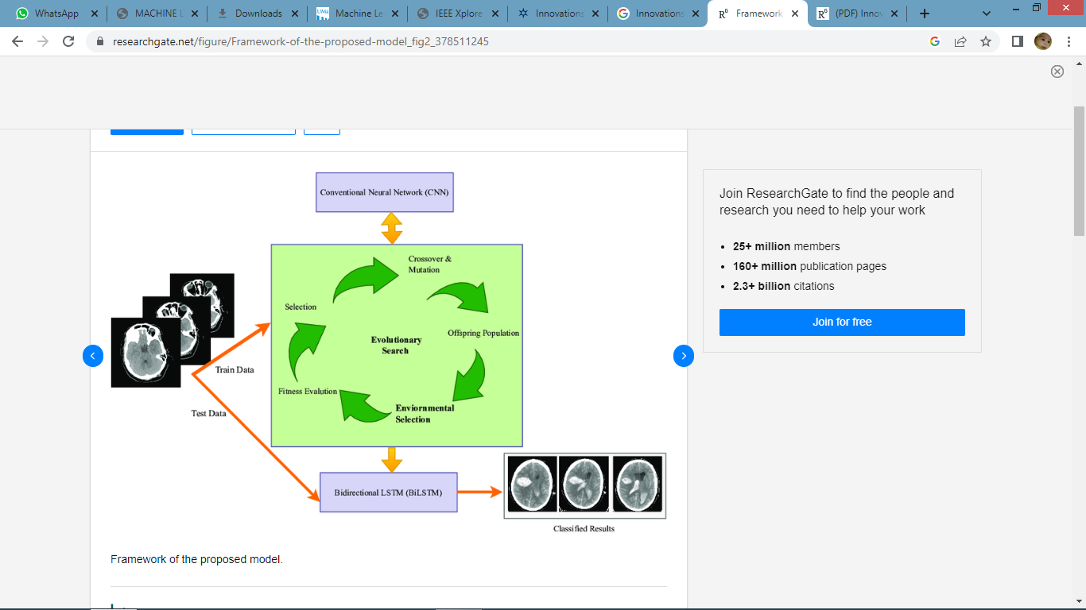
Block Diagram

Slide 10
SOFTWARE REQUIREMENTS:
Operating System : Windows 10
Language :PYTHON Google Colab

Slide 11
HARDWARE REQUIREMENTS:
Keyboard
Mouse
Harddisk
Ram

Slide 12
CONCLUSION
This study proposes a method for stroke detection using machine learning techniques.
An image-based dataset is used to validate the performance of the newly developed model.
The proposed model is based on a genetic algorithm and BiLSTM.
A genetic algorithm based on a neural network is applied to recognize the key features of CT brain images.
These features are input into the LSTM and BiLSTM models for stroke prediction.

Slide 13
The performance of different K-folds was evaluated to determine which is the most effective classification.
We also tested different machine-learning algorithms for stroke prediction.
The results of the experiment show that the proposed machine-learning model is more efficient than other models.
To improve stroke detection in the future, we aim to use more complex models that can predict strokes automatically.

Slide 14
REFERENCE
Vision Impairment and Blindness, Feb. 2023, [online] Available: https://www.world-stroke.org/world-stroke-day-campaign/why-stroke-matters/learn-about-stroke.
A. Khosla, Y. Cao, C. C.-Y. Lin, H.-K. Chiu, J. Hu and H. Lee, "An integrated machine learning approach to stroke prediction", Proc. 16th ACM SIGKDD Int. Conf. Knowl. Discovery Data Mining, pp. 183-192, Jul. 2010.
Y. Xu, K. Li, Y. Zhao, L. Zhou, Y. Liu and J. Zhao, "Role of ferroptosis in stroke", Cellular Mol. Neurobiol., vol. 43, no. 1, pp. 205-222, Jan. 2023.

Slide 15
Y. Yang, J. Zheng, Z. Du, Y. Li and Y. Cai, "Accurate prediction of stroke for hypertensive patients based on medical big data and machine learning algorithms: Retrospective study", JMIR Med. Informat., vol. 9, no. 11, Nov. 2021.
M. Chun, R. Clarke, B. J. Cairns, D. Clifton, D. Bennett, Y. Chen, et al., "Stroke risk prediction using machine learning: A prospective cohort study of 0.5 million Chinese adults", J. Amer. Med. Inform. Assoc., vol. 28, no. 8, pp. 1719-1727, Jul. 2021.
G. Ntaios, D. Sagris, A. Kallipolitis, E. Karagkiozi, E. Korompoki, E. Manios, et al., "Machine-learning-derived model for the stratification of cardiovascular risk in patients with ischemic stroke", J. Stroke Cerebrovascular Diseases, vol. 30, no. 10, Oct. 2021.

Slide 16
H. Z. U. Rehman, H. Hwang and S. Lee, "Conventional and deep learning methods for skull stripping in brain MRI", Appl. Sci., vol. 10, no. 5, pp. 1773, Mar. 2020.
M. Lim, A. Abdullah, N. Z. Jhanjhi, M. K. Khan and M. Supramaniam, "Link prediction in time-evolving criminal network with deep reinforcement learning technique", IEEE Access, vol. 7, pp. 184797-184807, 2019.
M. Lim, A. Abdullah, N. Jhanjhi and M. Supramaniam, "Hidden link prediction in criminal networks using the deep reinforcement learning technique", Computers, vol. 8, no. 1, pp. 8, Jan. 2019.

