Slide 1
Application of Block Chaining Technology in Finance and Accounting Field

Slide 2
Abstract
Block chaining technology is a distributed infrastructure and computing paradigm.
The latest version is represented by the super account book. The latest version is block chain 3.
From the perspective of large data, this paper systematically combs the essence and core technology of block chain technology, and expounds the application status of block chain technology in accounting industry.

Slide 3
This paper focuses on building an irreversible distributed financial system based on large data in the context of large data in order to apply the scenario of "Block Chain Technology + Accounting Services" to the accounting industry, and prospects the application of Block Chain Storage Technology and Intelligent Internet of Things technology based on large data, providing inspiration for future research.

Slide 4
OBJECTIVE
Using Block Chain Technology we Secure Finance and Accounting System of Banking Applocation.

Slide 5
Existing System
With the further development of the block chain, its application field has developed from the initial digital currency to a deeper direction.
Block Chain as a Service (BCS) transforms the infrastructure of large data and cloud computing, liberating closed data services and cloud computing infrastructure, allowing the public to operate their own infrastructure and provide rich distributed system features.

Slide 6
Disadvantage of Existing System
Mining does not provide network security.
Scalability remains block chain's weakness.
Block chains use excessive energy to retrieve.

Slide 7
PROPOSED SYSTEM :
Blockchain is being recognized as the new technology that would reduce fraud in the financial world where 45% of financial intermediaries like stock exchanges and money transfer services are prone to financial crimes routinely.
Most banking systems in the world, built on a centralized database, are more vulnerable to cyberattack because once hackers attack the one system they get full access. This technology would get rid of some of the current crimes committed online today against our financial institutions.
Block chain is a distributed book composed of data blocks based on cryptography using SHA Algorithm.

Slide 8
Each block contains a large amount of transaction information to verify the validity of the information.
In general, it is encrypted with a public key and a private key, and encrypted with a secret key, it needs to be decrypted with another secret key, for example, encrypted with a public key and decrypted with a private key. Public key generation is irreversible, that is, the private key can not be deduced from the public key, only the decryptor can see, thus ensuring a high degree of confidentiality of information.

Slide 9
ADVANTAGE
By using asymmetric encryption technology, timestamp, Merkle tree, consensus mechanism and incentive mechanism, point-to-point transactions based on decentralized credit are implemented in independent node distributed networks.
High reliability and safety
Low cost and high efficiency of decentralization, the problems of centralization are solved.

Slide 10
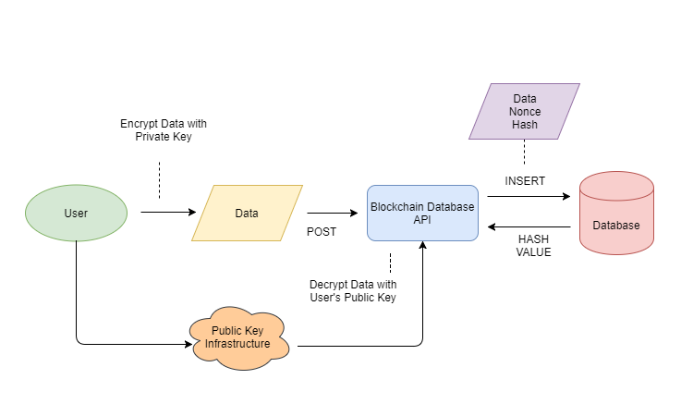
Architecture Diagram

Slide 11
Literature Review
Paper -I
Blockchain and Its Coming Impact on Financial Services
Technology Used:
Block chains
Methodology:
It is constantly growing as completed blocks are added to previous blocks forming a chain. Importantly, blocks are added to the Blockchain in a linear, chronological order. Each miner gets a copy of the Blockchain when joining the Bitcoin network.
Limitations:
The Blockchain they receive has complete and accurate information about the addresses and their balances right from the genesis block to the most recently completed block.

Slide 12
Paper-II
2. Authentication and Access Control in e-Health Systems in the Cloud
Technology Used:
Crypto System
Methodology:
Consumer credit has become an enormous business in industrialized countries.
Limitations:
finance agencies have started to develop new products aiming not only to widen their portfolio but also to keep active relationships with good clients already taken on file and to prevent bad clients from becoming a loss for the agency.

Slide 13
Paper-III
3. On Scaling Decentralized Blockchains
Technology Used :
Bitcoin Transaction
Methodology:
We oﬀer a structured perspective on the design space for such approaches. Within this perspective, we enumerate and brieﬂy discuss a number of recently proposed protocol ideas and oﬀer several new ideas and open challenges.
Limitations:
We analyze how
fundamental and circumstantial bottlenecks in Bitcoin limit the ability of its current peer-to-peer overlay network to support substantially higher throughputs and lower latencies.

Slide 14
Paper-IV
4. Does the market overweight imprecise information? Evidence from customer earnings announcements
Technology Used :
pseudo-anonymous transactions
Methodology:
We examine how supplier-firm shareholders respond to the earnings announcements of their major customers to test the moderated confidence hypothesis, which predicts overreaction to imprecise signals.
Limitations:
We find evidence that supplier earnings announcement abnormal returns are negatively correlated with supplier abnormal returns at the earlier customers’ earnings announcements, consistent with supplier overreaction.

Slide 15
Paper-V
5. EuroMInd-C: A disaggregate monthly indicator of economic activity for the Euro area and member countries
Technology Used :
Block chain in ecnomics
Methodology:
This paper deals with the estimation of monthly indicators of economic activity for the Euro area and its largest member countries that possess the following attributes: relevance, representativeness and timeliness.
Limitations:
Representativeness is achieved by considering a very large number of (timely) time series of monthly indicators relating to the level of economic activity, providing a more or less complete coverage.

Slide 16
SOFTWARE REQUIREMENTS:
Operating system : Windows XP/7.
Coding Language : Asp.Net
IDE : .Net Framwork3.5
Database : Mssql2008

Slide 17
HARDWARE REQUIREMENTS:
System : I3 Processer
Hard Disk : 500 GB.
Monitor : 15 VGA Colour.
Mouse :
Ram : 2 Gb

