Slide 1
AMBULANCE TRACKING SYSTEM IN ANDROID

Slide 2
ABSTRACT :
About 33,000 people die because the ambulance cannot reach them in time. It is not necessary that when you call an ambulance, the nearest ambulance will reach you.
The paper describe a model to track the nearest free ambulance in the area using global positioning system and bring it to the person in distress.
The GPS device continuously move with the ambulance and will calculate the the co-ordinate of each position and can be obtained whenever required by the server. Hence it can track the nearest ambulance and bring it to the person in distress.

Slide 3
INTRODUTION
Instauration of mobile devices gave birth to lot of innovative technology, and exchanging information globally has become more prominent.
Smart phones gave a new dimension to the usage of mobile phones for the users. Apart from basic functionality such as messaging, calling and cameras, smart phones laid a way to portray a personal computer.
Not only the mobile phone looks newer, it‟s the operations system and the applications which are built to meet the various features of the hardware made difference.

Slide 4
The mobile phone has now become a major source of information device which can be seen almost in everyone’s hand in the world.
Mobile devices with computing process ability have been widely used to access network via mobile communication network. Different categories of application such as games, social networks, and health care are being developed to meet the user’s requirements.
Each mobile user is of unique kind, one wants to use the basic functionality of the smart phones, the other want to use the built in application, the most advanced user who wants to play with the hardware and to develop his own customizable application.
To answer each kind of user, Google mustered up a groundbreaking product called as “ANDROID”, which includes an open source operating system, middleware and a user-interface.

Slide 5
Existing System:
  In this system the patient or third person can call to toll free number and they are assigning driver to attend the patient.
  In this scenario there is waste of time happens while conversation and also there is big issue to find location of patient, high way and interior place is very tough to find patient location.In this situation the patient may have trouble.

Slide 6
Drawback :
1. Three way communication may take miscommunication
2. Location of patient not exact to find
3. Not timely precaution

Slide 7
Proposed Work :
modules work on the principle of IoT with the help of REST APIs. First module is used to find locations of ambulances within the 5km radius from user’s location.
Also the same module is used to find hospitals and their services within radius of 10km of user’s current location. Here user’s location is traced using GPS hardware device.
The location is retrieved in the form of double value as latitude and longitude. E.g. 19.54526, 73.87099. This is the format of the latitude and longitude.

Slide 8
This location is transmitted to the server by executing POST request. Depending on the user’s location, server processes the data and matches with records stored into the database. After processing of such data the result of user’s query is sent back to the user in form of JSON format.

Slide 9
ADVANTAGES :
It’s beneficial for the users in case of emergencies as it saves time which gets consumed in searching for the ambulance by other means.
Information about the hospitals provided helps in getting the appropriate hospital which is suitable for the patient’s treatment.
Sending patient’s health information to the hospitals helps the hospital staff to get things ready required for the treatment.

Slide 10
Here the patient need not to wait in any case. Hospitals information is directly provided through maps and hence there is no need to visit the particular hospital’s website for information.
Live feeds will help for better medical procedures which helps in saving patient’s life in an effective way.

Slide 11
Modules
1. User application
2. Server end
3. Global Positioning System

Slide 12
1. User application
This application will initially be based on Android . On launching the app first device will automatically detect the location of user using the GPS devices .
Later depending on the user’s requirement/need user will choose option of finding nearby ambulances or hospitals or just view services provided by hospitals. This query is sent in the JSON format to the server.
Server will process on it and respond accordingly. The response from server will also be in JSON format . Smartphone app will read the data from response and plot the coordinates or information according to the user’s request.

Slide 13
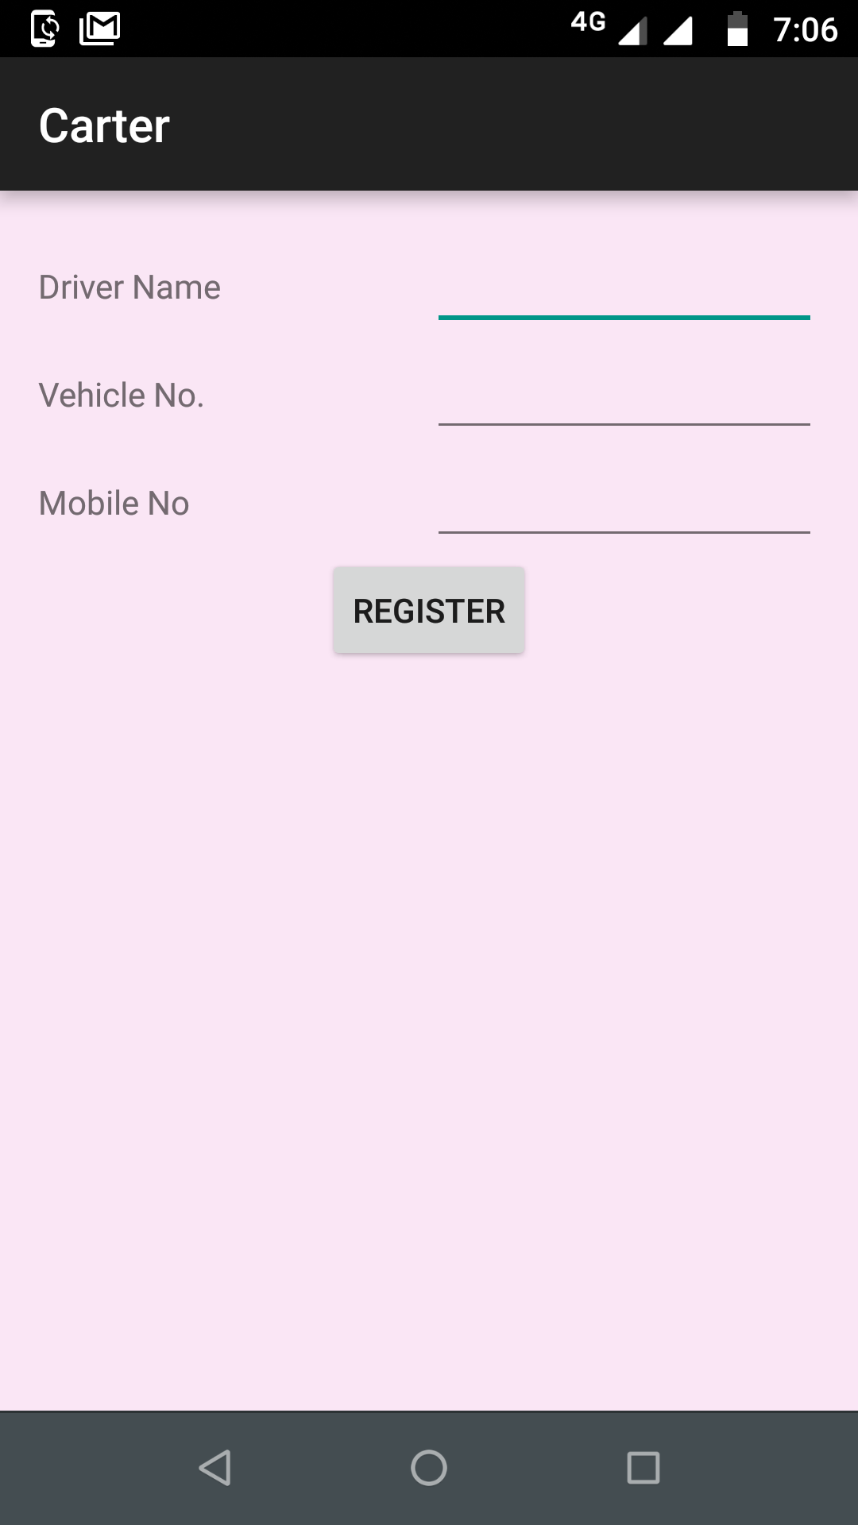

Slide 14
Hardware Requirements:
System : Intel i3 2.4 GHz.
Hard Disk : 250 GB.
Monitor : 14’ Colour Monitor.
Mouse : Optical Mouse.
Ram : 2 Mb.

Slide 15
Software Requirements:
Operating system : Windows 7 Ultimate.
Coding Language : Java based Android Coding
Front-End : XML Design
Data Base : MSSQL SERVER 2008

