Slide 1
Intelligent Vehicle Theft Control using Embedded System

Slide 2
Abstract :
This paper presents a mechanism to make vehicle thefts almost impossible. GSM and GPS technologies are used for that purpose.
The proposed system provides two levels of security, password protection for the vehicle and remote ignition cut-off mechanism.
This system also provides provision for vehicle tracking using GPS. GSM technology is used for intimating the owner. An alert message is sent to the owner if the wrong password is entered.

Slide 3
Message is also sent when the ignition system of the vehicle is started. The owner can respond with an SMS to stop the engine.
A buzzer is also activated to alert the nearby people or the security personnel if the right password is not entered after maximum number of trials. Message is sent to owner even when vehicle is started using correct password.
If Engine also tried to theft by thief the alert sms sent to owner of the vehicle
Also any accident occurs will send sms with location alert to concern person’s mobile number.

Slide 4
Existing System :
In Exiting system there is effective gps tracking system.
If anybody tried to theft vehicle engine not possible to get any notification .

Slide 5
Proposed System:
The proposed security system in this paper is an integration of existing technology GPS that is currently used in location tracking and modern Technology is to provide pasword authentication to engine for ON and OFF.
If any body theft vehicle the engine will ask password to start the vehicle .

Slide 6
Introduction
In recent years the vehicle stealing is a big problem. The protection of the vehicle is needed. There are also some limitations.
Therefore, an effective security threat protection of vehicle is required. The Arduino interface is an integral a section of dc motor and GPS. Wireless fidelity module is used to search out the vehicle’s location through the Global Positioning System (GPS).
GPS can be a navigation system that would be used to tracking the car, and it provides entirely environmental conditions for putting the consumptive unit. Victimization the GPS antenna provides the latitude and meridian of the device

Slide 7
When the vehicles are left outside, currently if the vehicle is taken, the D.C. motor starts and therefore the method on top of is over and also the info is distributed through the web content.
This vehicle is employed as a vehicle thievery and rescue tool for thievery hindrance and following system. Prevention of cars is often done by providing authorization for owners and by building anti-theft system in vehicles.

Slide 8
NODE MCU
NodeMCU is an open source firmware for which open source prototyping board designs are available. The name "NodeMCU" combines "node" and "MCU" (micro-controller unit).
Strictly speaking, the term "NodeMCU" refers to the firmware rather than the associated development kits.

Slide 9
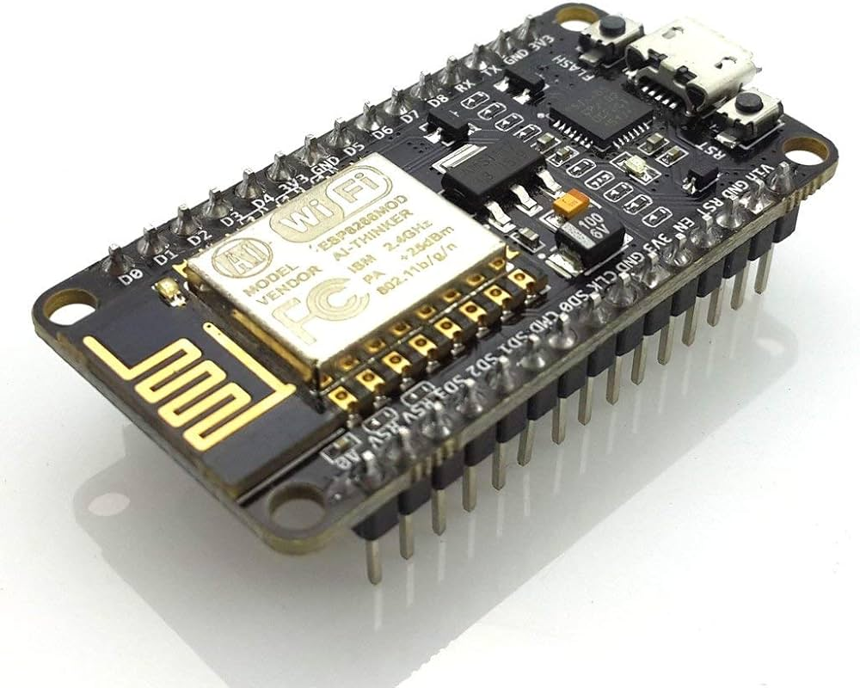

Slide 10
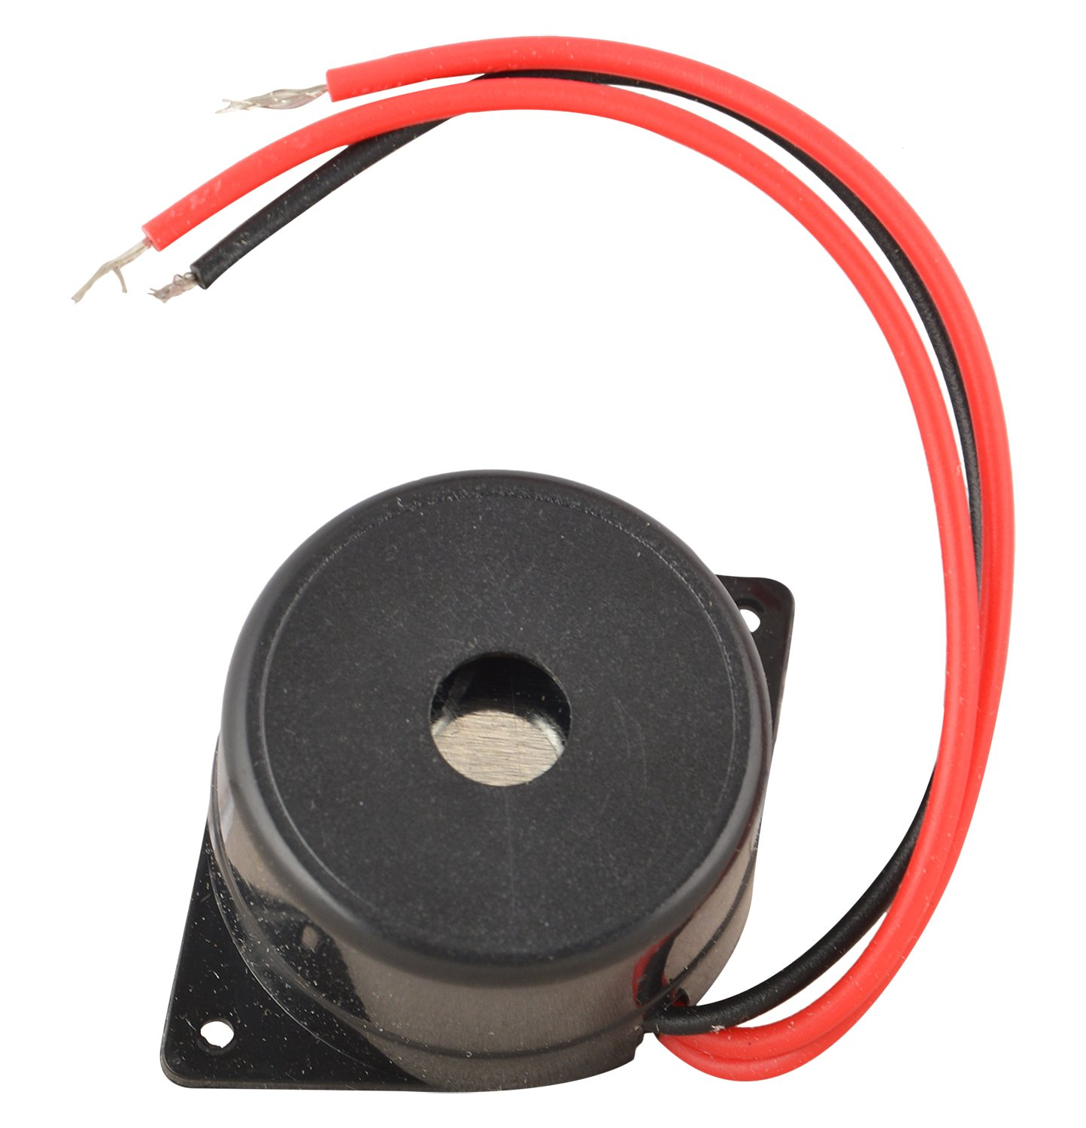
Buzzer

Slide 11
A sound device that uses sound and is used to sign in.
The bazaar emphasizes a warning form in the form of a constantly waking sensation or beep. Initially, this device has an electroquintic system, which is surprising to an electric bell.

Slide 12
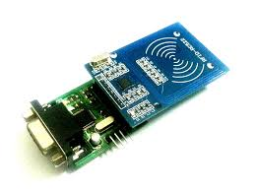
RFID READER

Slide 13
Radio Frequency Identification (RFID) refers to a wireless system comprised of two components: tags and readers. The reader is a device that has one or more antennas that emit radio waves and receive signals back from the RFID tag
Radio Frequency Identification (RFID) is a technology that uses radio waves to passively identify a tagged object. It is used in several commercial and industrial applications, from tracking items along a supply chain to keeping track of items checked out of a library.

