Slide 1
RECOMMENDATION OF CROP AND FERTILIZER SYSTEM USING MACHINE LEARNING

Slide 2
Abstract
Machine learning (ML) can make use of agricultural data related to crop yield under varying Crop based nutrient levels, and climatic fluctuations to suggest appropriate crops or supplementary nutrients to achieve the highest possible production.
The aim of this study was to evaluate the efficacy of five distinct ML models for a dataset sourced from the Kaggle repository to generate practical recommendations for crop selection or determination of required nutrient(s) in a given site.
The datasets contain information on NPK, Crop based pH, and three climatic variables: temperature, rainfall, and humidity.

Slide 3
The models namely Support vector machine, XGBoost, Random forest, KNN, and Decision Tree were trained using yields of individual data sets of 11 agricultural and 10 horticultural crops, as well as combined yield of both agri-horticultural crops.
The results strongly suggest to evaluate individual data sets separately for each crop category rather than using combined the data sets of both categories for better predictions.
Comparing the five ML models, the XGBoost demonstrated the highest level of accuracy. The precision rates of XGBoost for recommending agricultural crops, horticultural crops, and a combination of both were 99.09 % (AUC 1.0), 99.3 % (AUC 1.0), and 98.51 % (AUC 0.99), respectively.
This non-intrusive method for generating crop recommendations in diverse environmental conditions holds the potential to provide valuable insights for the development of a user-friendly AI cloud-based interface. Such an interface would enable rapid decision-making for optimal fertilizer applications and the selection of suitable crops for cultivation at specific sites.

Slide 4
Existing System
Crop based fertility changes with every harvest and changing weather condition and also affects the nutrient content of Crop based. Also fertility of Crop based varies at different part of field and it requires to be monitored for healthy crop production.
For Testing Crop based Every farmer should take the Crop based and travel to agriculture office and need to test there. so it will take more time to test Crop based in lab.

Slide 5
Disadvantage of Existing System
These systems heavily rely on accurate and extensive datasets for training. Obtaining high-quality data can be challenging, especially in regions where agricultural practices are not well-documented or data collection infrastructure is lacking.
Machine learning algorithms used in these systems can be complex, requiring significant computational resources and expertise to develop and maintain. This complexity may pose challenges for implementation in resource-constrained environments or for farmers with limited technical knowledge.
Fertilizer requirements can vary significantly based on factors such as soil type, climate, crop variety, and management practices. Existing machine learning models may not always capture these localized nuances accurately, leading to suboptimal recommendations in certain contexts.
Many machine learning models, particularly deep learning models, lack interpretability. Farmers may be hesitant to adopt recommendations from black-box models if they cannot understand the underlying rationale or trust the output.

Slide 6
PROPOSED SYSTEM :
The objective of proposed system is to replace the traditional farming technique of testing Crop based fertility by the automated remotely monitored fertility monitoring technique. In this system the farmer gets current status of Crop based fertility in his land at real time.
The Crop based quality is determined by using the sensors to calculate the Crop based nutrient contents i.e. nitrogen, phosphorus and potassium (NPK).
The farmer tests multiple sample of Crop based in his land using a portable device. Result of each test is averaged to determine the approximate fertility of tota

Slide 7
Result of all the tests will be displayed on display screen. The farmer physically enters the displayed value in his mobile application to get a digitally generated Crop based fertility e-report.
A digital report generated on the basis of all the tests, which will include the averaged result of all the tests, reflecting the ratio in which various nutrients i.e. Nitrogen, Phosphorous, Potassium are present in the Crop based. And will also contain the list of suitable crop and the required fertilizer for the land.

Slide 8
ADVANTAGE
Machine learning algorithms can analyze large amounts of data, including soil characteristics, weather patterns, crop types, and historical yield data, to provide precise recommendations tailored to specific fields or even individual plants. This precision helps optimize fertilizer usage, minimizing waste and environmental impact while maximizing crop yield and quality.
By considering multiple factors influencing plant growth, such as soil nutrient levels, pH, moisture content, and crop nutrient requirements, machine learning models can generate optimized fertilizer recommendations. This leads to better nutrient management, ensuring that crops receive the right amount of nutrients at the right time, which is crucial for their growth and development.
Automated fertilizer recommendation systems powered by machine learning can streamline decision-making processes for farmers. By providing timely and accurate recommendations, these systems help farmers make informed choices about fertilizer application, leading to more efficient use of resources and labor.

Slide 9
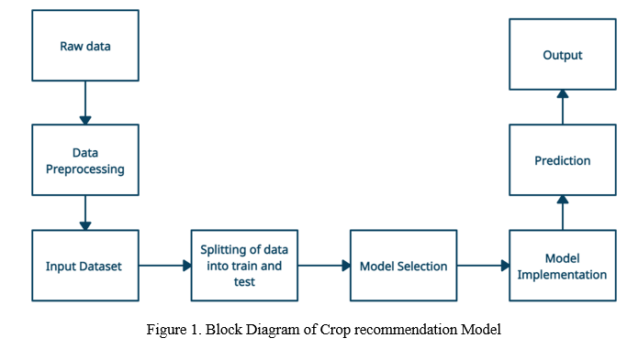
Database Diagram

Slide 10
SOFTWARE REQUIREMENTS:
Operating System : Windows 10
Platform : DOT NET TECHNOLOGY
Front End : PYTHON
Back End : SQL SERVER 2014

Slide 11
HARDWARE REQUIREMENTS:
Keyboard
Mouse
Hard disk 500GB
Ram 4 Gb

Slide 12
CONCLUTION
Automatic crop classification using new technologies and techniques is recognized as one of the most important keys in today’s smart farming improvement.
It plays a crucial role in reducing the overall financial cost in reducing the number of workers, the amount of applied agrochemical products, among others. Most of previous studies are based on satellites and UGVs as remote sensing platforms and classical machine learning algorithms as processing techniques.
However, UAVs have emerged as new effective remote sensing platforms that provide valuable data through the carried sensors. UAV-based Aerial image processing using different CNN-based algorithms have been applied successfully in crop/plant classification even though there still many challenges.

Slide 13
So, in this paper, the advantages of UAVs over traditional technologies were highlighted.
Moreover, different object-based and pixel-based algorithms were investigated in this review to help researchers and farmers to choose the right classifier according to the targeted crop, the used camera sensors, among other parameters.
The choice of the right model is a fundamental key that should improve the accuracy, speed, and reliability to classify different crop types. Furthermore, possible challenges and their solutions for crop identification from UAV imagery were presented in this paper.

Slide 14
REFERENCE
[1] S.W. Wang, W.K. Lee, Y. Son An assessment of climate change impacts and adaptation in South Asian agriculture
[2] K.K. Verma, X.P. Song, A. Joshi, D.D. Tian, V.D. Rajput, M. Singh, J. Arora, T. Minkina, Y.R. Li Recent trends in nano-fertilizers for sustainable agriculture under climate change for global food security
[3] X. Liu, Y. Xu, S. Sun, X. Zhao, P. Wu, Y. Wang What is the potential to improve food security by restructuring crops in Northwest China?
[4] A. Bouguettaya, H. Zarzour, A. Kechida, A.M. Taberkit Deep learning techniques to classify agricultural crops through UAV imagery: a review
[5] United Nations World Population Prospects 2019 (2019)

