Slide 1
Railway Reservation Management System

Slide 2
Abstract
The Railway Reservation System (RRS) is a comprehensive software solution designed to facilitate the booking of train tickets for passengers.
With the ever-growing demand for rail travel, an efficient and user-friendly reservation system becomes indispensable for both passengers and railway authorities.
The RRS aims to streamline the ticket booking process, improve passenger experience, and optimize operational efficiency for railway administrations.
The RRS encompasses various modules, including user management, ticket booking, seat allocation, train schedule management, payment processing, cancellation and refund handling, reporting and analytics, admin management, integration, and notification. These modules work together seamlessly to provide a robust and feature-rich platform for booking train tickets.

Slide 3
Existing System
Before the introduction of computerized railway reservation systems, the process of booking train tickets was primarily manual and involved several challenges and limitations. Here's an overview of the existing system prior to the implementation of computerized railway reservation systems:
Manual Booking Process:
Passengers had to visit railway stations or authorized ticket counters to book train tickets.
Booking agents manually wrote down passenger details, journey information, and seat preferences on paper tickets or reservation charts.

Slide 4
Limited Access to Information:
Passengers had limited access to information about train schedules, seat availability, and fare details.
They relied on printed timetables, announcements at stations, or word-of-mouth to gather information about train services.
Long Queues and Waiting Times:
Ticket counters often experienced long queues, especially during peak travel seasons or for popular routes.

Slide 5
Disadvantage of Existing System
Limited Accessibility: Passengers had to physically visit railway stations or ticket counters to book tickets, which could be inconvenient, especially for those living in remote areas or with mobility issues.
Long Queues and Waiting Times: Ticket counters often experienced long queues, especially during peak travel seasons or for popular routes. This led to delays and frustration for passengers.
Limited Information Availability: Passengers had limited access to information about train schedules, seat availability, and fare details. They relied on printed timetables or word-of-mouth, which could be inaccurate or outdated.

Slide 6
PROPOSED SYSTEM :
Online Booking Portal:The proposed system includes an online booking portal accessible through web browsers and mobile applications, allowing passengers to book tickets from anywhere with internet access.Users can create accounts, search for trains, view schedules, check seat availability, and make bookings conveniently through the user-friendly interface.
Real-Time Information:The system provides passengers with real-time information on train schedules, seat availability, and fare details, ensuring accuracy and reliability.Passengers can make informed decisions about their travel plans, reducing the likelihood of booking errors or misunderstandings.
Automated Seat Allocation:The proposed system employs automated seat allocation algorithms to assign seats or berths to passengers based on their preferences, availability, and booking requirements.This ensures efficient utilization of seating capacity and improves the overall passenger experience by providing optimal seating arrangements.

Slide 7
ADVANTAGE
Passengers can book train tickets anytime, anywhere using the online booking portal, eliminating the need to visit ticket counters physically.
The user-friendly interface makes it easy for passengers to search for trains, check seat availability, and make bookings with minimal effort.
Passengers have access to real-time information on train schedules, seat availability, and fare details, enabling them to make informed decisions and plan their travel accordingly.
Instant confirmation of bookings and electronic tickets (e-tickets) provide passengers with immediate confirmation of their reservations, reducing uncertainty and ensuring peace of mind.
Automated seat allocation algorithms ensure optimal utilization of seating capacity and provide passengers with preferred seating arrangements whenever possible.
Passengers can select their preferred seats or berths during the booking process, enhancing their overall travel experience.

Slide 8
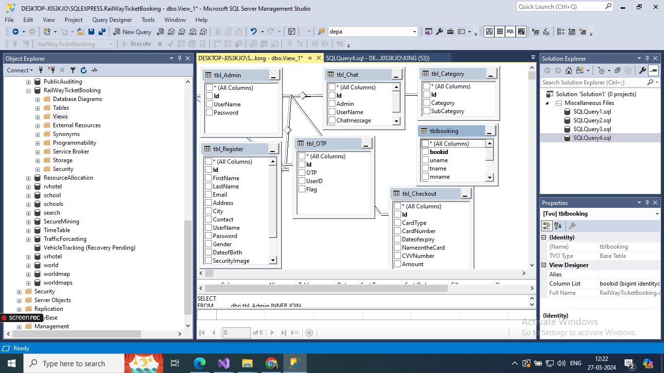
Database Diagram

Slide 9
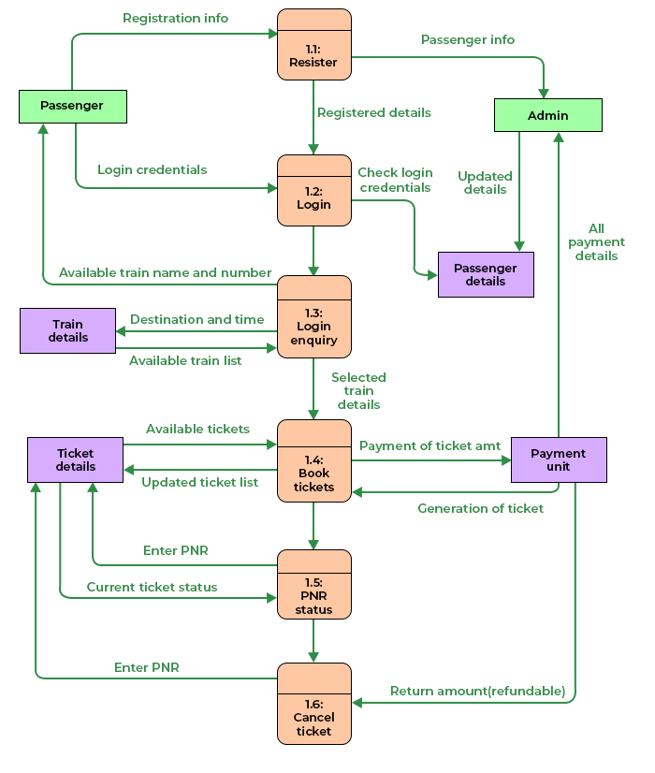
DFD Diagram

Slide 10
SOFTWARE REQUIREMENTS:
Operating System : Windows 10
Platform : DOT NET TECHNOLOGY
Front End : ASP.Net 4.0
Back End : SQL SERVER 2014

Slide 11
HARDWARE REQUIREMENTS:
Keyboard
Mouse
Hard disk 500GB
Ram 4 Gb

Slide 12
CONCLUTION
The development and implementation of the Railway Reservation Management System have brought substantial improvements to the efficiency and user experience in booking railway tickets. This system offers a comprehensive platform that facilitates various functions such as ticket booking, cancellation, seat availability checks, and passenger information management.
Through the integration of modern technologies and a user-friendly interface, the system ensures accessibility for users of all technical backgrounds. The adoption of robust security measures guarantees the protection of sensitive passenger information and transaction data, thereby fostering trust and reliability among users

Slide 13
REFERENCE
Pressman, R.S. (2014). Software Engineering: A Practitioner's Approach. McGraw-Hill.Sommerville, I. (2015).
Software Engineering. Pearson Education
Indian Railways. (2023). Indian Railways Official Website. Retrieved from https://www.indianrailways.gov.in
Amadeus IT Group. (2023). Amadeus Rail IT. Retrieved from https://amadeus.com
Oracle Corporation. (2022). Oracle Cloud Infrastructure Documentation. Retrieved from https://docs.oracle.com/en/cloud/Microsoft Azure. (2022).

