Slide 1
Machine Learning Based Healthcare System for Investigating the Association Between Depression and Quality of Life

Slide 2
Abstract
The present study aims to elucidate the main variables that increase the level of depression at the beginning of military conscription service using an artificial neural network (ANN)-based prediction model.
Random sample data were obtained from one battalion of the Lithuanian Armed Forces, and a survey was conducted to generate data for the training and testing of the ANN models.
Using nonlinearity in depression research, numerous ANN structures were constructed and verified to limit the optimal number of neurons, hidden layers, and transfer functions. The highest accuracy was obtained by the multilayer perceptron neural network (MLPNN) with a 6-2-2 partition.

Slide 3
A standardized rescaling method was used for covariates. For the activation function, the hyperbolic tangent was used with 20 units in one hidden layer as well as the back-propagation algorithm.
The best ANN model was determined as the model that showed the smallest cross-entropy error, the correct classification rate, and the area under the ROC curve.
These findings show, with high precision, that cohesion in a team and adaptation to military routines are two critical elements that have the greatest impact on the depression level of conscripts.

Slide 4
Existing System
The performance of the ANNs will not only provide how well depression can be classified from the features derived from the primary signals for depression but also provide an insight to irrelevant features that exist in the feature space.
The classification accuracy of the anticipated scheme is higher when compared to the existing schemes, owing to the efficient classification and efficient preprocessing.
Due to the less false negative errors, the sensitivity evaluation of the proposed FSVM is comparatively higher than that of the existing method, as well specificity is also encountered to be higher in FSVM due to its high true positive rate compared to the existing methods.
In existing approach, depression can be predicted by face reading, interview, and other activities, people are analyses to each other.

Slide 5
Disadvantage of Existing System
Depression is a major problem facing our world today and it is important to develop an understanding of how an average person responds to depression in a typical activity like reading.
A genetic algorithm (GA) could help solve these problems by selecting subsets of features for optimizing ANN depression classifications.
This can lead to the issue where the ratio for number of samples to the number of connections and weights in an ANN could be relatively small, which could affect classifications.
When experienced for longer periods of time and not controlled, depression has been widely recognized as a major growing concern in our age adversely impacting society due to its potential to cause chronic illnesses (e.g. cardiovascular diseases, diabetes and some forms of cancer) and high economic costs in societies (especially in developed countries.
.

Slide 6
Ongoing pressure can bring about genuine medical issue including uneasiness, sleep deprivation, muscle torment, hypertension and a debilitated invulnerable system.
The quick increment of mental issues or depression has become an extraordinary test to human wellbeing and nature of life

Slide 7
PROPOSED SYSTEM :
This paper proposes and tests a variety of ANNs that can be used to classify depression in reading using a novel set of depression response signals.
It also proposes methods for ANNs to deal with hundreds of features derived from the response signals using a genetic algorithm (GA) based approach.
This proposed method ensures the accurate classification outcome which leads to efficient human life saving.
They propose a novel mind-set acknowledgment structure that can distinguish five force levels for eight distinct kinds of mind-sets like clockwork.
In addition, a ranking transformation was proposed utilizing self-reports in order to investigate the correlation of facial parameters with a participant's perceived amount of depression/anxiety.
The proposed designed is helpful for predicting the mental depression of user using the conversation and social media data.

Slide 8
ADVANTAGE
A slight performance drop between binary depression detection and 3-class emotion classifcation is expected, as multi-class classifcation is a more challenging task than binary classifcation.
Te performance drop of the traditional machine learning algorithms occurs for both binary depression detection and 3-class emotion classifcation, measuring physiological data from both the chest-worn sensors and the wrist-worn sensors.
However, adding signals from the ACC sensor should improve the performance of an ideal model, as more data points are being analyzed in the tasks performed.
Deep neural networks possess key advantages in their capabilities to model complex systems and utilize automatically learning features through multiple network layers.
Te key reason for using a convolutional neural network was the advantage of parameter-sharing that a convolutional neural network ofers.
In a convolutional neural network, a small number of flters can be used for feature extraction across entire inputs.

Slide 9
LITERATURE SURVEY
1. “Introducing WeSAD, a Multimodal Dataset for Wearable Depression and Affect Detection” Schmidt, P.; Reiss, A.; Duerichen, R.; van Laerhoven, K.
Affect recognition aims to detect a person’s affective state based on observables, with the goal to e.g. improve human-computer interaction. Long-term depression is known to have severe implications on wellbeing, which call for continuous and automated depression monitoring systems.
2. “Supervisor Support, Control over Work Methods and Employee Well-Being: New Insights into Nonlinearity from Artificial Neural Networks” Somers, M.J.; Birnbaum, D.; Casal, J.
The purpose of this study was to test a nonlinear model of psychological well-being at work. Specifically, artificial neural networks (ANNs) were used to identify and map nonlinearities among supervisor support, control over work methods and employee well-being.

Slide 10
3.“ Low Depression Resilience in Late Adolescence and Risk of Hypertension in Adulthood” Crump, C.; Sundquist, J.; Winkleby, M.A.; Sundquist, K.
Greater blood pressure reactivity to psychological depression has been associated with higher risk of developing hypertension. We hypothesised that low depression resilience based on psychological assessment early in life is associated with hypertension in adulthood.
4. “Artificial Neural Network for Classification of Depressive and Normal in EEG” Mohan, Y.; Chee, S.S.; Xin, D.K.P.; Foong, L.P.
Depression is one of the greatest problems nowadays which might lead to high rates of other negative health outcomes such as obesity, heart disease, and stroke. However, diagnosis of the depression is still greatly depended on the questionnaires.

Slide 11
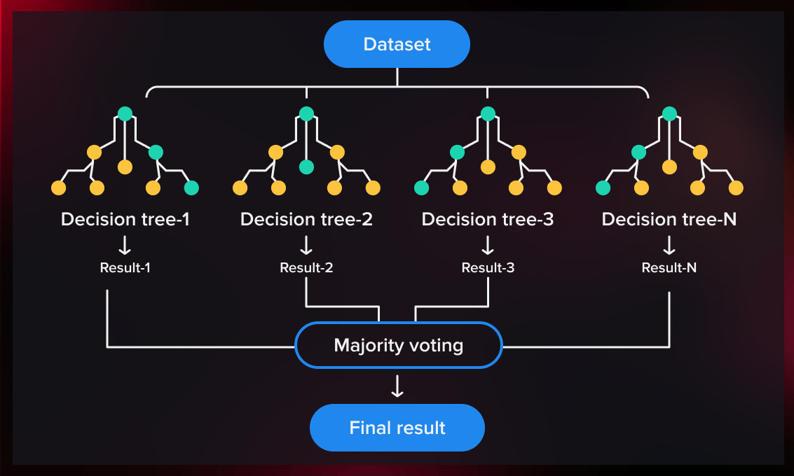
Block Diagram

Slide 12
SOFTWARE REQUIREMENTS:
Operating System : Windows 10
Platform : DOT NET TECHNOLOGY
Front End : ASP.Net 4.0
Back End : SQL SERVER 2014

Slide 13
HARDWARE REQUIREMENTS:
Keyboard
Mouse
Hard disk 500GB
Ram 4 Gb

Slide 14
CONCLUSION
The paper detects the depressed and not depressed people analyzing the heart beat blood pressure and sugar level expression using the dataset.
We combined the ANN classifier, for train and tested our proposed architecture. The proposed architecture performance is also compared with different proposed architecture accuracy.
The proposed architecture gives good performance. We are certain that the impact of our research effort will pave the path for future necessary image processing research and enhance the intellect and practicability in further research

Slide 15
REFERENCE
1. Samele, C.; Lees-Manning, H.; Zamperoni, V.; Goldie, I.; Thorpe, L.; Wooster, E.; Giugliano, T.; O’sullivan, C.; Kousoulis, A.; Breedvelt, J.; et al. Depression: Are We Coping? Mental Health Foundation: London, UK, 2018.
2. Nuhu, F.; Bhandari, S. Oxidative Depression and Cardiovascular Complications in Chronic Kidney Disease, the Impact of Anaemia. Pharmaceuticals 2018, 11, 103. [CrossRef]
3. Saha, S.K.; Lee, S.B.; Won, J.; Choi, H.Y.; Kim, K.; Yang, G.M.; Dayem, A.A.; Cho, S.G. Correlation between Oxidative Depression, Nutrition, and Cancer Initiation. Int. J. Mol. Sci. 2017, 18, 1544. [CrossRef]
4. Leightley, D.; Williamson, V.; Darby, J.; Fear, N.T. Identifying Probable Post-Traumatic Depression Disorder: Applying Supervised Machine Learning to Data from a UK Military Cohort. J. Ment. Health 2019, 28, 34–41. [CrossRef] [PubMed]
5. Platania, S.; Castellano, S.; Petralia, M.C.; Digrandi, F.; Coco, M.; Pizzo, M.; di Nuovo, S. The Moderating Effect of the Dispositional Resilience on the Relationship between Post-Traumatic Depression Disorder and the Professional Quality of Life of the Military Returning from the Peacekeeping Operations. Mediterr. J. Clin. Psychol. 2020, 8, 1–21. [CrossRef]
6. Purre, M.; Oja, L. Mental health in the military context: Emotional states and help-seeking behaviours during conscription. Est. J. Mil. Stud. 2018, 6, 196–222.

Slide 16
7. Do, J.J.; Samuels, S.M. I Am a Warrior: An Analysis of the Military Masculine-Warrior Narrative Among U.S. Air Force Officer Candidates. Armed Forces Soc. 2021, 47, 25–47. [CrossRef]
8. Bekesiene, S.; Hoskova-Mayerova, S.; Diliunas, P. Structural Equation Modeling Using the Amos and Regression of Effective Organizational Commitment Indicators in Lithuanian Military Forces. In Proceedings of the Aplimat—16th Conference on Applied Mathematics 2017 Proceedings, Bratislava, Slovakia, 31 January–2 February 2017; pp. 91–102.
9. Song, Q.; Li, J.; Duan, H.; Yu, D.; Wang, Z. Towards to Sustainable Energy-Efficient City: A Case Study of Macau. Renew. Sustain. Energy Rev. 2017, 75, 504–514. [CrossRef]
10. Schmidt, P.; Reiss, A.; Duerichen, R.; van Laerhoven, K. Introducing WeSAD, a Multimodal Dataset for Wearable Depression and Affect Detection. In Proceedings of the 20th ACM International Conference on Multimodal Interaction (ICMI 2018), Boulder, CO, USA, 16–20 October 2018; Association for Computing Machinery, Inc.: New York, NY, USA, 2018; pp. 400–408.
11. Taherdangkoo, R.; Tatomir, A.; Taherdangkoo, M.; Qiu, P.; Sauter, M. Nonlinear Autoregressive Neural Networks to Predict Hydraulic Fracturing Fluid Leakage into Shallow Groundwater. Water 2020, 12, 841. [CrossRef]

