Slide 1
LANDSLIDE MONITORING AND NOTIFICATION USING IOT

Slide 2
Abstract
Hazards from landslides are everywhere. Landslides are more likely to occur on steeply sloped hillsides. For several case studies throughout the globe, researchers have performed landslide prediction, detection, and monitoring.
The major goal of researching landslide detection is to stop natural disasters by seeing their early movement. This will lessen or prevent the landslide's fatalities among humans.
Finding a method for the sensing components to react promptly to data changes and transmit the perceived data to the data analysis centre is another goal.

Slide 3
The Wireless Sensor Network (WSN) and the Internet of Things serve as the foundation for the Implemented system (IoT).
This technology is inexpensive, reliable, and delay-effective. The suggested system makes use of accelerometer and soil moisture sensors.
While the accelerometer measures ground movement, moisture sensor data reveal the amount of moisture in the soil. The measurements that exceed the established criteria warn nearby residents to take precautions

Slide 4
Existing System
In this paper, multisource remote sensing images acquired after the earthquake were used to map landslides, referred to the existing inventory from as shown
The landslides were mapped as polygons that separately document source areas and runout areas, based on image and topographic features .
Only the initiation areas were set as samples for model training and testing.

Slide 5
Disadvantage of Existing System
This method is based on mathematical computation, with the capability to solve physical problems with complex geometries, material properties, and boundary conditions, and it is suitable for critical projects researching the stability of artificial slopes .
Many studies have indicated that a different group of factors influences the occurrence of EQIL, i.e., identifying EQIL could be considered as a multivariate inverse inference problem,

Slide 6
PROPOSED SYSTEM :
displays the suggested system's block diagram. Sensor nodes, a controller at the landslide site, and an ESP32 at the monitoring station make up the system.
To fully cover a region, often many sensor nodes are required. All of these sensors gather data on the criteria used to monitor landslides, including tilt angle, soil moisture, and displacement.
The suggested system makes use of a 3.3 to 5 V soil moisture sensor. It contains two plates that measure the soil's water content. The electric current flowing across the plates varies in direct proportion to the water content. More moisture surrounding the sensor causes it to draw more current, which reduces output resistance and lowers the output voltage.

Slide 7
Another scenario is when the sensor draws less current when there is less moisture surrounding it, leading to a high output resistance and a corresponding output voltage of People who live nearby are at risk from landslides in places with high rainfall.
Additionally, making predictions regarding it becomes challenging. In order to create a new prediction tool that can be used to analyse the movement of an area using sensors, telecommunication is joining with a collaboration of professional labs, including IS Terre: earth science and LCIS: embedded electronics.
The primary idea is that the sensors will use the least amount of money and energy possible to detect movement in the field. The monitoring methods rely on wireless sensor IoT-based transmission.
A frequent method is to have a collection of permanent (non-mobile) nodes and anchors whose locations are previously known in order to accomplish geo location utilising a network of sensors. Several methods are used to calculate the position of the sensor node.

Slide 8
ADVANTAGE
we used high-resolution remote sensing images and a digital elevation model (DEM) to extract the source area of an EQIL.
Previously, field investigation has been commonly used to obtain an EQIL inventory, but it is time consuming and incomplete in some remote and inaccessible places.

Slide 9
TITTLE | AUTHOR | DESCRIPTION
“Earthquake-induced chains of geologic hazards: Patterns, mechanisms, and impacts. | Fan, X.; Scaringi, G.; Korup, O.; West, A.J.; van Westen, C.J.; Tanyas, H.; Hovius, N.; Hales, T.C.; Jibson, R.W.; Allstadt, K.E. | Third Edition is the most comprehensive source available for data on engineering materials. Organized in an easy-to-follow format based on materials properties, this definitive reference features data verified through major professional societies in the materials field, such as ASM International a
Earthquake induced landslide susceptibility mapping using an integrated ensemble frequency ratio and logistic regression models in West Sumatera Province, Indonesia. | Umar, Z.; Pradhan, B.; Ahmad, A.; Jebur, M.N.; Tehrany, M.S. | The term machine learning was first coined in the 1950s when Artificial Intelligence pioneer Arthur Samuel built the first self-learning system for playing checkers..

Slide 10
TITTLE | AUTHOR | DESCRIPTION
“Wenchuan earthquake-induced landslide lakes: Distribution and preliminary risk evaluation. | Cui, P.; Zhu, Y.-Y.; Han, Y.-S.; Chen, X.-Q.; Zhuang, J.-Q. | To resolve complicated nonlinear physical world tasks, at times, SHO reveals deprived performance concerning to explorative strength
“Distribution pattern of earthquake-induced landslides triggered by the 12 May 2008 Wenchuan earthquake. | Gorum, T.; Fan, X.; van Westen, C.J.; Huang, R.Q.; Xu, Q.; Tang, C.; Wang, G. . | Swarm-based algorithm is best suitable when it can perform smooth balance between the exploration and exploitation as well as faster convergence by successfully avoiding local optima entrapment.

Slide 11
OVERVIEW
As mentioned above, a new deep learning-based framework is applied for spatially predicting EQILs. In this framework, the stacked autoencoder is responsible for extracting the deep distribution features of EQIL that could represent the nonlinear and interacting relationship between causative factors and EQIL occurrence. Then, those extracted features are input into a classifier to identify an EQIL-prone area.
An autoencoder (AE) is a kind of construction of the neural network that consists of an input layer a hidden land an output laye. In the input layer, the value of every unit denotes raw data that are a quantitative description of the object.

Slide 12
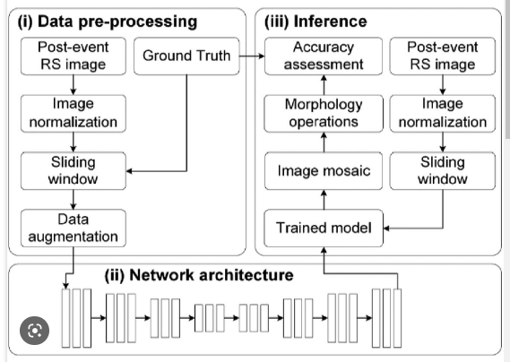
Block Diagram

Slide 13
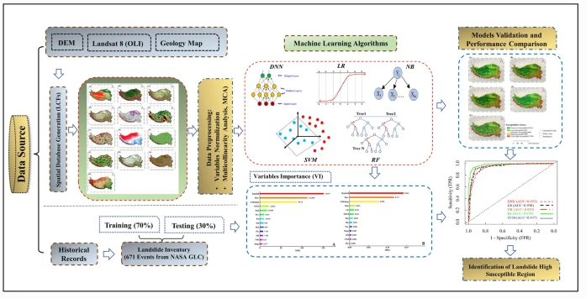
Architecture Diagram

Slide 14
SOFTWARE REQUIREMENTS:
Operating System : Windows 10
Platform : python

Slide 15
HARDWARE REQUIREMENTS:
Keyboard
Mouse
Hard disk 500GB
Ram 4 Gb

Slide 16
CONCLUTION
One of the toughest study fields now accessible in the geophysical discipline is real-time monitoring of landslides. the real field deployment of a landslide detection system powered mostly by a wireless device network.
To efficiently transmit real-time data to the system for monitoring and distributing alerts and risk assessments to the local population, this system makes use of wireless sensor nodes .
The capabilities and applicability of wireless sensor networks for critical and emergency applications will be understood using this network. The findings from the suggested system are encouraging

Slide 17
REFERENCE
1.Fan, X.; Scaringi, G.; Korup, O.; West, A.J.; van Westen, C.J.; Tanyas, H.; Hovius, N.; Hales, T.C.; Jibson, R.W.; Allstadt, K.E. Earthquake-induced chains of geologic hazards: Patterns, mechanisms, and impacts. Rev. Geophys. 2019, 57, 421–503. [Google Scholar] [CrossRef][Green Version]
2.Umar, Z.; Pradhan, B.; Ahmad, A.; Jebur, M.N.; Tehrany, M.S. Earthquake induced landslide susceptibility mapping using an integrated ensemble frequency ratio and logistic regression models in West Sumatera Province, Indonesia. Catena 2014, 118, 124–135. [Google Scholar] [CrossRef]
3.Alfaro, P.; Delgado, J.; García-Tortosa, F.; Lenti, L.; López, J.; López-Casado, C.; Martino, S.J.E.G. Widespread landslides induced by the Mw 5.1 earthquake of 11 May 2011 in Lorca, SE Spain. Eng. Geol. 2012, 137, 40–52. [Google Scholar] [CrossRef]

Slide 18
4.Cui, P.; Zhu, Y.-Y.; Han, Y.-S.; Chen, X.-Q.; Zhuang, J.-Q. The 12 May Wenchuan earthquake-induced landslide lakes: Distribution and preliminary risk evaluation. Landslides 2009, 6, 209–223. [Google Scholar] [CrossRef]
5.Gorum, T.; Fan, X.; van Westen, C.J.; Huang, R.Q.; Xu, Q.; Tang, C.; Wang, G. Distribution pattern of earthquake-induced landslides triggered by the 12 May 2008 Wenchuan earthquake. Geomorphology 2011, 133, 152–167. [Google Scholar] [CrossRef]
6.Parker, R.N.; Hancox, G.T.; Petley, D.N.; Massey, C.I.; Densmore, A.L.; Rosser, N.J. Spatial distributions of earthquake-induced landslides and hillslope preconditioning in northwest South Island, New Zealand. Earth Surf. Dynam. 2015, 3, 501–525. [Google Scholar] [CrossRef][Green Version]

Slide 19
7.Ye, C.; Li, Y.; Cui, P.; Liang, L.; Pirasteh, S.; Marcato, J.; Goncalves, W.N.; Li, J. Landslide detection of hyperspectral remote sensing data based on deep learning with constrains. IEEE. J. Sel. Top. Appl. 2019, 12, 5047–5060. [Google Scholar] [CrossRef]
8.Fan, X.; Scaringi, G.; Xu, Q.; Zhan, W.; Dai, L.; Li, Y.; Pei, X.; Yang, Q.; Huang, R. Coseismic landslides triggered by the 8th August 2017 M s 7.0 Jiuzhaigou earthquake (Sichuan, China): Factors controlling their spatial distribution and implications for the seismogenic blind fault identification. Landslides 2018, 15, 967–983. [Google Scholar] [CrossRef]
9.Meunier, P.; Hovius, N.; Haines, J.A. Topographic site effects and the location of earthquake induced landslides. Earth Planet. Sci. Lett. 2008, 275, 221–232. [Google Scholar] [CrossRef]

Slide 20
10.Valagussa, A.; Marc, O.; Frattini, P.; Crosta, G.B. Seismic and geological controls on earthquake-induced landslide size. Earth Planet. Sci. Lett. 2019, 506, 268–281. [Google Scholar] [CrossRef]
11.Korup, O.; Stolle, A. Landslide prediction from machine learning. Geol. Today 2014, 30, 26–33. [Google Scholar] [CrossRef]
12.Mao, Z.; Liu, G.; Huang, Y.; Bao, Y. A conservative and consistent Lagrangian gradient smoothing method for earthquake-induced landslide simulation. Eng. Geol. 2019, 260, 105226. [Google Scholar] [CrossRef]

Slide 21
13.Romeo, R. Seismically induced landslide displacements: A predictive model. Eng. Geol. 2000, 58, 337–351. [Google Scholar] [CrossRef]
14.Song, J.; Fan, Q.; Feng, T.; Chen, Z.; Chen, J.; Gao, Y. A multi-block sliding approach to calculate the permanent seismic displacement of slopes. Eng. Geol. 2019, 255, 48–58. [Google Scholar] [CrossRef]
15.Yiğit, A. Prediction of amount of earthquake-induced slope displacement by using Newmark method. Eng. Geol. 2020, 264, 105385. [Google Scholar] [CrossRef]

