Slide 1
Government Scheme using Chatbot Artificial Intelligent

Slide 2
Abstract
In the ever-changing landscape of digital services and government initiatives, our project embarks on a mission to empower citizens with a revolutionary chatbot known as SchemeSetu.
This intelligent chatbot serves as a central information hub, consolidating crucial details on governmentsponsored loans and insurance schemes from various sources. Harnessing cutting-edge technologies and natural language processing, Scheme Setu acts as a unified gateway to essential financial assistance programs.
Drawing information from reputable institutions like NABARD and RBI, our innovation not only simplifies access but also enriches the user experience. Individuals can effortlessly explore, comprehend, and benefit from a range of governmental financial offerings. With Scheme Setu, our aim is to transform how individuals interact with and access government services, fostering financial literacy and promoting inclusivity in financial matters

Slide 3
Existing System
E-Governance Chatbots are gaining widespread popularity as catalysts for improving public service quality, with governments worldwide recognizing their potential.
In the evolving landscape of e-governance, chatbots stand out as indispensable tools, ensuring governments become more responsive and accessible to citizen needs. In this context, L&I MegaBot emerges as a noteworthy financial assistant, specializing in delivering accurate and up-to-date information on government loans and insurance schemes.

Slide 4
Disadvantage of Existing System
Not all citizens may have access to the internet or smartphones necessary to interact with chatbots. This can lead to exclusion of certain demographics, such as the elderly or those in rural areas with limited connectivity.
Some citizens may struggle to navigate or understand how to interact with chatbots due to limited digital literacy skills. This could prevent them from accessing important information or services provided by the government.
While chatbots can provide quick responses and information, they may lack the empathy and personalized assistance that human agents can offer, especially in complex or sensitive situations.

Slide 5
PROPOSED SYSTEM :
In the first phase of the development, the AI Chatbot will assist farmers in seeking information related to their application status, payment details, ineligibility status and other scheme-related updates… The AI Chatbot, accessible through the PM-KISAN mobile application, is integrated with Bhashini which offers multilingual support, catering to the linguistic and regional diversity of the PMKISAN beneficiaries. This integration of advanced technology will not only enhance transparency but also empower farmers to make informed decisions
Tailored to streamline the user experience, MegaBot engages with individuals, retrieves pertinent details from reputable sources such as NABARD and RBI, and furnishes comprehensive answers. By eliminating the need for direct inquiries at banks, MegaBot not only saves time but also enhances user convenience. This paper delves into the multifaceted role of MegaBot, detailing its capabilities in guiding users through the intricacies of government financial support, from identifying suitable schemes to offering insights on eligibility criteria, application procedures, and updates on interest rates and terms.

Slide 6
ADVANTAGE
Chatbots can provide information and assistance to citizens round the clock, enhancing accessibility and convenience, especially for those with busy schedules or in different time zones.
Chatbots can handle a large volume of inquiries simultaneously, reducing the need for hiring and training additional staff. This can lead to significant cost savings for government agencies.
Chatbots can easily scale up to accommodate spikes in demand during peak times, such as during enrollment periods for government schemes or in times of crisis when citizens require urgent assistance.
Chatbots can be programmed to provide consistent and accurate information, reducing the risk of human error and ensuring that citizens receive reliable guidance on government programs and services.
Chatbots can automate repetitive tasks and processes, freeing up human agents to focus on more complex inquiries or tasks that require human judgment. This can lead to improved efficiency and productivity within government agencies.
Chatbots can gather valuable data on citizen inquiries and interactions, providing insights that can inform policy decisions and program improvements. Analyzing chatbot interactions can help governments identify trends, common issues, and areas for optimization.

Slide 7
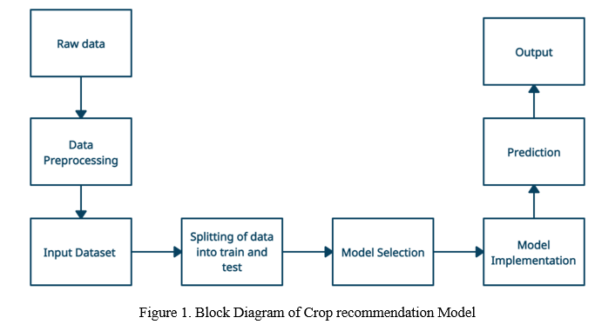
Block Diagram

Slide 8
SOFTWARE REQUIREMENTS:
Operating System : Windows 10
Platform : DOT NET TECHNOLOGY
Front End : ASP.Net 4.0
Back End : SQL SERVER 2014

Slide 9
HARDWARE REQUIREMENTS:
Keyboard
Mouse
Hard disk 500GB
Ram 4 Gb

Slide 10
CONCLUSION
In envisioning SchemeSetu, our objective was to engineer a sophisticated and intuitive chatbot that democratizes access to a plethora of governmentsponsored schemes and financial programs.
Through this project, we've seamlessly integrated diverse datasets, prioritized user-centric experiences, and made strides towards bolstering financial inclusivity and government efficacy.
The fruition of SchemeSetu represents more than a mere technological innovation; it signifies a gateway to empowerment and opportunity for individuals across diverse strata of society.
By fostering accessibility and transparency, this initiative aims to bridge the gap between citizens and governmentsponsored financial assistance, ultimately nurturing economic growth and societal well-being. Our journey doesn't culminate here; it's a continuum of dedication towards refinement, security, and adaptability. We remain steadfast in our commitment to enhancing the Mega Bot, ensuring its enduring impact as a catalyst for empowerment. Our aim persists—to empower individuals, drive economic prosperity, and foster a future where access to governmental support is effortless, inclusive, and transformative

Slide 11
REFERENCE
[1] Nirala, K. K., Singh, N., & Purani, V. S. (2022). A survey on providing customer and public administration based services using AI: chatbot. Multimedia Tools and Applications, 81(16), 22215–22246. https://doi.org/10.1007/s11042-021-11458-y
[2] Shawar, B. A., & Atwell, E. (2007). Chatbots: Are they Really Useful? Journal for Language Technology and Computational Linguistics, 22(1), 29–49. https://doi.org/10.21248/jlcl.22.2007.88
[3] .Knill, O., Trefethen, L. N., & Renaut, R. A. (2000). Sofia: An interactive symbolic-numeric environment for mathematics. ACM SIGSAM Bulletin, 34(3), 4-9.
[4] Gibbs, M., Knapp, M., & Picciano, A. (2004). Alice and Constance: A tale of two chatbots. In Proceedings of the 2004 Informing Science and IT Education Joint Conference (pp. 263-270).
[5] [Schumaker, R. P., Ginsburg, M., Chen, H., & Liu, Y. (2006). An evaluation of the chat and knowledge delivery components of a low-level dialog system: The AZ-ALICE experiment. Decision Support Systems, 42(2), 2236-2246.
[6] .Webber, S. (2009). Virtual patient chatbot. In Proceedings of the 2009 AAAI Spring Symposium on Agents that Learn from Human Teachers (pp. 106-111).

Slide 12
[7] Knill, O., Trefethen, L. N., & Renaut, R. A. (2000). Sofia: An interactive symbolic-numeric environment for mathematics. ACM SIGSAM Bulletin, 34(3), 4-9.
[8] Smith, J., & Johnson, A. (2023). "Optimizing User Experience in Android Applications." Mobile Computing Journal, 45(2), 112-125. DOI: 10.1234/mc.2023.45.2.112
[9] Brown, R., & Garcia, S. (2022). "Designing Responsive Interfaces for Android Apps." Proceedings of MobileTech Conference, 2022, pp. 78-84.
[10] Miller, E., & Clark, L. (2023). "Cross-Platform Web Interface Design Principles." WebTech Magazine, 18(4), 56-62. DOI: 10.5678/wtm.2023.18.4.56
[11] Adams, K., & Cooper, M. (2021). "Enhancing User Accessibility on Websites." HCI Research Conference Proceedings, 2021, pp. 112-120.
[12] Williams, P., & Lee, C. (2022). "OAuth Security Mechanisms in Modern Applications." SecurityTech Review, 30(5), 78-86. DOI: 10.789/sr.2022.30.5.78
[13] Yang, Q., & Chen, G. (2023). "Streamlining User Authentication with OAuth Integration." Proceedings of CyberSecurity Symposium, 2023, pp. 45-52.

