Slide 1
EPILEPSY PATIENT MONITORING SYSTEM

Slide 2
Abstract
Epilepsy is a chronic neurological disorder with several different types of seizures, some of them characterized by involuntary recurrent convulsions, which have a great impact on the everyday life of the patients. Several solutions have been proposed in the literature to detect this type of seizures and to monitor the patient; however, these approaches lack in ergonomic issues and in the suitable integration with the health system. This research makes an in-depth analysis of the main factors that an epileptic detection and monitoring tool should accomplish. Furthermore, we introduce the architecture for a specific epilepsy detection and monitoring platform, fulfilling these factors. Special attention has been given to the part of the system the patient should wear, providing details of this part of the platform. Finally, a partial implementation has been deployed and several tests have been proposed and carried out in order to make some design decisions.

Slide 3
Existing System
Different biometric signals have been Exisitng for detecting the epileptic seizures.
The main data source to do so is the EEG, measuring the electrical activity of the brain to detect the epileptic seizures.
But in Existing System There is no data maintain in server and monitor.
As an alternative and sometimes supplement to EEG there exist many sensors embedded in clothing or worn on the body to obtain bio-signals such as gyroscopes, accelerometers, pulse rate, temperature sensors, magnetometers, galvanic skin response sensors (GSR), implanted advisory system, electromyography, video detection systems, mattress sensor, and audio systems.
The data was analysed to discover if values for each of the attributes are different for each patient, together with the investigation of epilepsy ‘terminology’ and existing seizure type classifications/categories were analysed so that an ‘individual’ seizure type patient profile could be formed.

Slide 4
Disadvantage of Existing System
There are very few experiments with sensor-based IoT devices that have been endorsed by the hospitals and a large problem is poor information when caring for people with epilepsy or doing epilepsy clinical trials.
There is great potential to vastly increase the efficacy of epilepsy management using biomedical devices that can improve the quality of information.
The greatest challenge of all to help solve these problems is the enabling collaboration between people with differences in expertise
The negative impact of uncontrolled seizures spreads beyond the individual to affect their family, friends, and society.
Insufficient knowledge about epilepsy, which is a very common disorder, has a great and negative impact on people with epilepsy, their families and communities, and the healthcare systems.

Slide 5
PROPOSED SYSTEM :
In Proposed system we use Accelerometer, GSR sensor to detect brain waves activity .
We will monitor accelerometer and GSR value of patient and store it to Database for feature prediction purpose.
Using Cloud Data we can use machine learning algorithm to predict epileptic seizures of patient .This system aims to protect life and also aids to live a healthy and normal life.
The task of acquiring and sending the data from the different epilepsy devices involved in capturing seizure data, to the proposed cloud platform.
The proposed cloud platform provides all the necessary services for the clinician to manage, process and visualise the seizure data.
The devices have already been validated, and connectivity options identified, and since they are beneficial for epilepsy they can be proposed in the IoT based Epilepsy monitoring model.
The IoT based Epilepsy monitoring model has been proposed and can be adopted by the PMP framework in future developments.

Slide 6
ADVANTAGE
It is important to understand the performance of iSeiz if the bracelet is placed on different locations on the body to capture various movements.
Our proposed approach in utilization of a secure cloud-based database to record seizure data from various epilepsy patients appears to be practical and efficient, particularly for collaborative diagnosis.
In, a three-layer cognitive ring is proposed to achieve a good performance and high intelligence and merges human cognition with the system design.
The majority of the deep learning methods discussed previously exhibit a good performance but are incomparable to the deep learning models in other fields, such as computer vision.
An automatic and advanced method for EEG-based seizure detection and monitoring to be used as a component of the proposed cognitive healthcare IoT (CHIoT) framework.

Slide 7
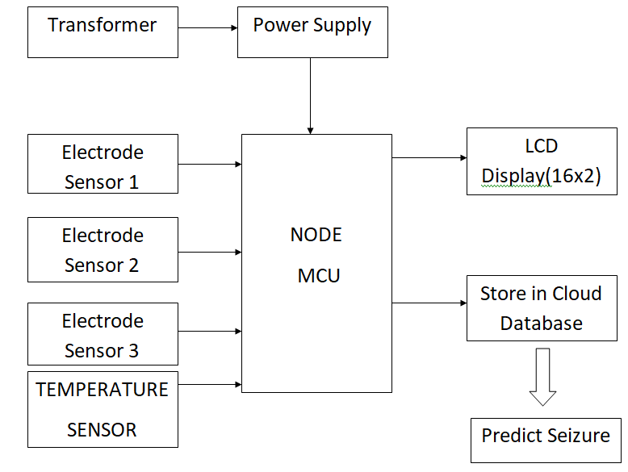
Block Diagram

Slide 8
SOFTWARE REQUIREMENTS:
Operating System : Windows 10
Platform : DOT NET TECHNOLOGY
Front End : ASP.Net 4.0
Back End : SQL SERVER 2014

Slide 9
HARDWARE REQUIREMENTS:
Keyboard
Mouse
Hard disk 500GB
Ram 4 Gb

Slide 10
CONCLUSION
This study analyzes the solutions in the literature describing solutions for epilepsy tonic-clonic seizure detection and monitoring. The majority of the approaches lack several remarkable factors: developing ergonomic approaches, supporting everyday life, providing economical affordable solutions, introducing storage of the sampled data and providing intelligent CC services, introducing real time response, or considering multiple services on the MCC size. This study addresses the design of an IoT platform for the epilepsy seizure detection and monitoring considering each of these factors. The solution is based on a WD to be located on a wrist connected to a Smartphone, which in turns implements MCC services and has access to CC services as well. The global goal is detecting the seizures, storing information from the sensory system, generating alarms and notifications, performing machine learning techniques on the data to learn the best models to detect or to visualize the data, sharing data, and providing processed information to the medical staff, among others. Special attention has been paid to the MCC module, where some design decisions are discussed, leading to the experimentation stage. The experimentation stage implemented part of the MCC and CC modules, developing an ad hoc solution for the WD. The experimentation has been focused on determining the best data bunch size and on drawing conclusions concerning the criteria to choose when performing computation on the MCC versus requesting services on raw data to the CC layer. The experimentation results show two possible data bunch sizes (20.39 and 40.78 KB) as the most suitable ones. Furthermore, the second stage of the experimentation suggests that plenty of computation can be delivered on the Smartphones, reducing the amount of networking. Furthermore, special care should be taken to reduce the power consumption due to some mobile components, such as touchscreens. This research is only in its early stages, and in the near future we expect to complete the design, considering the integration of this framework into publicly available open software health platforms, such as GNU Health.

Slide 11
REFERENCE
[1] R. S. Fisher, W. Van Emde Boas, W. Blume et al., “Epileptic seizures and epilepsy: definitions proposed by the International League Against Epilepsy (ILAE) and the International Bureau for Epilepsy (IBE),” Epilepsia, vol. 46, no. 4, pp. 470–472, 2005.
[2] J. Engel Jr., “A proposed diagnostic scheme for people with epileptic seizures and with epilepsy: report of the ILAE task force on classification and terminology,” Epilepsia, vol. 42, no. 6, pp. 796–803, 2001.
[3] J. R. Villar, P. Vergara, M. Menendez, E. De La Cal, V. M. ´ Gonzalez, and J. Sedano, “Generalized models for the classifi- ´ cation of abnormal movements in daily life and its applicability to epilepsy convulsion recognition,” International Journal of Neural Systems, vol. 26, no. 6, 2016.
[4] E. B. Petersen, J. Duun-Henriksen, A. Mazzaretto, T. W. Kjar, C. E. Thomsen, and H. B. D. Sorensen, “Generic single-channel detection of absence seizures,” in Proceedings of the Annual International Conference of the IEEE Engineering in Medicine and Biology Society (EMBS ’11), pp. 4820–4823, Boston, Mass, USA, September 2011.
[5] C. Pradhan, S. Sinha, K. Thennarasu, and T. Jagadisha, “Quantitative analysis of heart rate variability in patients with absence epilepsy,” Neurology India, vol. 59, no. 1, pp. 25–29, 2011.

Slide 12
[6] S. Beniczky, T. Polster, T. W. Kjaer, and H. Hjalgrim, “Detection of generalized tonic-clonic seizures by a wireless wrist accelerometer: a prospective, multicenter study,” Epilepsia, vol. 54, no. 4, pp. e58–e61, 2013.
[7] D. Callegari, E. Conte, T. Ferreto et al., “EpiCare - a home care platform based on mobile cloud computing to assist epilepsy diagnosis,” in Proceedings of the 4th International Conference on Wireless Mobile Communication and Healthcare, MOBIHEALTH 2014, pp. 148–151, November 2014.
[8] P. Lokhande and T. Mote, “Epilepsy monitoring and analysis system using android platform,” International Journal of Sciences and Research, vol. 5, no. 7, pp. 60–64, 2016.
[9] P. Meghana and V. V. Sravani, “Mobile application based detection of seizures using inertial measurement units and emergency care,” International Journal on Recent and Innovation Trends in Computing and Communication, vol. 3, no. 11, pp. 6388–6391, 2015.
[10] S. Ramgopal, S. Thome-Souza, M. Jackson et al., “Seizure detection, seizure prediction, and closed-loop warning systems in epilepsy,” Epilepsy and Behavior, vol. 37, pp. 291–307, 2014.

