Slide 1
EFFICIENT DATA INTEGRITY AND AUDITING IN CLOUD BY USING
SH256

Slide 2
ABSTRACT:
The utilization of cloud storage is increasingly prevalent as the field of cloud computing continues to expand. Several cloud data auditing schemes have been proposed within the academic community to guarantee the availability and integrity of cloud data.
Nevertheless, several schemes rely on public key infrastructure and identity-based encryption, introducing intricate challenges associated with certificate management and key escrow. Consequently, we present a certificateless encryption-based blockchain-assisted public cloud data integrity auditing scheme for data integrity.
Furthermore, our proposed scheme incorporates blockchain technology to oversee the activities of semi-trusted third-party auditors and resolve the concerns mentioned above. To enhance the efficiency of dynamic data updating and ensure data privacy security, we introduce a new data structure that combines a novel counting bloom filter and a Multi-Merkel hash tree approach.

Slide 3
The assumption of the discrete logarithm issue determines the system’s security. In contrast, the security model of the scheme is comprehensively delineated. In the part dedicated to performance analysis, we assess the scheme’s functionality and computational cost within the framework of existing literature.
The experimental results provide proof of the scheme’s comprehensive functionality and effectiveness

Slide 4
EXISTING SYSTEM:
The existing system employs the random sample technique and homomorphic linear authenticators to design a PDPscheme, which allows an auditor to verify the integrity of cloud data without downloading the whole data from the cloud. The Proof of Retrievability (PoR)Ateniese et al.
In the proposed scheme, the error correcting codes and the spot-checking technique are utilized to ensure the retrievability and the integrity of the data stored in the cloud.
The existing system implements private verifiability and public verifiability by using pseudorandom function and BLS signature, Liu et al.
To support user-interactions, including data modification, insertion and deletion, constructed a dynamic data integrity auditing scheme by exploiting the index hash tables.
In public data integrity auditing, The TPA might derive the contents of user’s data by challenging the same data blocks repeated times

Slide 5
Disadvantage Of Existing System:
In the existing system, there are no accurate data integrity proof results. The system’s security is extremely less thanks to lack of BLS Short Signature for data blocks.
The user’s computation burden of authenticator generation.
The data integrity auditing scheme which preserves data privacy from the TPA proposed a cloud storage auditing scheme Zhang et al. with perfect data privacy preserving by making use of zero- knowledge proof.
The problem of data dynamics in data integrity auditing and designed a data integrity auditing scheme supporting data dynamic operations based on the Divide and Conquer Table.
The high validity times may put in distrust the reliability of cloud service provider. The Data Consistency is also an issue in the existing system. The Third-party Verifiers are also involved which involves the data privacy.

Slide 6
PROPOSED SYSTEM:
The system mainly aim to design a practical data integrity auditing scheme without private key storage for secure cloud storage.
In our scheme, two fuzzy private keys (biometric data) are extracted from the user in the phase of registration and the phase of signature generation. We respectively use these two fuzzy private keys to generate two linear sketches that contain coding and error correction processes.
In this proposed work we first create a certificateless public verification scheme against procrastinating auditors (CPVPA) by utilizing private blockchain innovation with less force utilization.

Slide 7
In a MultiCloud environment, the remote data integrity checking requires to ensure the user’s data. The uploading data may be in either format, such as a document or audio or video.
This data is split into blocks using the Dynamic Block generation Algorithm and stored in a MultiCloud environment.
The key idea is to require verifiers to record each verifying result into a blockchain as an event. The events on the blockchain are time-sensitive. After the transactions are time-stamped, following the analogous transactions are recorded into the blockchain.

Slide 8
ADVANTAGE:
An affective technique to ensure that when the cloud properly stores users’ data, the proof it generates can pass the verification of the TPA.
An efficient technique to assure that if the cloud doesnot possess user intact data, it cannot pass the verification of the TPA.
Secure and efficient techniques to allow the user to utilize biometric data as fuzzy private key to accomplish data integrity auditing without private key storage.

Slide 9
TITLE | AUTHOR | DESCRIPTION
Data Integrity Auditing without Private Key Storage for Secure Cloud Storage | Wenting Shen, Jing Qin | In this paper, they investigate how to utilize private key to acknowledge data integrity inspecting without putting away private key.
Enabling Efficient User Revocation in Identity-based Cloud Storage Auditing for Shared Big Data | Yue Zhang | In this paper, we propose a novel storage auditing scheme that achieves highly-efficient user revocation independent of the total number of file blocks possessed by the revoked user in the cloud.

Slide 10
TITLE | AUTHOR | DESCRIPTION
Storage Key-Exposure Resilient Auditing for Secure Cloud Storage | Jia Yu | In order to deal with this problem, cloud storage auditing scheme with key-exposure resilience has been proposed.
Enabling Cloud Storage Auditing with Verifiable Outsourcing of Key Updates: A review | Jia Yu, Kui Ren, Cong Wang | Transparent resistance as possible with important performance features of the audit process, carefully designed to make the customer.

Slide 11
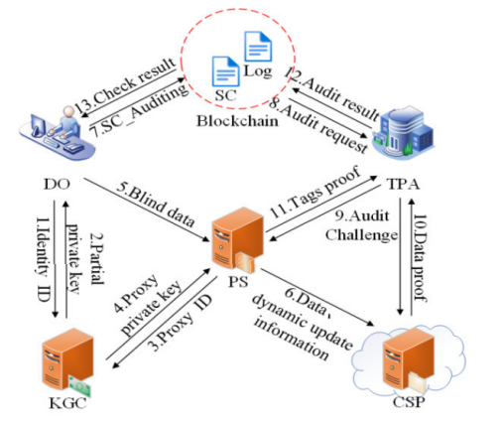
BLOCK DIAGRAM:

Slide 12
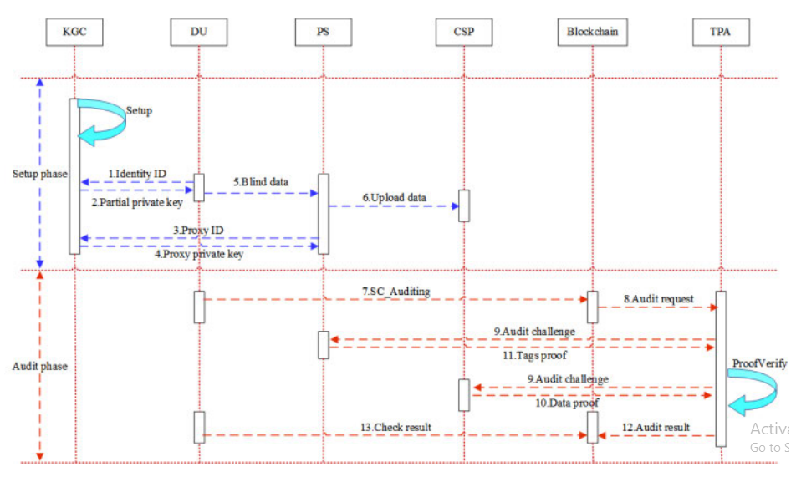
DATA AUDIT PROCESS

Slide 13
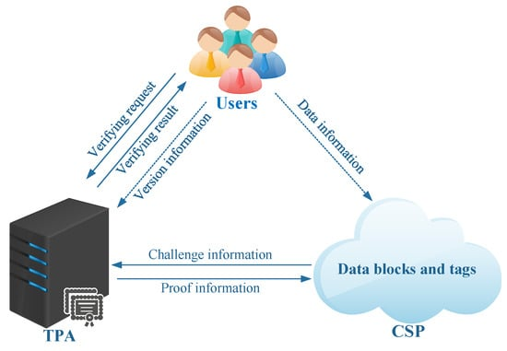
Cloud Data Integrity Auditing

Slide 14
Hash Functions:
Hash functions play a fundamental role in data integrity auditing. They generate unique fixed-size hashes (checksums) for data inputs.
Any change in the data, no matter how small, will result in a significantly different hash value. By comparing hash values before and after data transmission or storage in the cloud, one can verify data integrity.

Slide 15
Cryptographic Techniques:
Cryptographic techniques such as digital signatures, message authentication codes (MACs), and cryptographic hashes are used to ensure data integrity.
Digital signatures provide a means of verifying the authenticity and integrity of data by using public-key cryptography.

Slide 16
Data Logging and Monitoring:
Cloud service providers often offer logging and monitoring features that enable users to track changes to data. Monitoring tools can alert administrators to any suspicious activities or unauthorized modifications to data, helping maintain data integrity.

Slide 17
Checksums and Error Correction:
Checksums are used to detect errors in data transmission or storage.
By calculating checksums before and after data transfer, discrepancies can be identified, and error correction mechanisms can be applied to ensure data integrity.

Slide 18
Data Replication and Redundancy:
Implementing data replication and redundancy across multiple geographic locations or data centers helps ensure data integrity and availability.
Redundant copies of data can be compared to identify any inconsistencies or corruption.

Slide 19
Third-party Auditing Services:
Some organizations opt for third-party auditing services to independently verify the integrity of their cloud data.
These auditors examine cloud infrastructure, data storage mechanisms, access controls, and encryption practices to ensure compliance with regulatory requirements and industry standards.

Slide 20
Blockchain Technology:
In some cases, blockchain technology is utilized for cloud data integrity auditing. Blockchain provides a decentralized and immutable ledger that records data transactions in a secure and transparent manner.
By leveraging blockchain, organizations can enhance the integrity and auditability of their cloud data.

Slide 21
SOFTWARE REQUIREMENTS:
Operating System : Windows 10
Platform : DOT NET TECHNOLOGY
Front End : ASP.Net 4.0
Back End : SQL SERVER 2019

Slide 22
HARDWARE REQUIREMENTS:
Keyboard
Mouse
Hard disk 500GB
Ram 4 Gb

Slide 23
CONCLUSION:
In this paper, we investigate how to utilize fuzzy private key to realize data integrity auditing without putting away private key.
We propose the first practical data integrity auditing scheme without private key storage for secure cloud storage. In the proposed scheme, we utilize biometric information (e.g. fingerprint, iris check) as user’s fuzzy private key to attain data integrity auditing without private key capacity.
In expansion, we design a signature conspire supporting block less verifiability and the compatibility with the direct outline. The formal security proof and the execution examination appear that our proposed scheme is provably secure and productive.
Block Chain and Data Integrity shows their potential for transforming traditional industry with its key feature: decentralization, persistency, anonymity and auditability.

Slide 24
In future the Block Chain and Data Integrity associated concept &some possible future directions are also proposed. Nowadays Block Chain and Data Integrity based applications are arising and that we decide to conduct in-depth investigations on Block Chain and Data Integrity-based applications within the future.
The goal of Block Chain and Data Integrity is to supply anonymity, security, privacy, and transparency to all or any its users. However, these attributes set up a lot of technical challenges and limitations that need to be addressed.

Slide 25
REFERENCE:
[1] Wenting Shen, Jing Qin”Data Integrity Auditing without Private Key Storage for Secure Cloud Storage” A review IEEE Trans.2019.
[2] Yue Zhang “Enabling Efficient User Revocation in Identity-based Cloud Storage Auditing for Shared Big Data” A review IEEE Trans. 2018.
[3] Jia Yu “Storage Key-Exposure Resilient Auditing for Secure Cloud Storage” A review IEEE Trans. 2017.
[4] Anmin Fu, Huaqun Wang, Shui Yu, Chanyinghusang “NPP: A New Privacy-Aware Public Auditing Scheme for Cloud Data Sharing with Group Users: A review”IEEE Trans. 2017.
[5] Neeru Garg, Seema Bhava” RITS-MHT: Relative indexed and time stamped Merkle hash tree based data auditing protocol for cloud computing: A review” 2017.

Slide 26
[6] Wenting Shen, Jiayu, Hui Xia, Rong Hao” Light-Weight and Privacy-Preserving Secure Cloud Auditing Scheme for Group Users via the Third Party Medium: A review” 15 Jan 2017.
[7] Wenting Shen, Hanlin Zhang, Rong Hao, Fanyu Konhg “Data Possession Checking with Privacy-Preserving Authenticators for Cloud Storage: A review” 2017.
[8] Jia Yu, Kui Ren, Cong Wang” Enabling Cloud Storage Auditing with Verifiable Outsourcing of Key Updates: A review “IEEE Trans. 2016.
[9] Jiangtao Li, Lei Zhang, Joseph K. Liu, Zheming Dong” Privacy-Preserving Public Auditing Protocol for Low Performance End Devices in Cloud: A review” IEEE Trans. 2016.
[10] Huaqun Wang, Debiao He, Shaohua Tang” IdentityBased Proxy-Oriented Data Uploading and Remote Data Integrity Checking in Public Cloud: A review” 2016.

