Slide 1
Design & Implementation of High Dynamic Range Current Measurement System for IoT Applications

Slide 2
Abstract
Internet-of-Things (IoT) devices have a strict necessity for power consumption to achieve the expected battery life. Therefore, measuring and optimizing the energy consumption of IoT nodes are essential.
IoT nodes feature extreme current consumption range over 100 dB between their operating modes. The main focus of this article is to design and implement a low-power and low-cost current measurement circuit, which can be integrated into IoT nodes. A new pass element is introduced for measuring the current consumption.

Slide 3
This element is placed in the current path to measure current over a high dynamic range with a constant voltage drop. The introduced pass element consists of a capacitor and analog switches. The current consumption is measured based on the charge and discharge times of the capacitor in the specified period of time.
The voltage across the pass element is buffered and fed to a low-power microcontroller. The proper operation of the proposed circuit is verified numerically with simulations and experimental measurements. The implemented current measurement circuit offers a load regulation of 0.23%, a dynamic range of 173.98 dB , and a linearity error of 0.522%. It is expected that the proposed system provides clear information on the power behavior of IoT devices, which can be used for power optimization of IoT networks and self-power test equipment.

Slide 4
Introduction
Smart Energy measurement concept has been adapted more frequently as an initiative to create an intelligent space area by taking advantage of the rapid development of computational and communication architecture.
This concept is not only limited to Malaysia but other countries as well.
General public understanding of smart Energy measurement concept rotates on the idea of automated process, which is able to automatically control the Energy measurement’s operation through the usage of instrumentation measures and microcontrollers in two-way communication.

Slide 5
A smart energy consumption forecasting is important, especially for Energy measurements as Energy measurements’ energy usage is increasing and almost reaches 40% of primary energy use in developed countries.
The increasing of energy consumptions towards Energy measurements from day to day create enforcement to this country in managing and reducing the energy consumption as much as possible in order to improve energy efficiency.
A major advantage of using Microsoft Azure over SPSS is it is user friendly and easy to use even the user only has basic knowledge in cloud computing and machine learning.

Slide 6
Scope Of The Project
The work done in this paper falls under the scope of a research project named MiGrid.
The project mainly aims at creating a holistic testbed platform that couples smart Energy measurements and renewable energy storage and production.
These are wirelessly connected actuators that are supposed to translate electrical signals into mechanical actions to act on appliances.

Slide 7
Smart Grids
The SG comes with an improvement to the network that resides in the on-the-spot feedback about the operations, power interruptions, and electricity consumption.
The SG has the ability to tune itself to provide a better state of performance, and a better quality of the energy delivered.
This consists of the power lines, transformers, etc. The information given by these assets is used by the smart meters and wireless devices, in addition to microgeneration and storage devices.

Slide 8
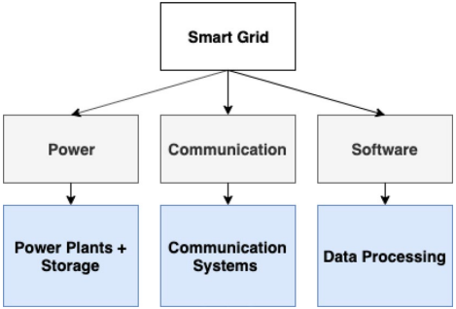
Smart grid’s components

Slide 9
Energy management systems
Monitoring Collection of energy consumption related information in order to establish the basis and clarify the changes in targets.
Control Putting in place control algorithms in order to correct any deviations from the target.
The EMS gets the users involved by displaying their real-time energy consumption. Making the consumers aware of their daily energy usage can have a huge impact on their consuming behaviors.

Slide 10
Smart Energy measurement
Although the term “smart Energy measurement” (SB) may bring a thought of a fictional smart space from science-fiction movies, but the reality is that SBs exist today, and their number is getting increased.
With recent advances in machine learning (ML), big data analytics, sensor technologies and the Internet of Things (IoT), regular Energy measurements can be cost-effectively transformed into SBs with bare minimum infrastructural modifications.

Slide 11
Existing System
The prediction performance of the stacking model in contrast with existing well-known prediction models including Random Forest, Gradient Boosted Decision Tree, Extreme Gradient Boosting, Support Vector Machine, and KNearest Neighbor.
Most of the existing research is based on single or integration models, which lack improvements in the essence of the algorithm.
Some existing studies have confirmed the effectiveness of using machine learning algorithms to build meta-models of Energy measurement performance in early Energy measurement performance evaluation.

Slide 12
Significant opportunities exist to take advantage of external data sources including real-time occupancy sensor networks, changing space schedules, weather forecasts, grid carbon intensity, and other environmental conditions that could help us better predict space set-points and schedules 24x7.
This missing data exists usually due to the interconnectivity or sensor problem which is the main complication for smart Energy measurement energy metering.
A highly skewed data indicates that the data was unbalanced in which certain classes or output exist much frequently than the other output.

Slide 13
Disadvantage of Existing System
It describes the different recently created strategies for the simplification of this problem, which deal with the engineering, statistical and artificial intelligence techniques.
The ANN-based model proved to be more productive than the regression model, and thereby consumed fewer electrical units, as it deals with nonlinear problems in a better way.
Many Energy measurement structures’ energy utilization undertakings can be perceived as multi objective optimization problems by reasonably recognizing and confirming the multiple objectives.

Slide 14
PROPOSED SYSTEM :
By integrating the data collection, data pre-processing, data analysis and generation with a deep neural network model, we propose an architecture for better energy efficiency and consumption in urban Energy measurements of smart cities.
Energy consumption dataset of 300 commercial Energy measurements was used to assess the effectiveness of the proposed algorithm.
In this paper we propose a new algorithm for selecting and fine - tuning the hyper parameters of the energy consumption model and tested it on the example of conglomerate of the commercial Energy measurements.

Slide 15
By integrating the machine learning-based approach with model optimization, we propose one architecture for better energy efficiency analysis and consumption in smart city public sector Energy measurements.
In this paper, we propose a method for estimating the consumption of electric power by large commercial centers and business Energy measurements, based on the GBM gradient boosting algorithm with adaptive tuning of hyper parameters using the 𝑘-fold cross-validation and randomization procedures.

Slide 16
ADVANTAGE
Some of these methods are also used along with predictors in the optimization of the energy consumption performance.
The performance of an energy consumption predictive intelligence model is dependent on the sample dataset size that is used for the prediction, and the proper selection ofthe deployed model.
A sensitivity analysis is required to quantify the association between the data size and the prediction model’s performance.
The role of computational intelligent techniques in developing an intelligent framework for overseeing energy efficiency.

Slide 17
TITLE | AUTHOR | DESCRIPTION
TensorFlow: Large-Scale Machine Learning on Heterogeneous Distributed Systems | Abadi, Martín, et al., 2016. | A computation expressed using TensorFlow can be executed with little or no change on a wide variety of heterogeneous systems, ranging from mobile devices such as phones and tablets up to large-scale distributed systems of hundreds of machines and thousands of computational devices such as GPU cards.
The weight-decay technique in learning from data: an optimization point of view | Gnecco, G., Sanguineti, M., 2009. | Weight-decay regularization is compared with Tikhonov’s regularization of the learning problem and with a mixed regularized learning technique.

Slide 18
TITLE | AUTHOR | DESCRIPTION
Plausibility of multivariate normality assumption when multiply imputing non-Gaussian continuous outcomes: a simulation assessment | Demirtas, H., Freels, S.A, Yucel, R.M, 2008. | Although we discourage its uncritical, automatic and, possibly, inappropriate use, we report that its performance is better than we expected, leading us to believe that it is probably an underrated approach.
Energy measurement energy consumption in Malaysia: an overview | Hassan, J.S., Zin, R.M., Majid, M.Z.A., Balubaid, S., Hainin, M.R., | The demand for housing is increasing all over the world because of the growing population. This leads to rise in the demand of energy use by the housing occupant’s globally.

Slide 19
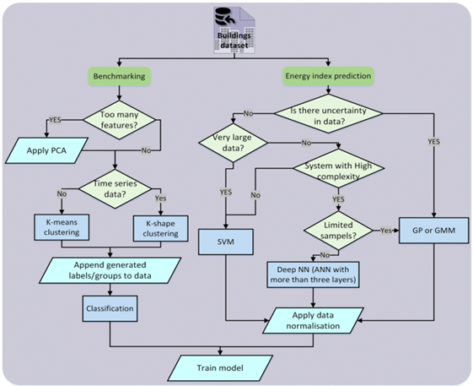
Block Diagram

Slide 20
SOFTWARE REQUIREMENTS:
Operating System : Windows 10
Platform : DOT NET TECHNOLOGY
Front End : ASP.Net 4.0
Back End : SQL SERVER 2014

Slide 21
HARDWARE REQUIREMENTS:
Keyboard
Mouse
Hard disk 500GB
Ram 4 Gb

Slide 22
CONCLUSION
The pre-processing was successfully executed inside AzureML environment, in which the resultant processed data had a mean valued at 0 and a standard deviation of 1.
An experimentation process was also made to determine the capability of the missing data imputation method.
A sampled data with missing value was generated to evaluate the PPCA method, in which it produced a promising result with low raw bias and coverage rate of more than 90% of the actual value.

Slide 23
Focusing on the objective of this research, three supervised machine learning prediction methods namely k-Nearest Neighbour, Support Vector Machine with Radial Basis Function kernel, and Artificial Neural Network with Multilayer Perceptron model, were chosen as the algorithm for the predictive model.
These methods were successfully compared in terms of their resultant structure and prediction performance.
The consequence of the model training and testing shows that each method performed differently for every tenant.

Slide 24
REFERENCE
Abadi, Martín, et al., 2016. TensorFlow: Large-Scale Machine Learning on Heterogeneous Distributed Systems. ArXiv abs/1603.04467.
Abdul Karim, S.A., Alwi, S., 2013. Electricity load forecasting in UTP using moving averages and exponential smoothing techniques. Appl. Math. Sci. 7, 4003–4014.
Ahmad, M.W., Mourshed, M., Mundow, D., Sisinni, M., Rezgui, Y., 2016. Energy measurement Energy Metering and Environmental Monitoring - a State-of-the-art Review and Directions for Future Research, 120, pp. 85–102.

Slide 25
Attewel, P., Monaghan, D., 2015. Data Mining for the Social Sciences: an Introduction. University of California Press, Oakland.
Azur, M.J., Stuart, E.A., Frangakis, C., Leaf, P.J., 2011. Multiple imputation by chained equation: what is it and how does it work? Int. J. Methods Psychiatr. Res. 49, 40–49.
Gnecco, G., Sanguineti, M., 2009. The weight-decay technique in learning from data: an optimization point of view. Comput. Manag. Sci. 6, 53–79. https://doi.org/10.1007/ s10287-008-0072-5.
Kang, H., 2013. The prevention and handling of the missing data. Kor. J. Anesthesiol. 64 (5), 402–406.

Slide 26
Gonzalez-Briones, A., Hernandez, G., Corchado, J.M., Omatu, S., Mohamad, M.S., 2019. Machine learning models for electricity consumption forecasting: a review. In: IEEE Virtual-Ledgers-Tecnologías DLT/Blockchain y Cripto-IOT.
Hassan, J.S., Zin, R.M., Majid, M.Z.A., Balubaid, S., Hainin, M.R., 2014. Energy measurement energy consumption in Malaysia: an overview. Jurnal Teknologi 707 (7), 2180–3722.
Hegde, H., Shimpi, N., Panny, A., Glurich, I., Christie, P., Acharya, A., 2019. MICE vs PPCA: missing data imputation in healthcare. Inf. Med. Unlocked 17. https://doi.org/ 10.1016/j.imu.2019.100275.

