Slide 1
Breast cancer detection using Ada boost classifier

Slide 2
Abstract
Breast cancer is a deadly disease; an accurate and early diagnosis of breast cancer is the most efficient method to decrease the death rate.
But, in the early detection and diagnosis of breast cancer, differentiating abnormal tissues is a challenging task. In this paper, a weight-based AdaBoost algorithm is proposed for an effective detection and classification of the breast cancer.
An AdaBoost algorithm effectively classifies the breast cancer classes by adding the weights to the samples in the week classifier during the training phase.
A weighted vote is performed on the results of each week classifier, and the strong classifier is integrated according to the weight of the week classifier. The breast cancer image datasets named CBIS-DDSM and MIAS are utilized for effective classification.

Slide 3
Tumor-like regions (TLRs) are diagnosed by utilizing the optimum method of Otsu thresholding to enhance training abilities. The convolutional neural network (CNN) architectures of the AlexNet and ResNet50 are utilized for the feature extraction.
A weight-based AdaBoost algorithm is proposed for the classification of breast cancer mammogram images into four classes benign calcification (BC), malignant calcification (MC), benign mass (BM) as well and malignant mass (MM).
The results shows that the proposed weight based AdaBoost algorithm delivers the performance metrics such as accuracy, specificity, sensitivity, precision and F1-score values about 99.56%, 99.38%, 99.40%, 98.89% and 99.18% respectively, which ensures the accurate classification results compared with the existing methods such as IMPAResNet50, Gray difference weight and MSER detector, MLO and CC methods.

Slide 4
Existing System
The performance classification accuracy has been encouraging comparison with various existing classifiers implemented in the literature. As expected the proposed model classifies diagnosis cases into either cancerous or non cancerous with high amount of accuracy.
Even if technology has developed, still lots of people are facing many issues with modern age diseases. Breast cancer has become one of the most common deadliest diseases rising over days among all countries in world.
Ratio of this disease increases due to lack of awareness and late identification. Our result reveals ANN (machine learning) plays measure factor for detection of cancer diagnosis to save the human life from the dangerous disease.

Slide 5
Disadvantage of Existing System
Previous researches reveal the increasing threats of breast cancer which drive to delve into unsolved and problematic issue, which is the main reason for the work reported in this paper. In the early stage of the breast cancer it appear as a malevolent lump and later stage it growths uncontrolled and variable manner.
By the help of the feature selector the datasets is free from ambiguity and dimension of data is also reduced. It solves the over fitting problem of dataset
The no of stages varies within the problem description of BPNN (Back Propagation Neural Network) is a gradient descent algorithm used in various domains

Slide 6
PROPOSED SYSTEM :
The proposed weight based AdaBoost algorithm is utilized for breast cancer detection using CBISDDSM dataset. This section consists of four different stages which include data collection, extraction of TLRs, feature extraction and classification. Fig. 1 represents the workflow of the proposed breast cancer detection methodology
The experiments of this proposed method utilize the breast cancer dataset named digital database for screening mammography (DDSM) and mammographic image analysis society (MIAS). The curated breast imaging subset (CBIS-DDSM) [21] is a standard and advanced form of the DDSM dataset that is utilized to take not only normal cases but also abnormal cases

Slide 7
This dataset consists of four classes such as BC, MC, BM and MM. This dataset consists 3549 region of interest as 1852 (1132 benign and 720 malignant) for calcification nodules and 1697 (913 benign and 784 malignant) for mass nodules. This type of image can be converted from the format of DICOM to the format of PNG with the size of. The MIAS [22] dataset contains 322 mammographic images with size of 1024 × 1024 in the format of Portable Grey Map. Further image size is reshaped into 256 × 256.
This dataset has two classes: normal (209) and abnormal (113). The abnormal category was divided into two classes: benign and malignant of 65 and 48 images. The classifications, asymmetries and masses are the abnormalities types identified in the data. For the CBIS-DDSM and MIAS dataset, this process utilized the 5-fold crossvalidation due to its increased size. This is divided into two portions such as 80% for training and 20% for validation. The provided results are evaluated as the average number of folds. The collected dataset is provided to the tumor-like regions for extraction.

Slide 8
ADVANTAGE
Some cases CAD (Computer Aided Tool) is also used by the physicians.
Various machine learning methods are used to detect whether the cancer gene is benign (or) malignant.
Then reduced data are used for ANN and classification has been performed
For classification radial basic function (RBF), General Regression Neural Network (GRNN) and Probabilistic Neural Network (PNN) were used.

Slide 9
TITTLE | AUTHOR | DESCRIPTION
A Combo Feature Selection Method (Filter+ Wrapper) for Microarray Gene Classification | Sahu, B | In this world cancer is the most dangerous diseases. So cancer diagnosis is most challenging and promising in case of clinical applications using microarray gene expression datasets.
‘‘Feature selection methods and algorithms | Ladha, L., & Deepa, T | As a data scientist working with Python, it’s crucial to understand the importance of feature selection when building a machine learning model. .

Slide 10
TITTLE | AUTHOR | DESCRIPTION
Combination of PCA with SMOTE resampling to boost the prediction rate in lung cancer dataset | ] Naseriparsa, M., & Kashani, M. M. R | These datasets contain many irrelevant and redundant features that mislead the classifiers. Furthermore, many huge datasets have imbalanced class distribution which leads to bias over majority class in the classification process.
new method for dimensionality reduction using kmeans clustering algorithm for high dimensional data set., | Napoleon, D., & Pavalakodi, S | Dimensionality reduction is the transformation of high-dimensional data into a meaningful representation of reduced dimensionality that corresponds to the intrinsic dimensionality of the data.

Slide 11
OVERVIEW
In the present generation, breast cancer has become most common disease occurring in females and becomes the reason for death. Early detection and diagnosis of cancer is needed to save the human life.
As per the data in 2012 1.7 million women have suffered by cancer
[1]. As any healthcare people are unable to identify the disease at early stage which impacts the death rate day by day
[2]. Report available at www.breastcanerindia.net, 144937 numbers of women were detected and 70218 numbers have died with breast cancer
[3]. Even if different test are done, still it is a difficult to detect the exact diagnosis. So many researchers have identified different automate diagnosis methods to detect the breast cancer.

Slide 12
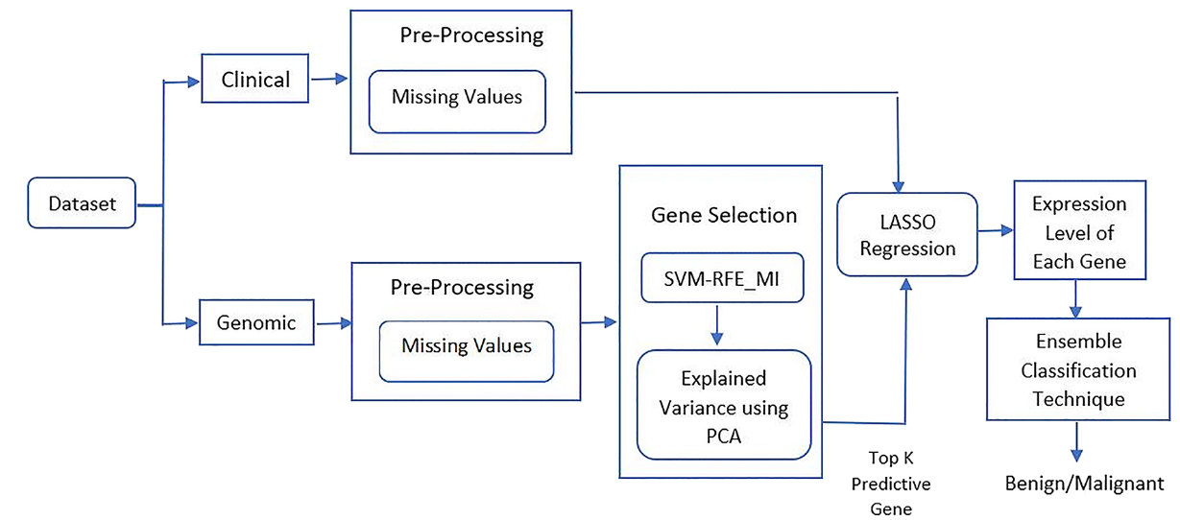
Block Diagram

Slide 13
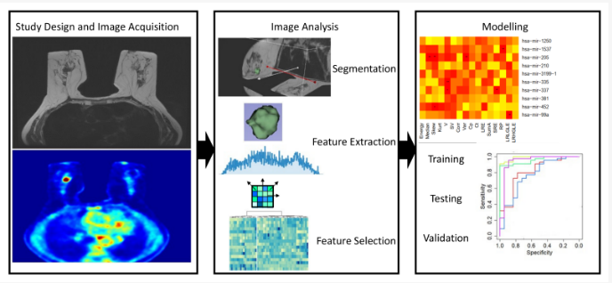
Architecture Diagram

Slide 14
SOFTWARE REQUIREMENTS:
Operating System : Windows 10
Platform : python

Slide 15
HARDWARE REQUIREMENTS:
Keyboard
Mouse
Hard disk 500GB
Ram 4 Gb

Slide 16
CONCLUTION
In this research, the breast cancer detection and early diagnosis weight based AdaBoost algorithm is proposed. The proposed method is used to evaluate the breast cancer image datasets named CBIS-DDSM and MIAS.
The Otsu thresholding method is utilized to identify the tumor-like-regions (TLRs) to enhance the training abilities. The network architectures of the AlexNet and ResNet50 are utilized for the feature extraction.
An AdaBoost algorithm is a classification algorithm, mostly utilized for medical applications, especially in the detection of breast cancer.

Slide 17
A weightbased AdaBoost algorithm is used for the classification of the mammogram images into four classes benign calcification (BC), malignant calcification (MC), benign mass (BM) as well and malignant mass (MM).
The proposed method achieves better accuracy results in the classification and achieved the accuracy result of 99.56% by comparison of the existing research models and the evaluation results using parameter metrics.
In the future, this proposed method will extend to utilize the huge number of datasets to improve the best classification results of breast cancer.

Slide 18
REFERENCE
[1] Sahu, B. (2018). A Combo Feature Selection Method (Filter+ Wrapper) for Microarray Gene Classification. International Journal of Pure and Applied Mathematics, 118(16), 389-401.
[2] www.breastcancerindia.net, Statistics of Breast Cancer in India.
[3] Ladha, L., & Deepa, T. (2011). Feature selection methods and algorithms. International journal on computer science and engineering, 3(5), 1787- 1797.

Slide 19
[4] Naseriparsa, M., & Kashani, M. M. R. (2014). Combination of PCA with SMOTE resampling to boost the prediction rate in lung cancer dataset. arXiv preprint arXiv:1403.1949.
[5] Napoleon, D., & Pavalakodi, S. (2011). A new method for dimensionality reduction using kmeans clustering algorithm for high dimensional data set. International Journal of Computer Applications, 13(7), 41-46.
[6] Raschka Sebastian and Mirjalili (2017),”Python Machine Learning”,2nd edition, Packt Publishing Ltd.,ISBN:978-1-78712-593-3.

Slide 20
[7] Kara, S., Güven, A., & İçer, S. (2007). Classification of macular and optic nerve disease by principal component analysis. Computers in Biology and Medicine, 37(6), 836-841.
[8] Kiyan, T., & Yildirim, T. (2004). Breast cancer diagnosis using statistical neural networks. IUJournal of Electrical & Electronics Engineering, 4(2), 1149-1153.
[9] Paulin, F., & Santhakumaran, A. (2011). Classification of breast cancer by comparing back propagation training algorithms. International Journal on Computer Science and Engineering, 3(1), 327–332.

Slide 21
[10]Karabatak, M., & Ince, M. C. (2009). An expert system for detection of breast cancer based on association rules and neural network. Expert Systems with Applications, 36(2), 3465–3469.
[11]Azar, A. T., & El-Said, S. A. (2014). Performance analysis of support vector machines classifiers in breast cancer mammography recognition. Neural Computing and Applications,24(5), 1163–1177.
[12]Jhajharia, S., Varshney, H. K., Verma, S., & Kumar, R. (2016). A neural network based breast cancer prognosis model with pca processed features. In: 2016 International Conference on Advances in Computing, Communications and Informatics (ICACCI), pp. 1896–1901

Slide 22
[13]Nayak, T., Dash, T., Rao, D. C., & Sahu, P. K. (2016, August). Evolutionary neural networks versus adaptive resonance theory net for breast cancer diagnosis. In Proceedings of the International Conference on Informatics and Analytics (p. 97). ACM.
[14]Nilashi, M., Ibrahim, O., Ahmadi, H., & Shahmoradi, L. (2017). A knowledge-based system for breast cancer classification using fuzzy logic method. Telematics and Informatics, 34(4), 133–144.
[15]Virmani, J., Dey, N., & Kumar, V. (2016). PCAPNN and PCA-SVM based CAD systems for breast density classification. In Applications of intelligent optimization in biology and medicine(pp. 159-180). Springer, Cham.

