Slide 1
AUTOMATIC WATER TANK CLEANER SYSTEM

Slide 2
ABSTRACT
Aim of this project is to develop a mechanical system for cleaning domestic cylindrical water tank. The mechanical system includes simple mechanism with centrifugal force.The principal involved in this mechanism is left hand fleming rule, were a simple electric energy is converted into rotational energy.
The motor shaft is connected to a long vertical arm with two PVC brushes and extended to the end of inner layer of water tank such that brushes gets contact with inner walls of the tank, as the power supply the shaft rotates with the help of gear motor ,such a way that brush cleans inside walls of cylindrical water tank.
The purpose of this project is to reduce human effort,time and avoid exposure to chemical influence on a health of person entering into the water tank for purpose of cleaning .

Slide 3
Existing System:
All methods of cleaning water tank as discussed above are time consuming and require more human efforts. So alternate method is required for cleaning purpose which will overcome the drawbacks of all other methods.
Therefore we are developing water tank cleaning equipment which requires less time and human efforts for cleaning.

Slide 4
PROPOSED SYSTEM
Automatic cleaning of the water tank saves time and money. If you are cleaning your tanks manually or using the fill and empty method, you may be surprised at how much you can save through automation.
Automated tank cleaning is best suited for apartment complexes and businesses or buildings installed with large water tanks.
Nowadays, professionals and companies working with automatic tank cleaning equipment arrive at their doors with their equipment to clean the water tanks in a few hours. The advantage of automated tank cleaning equipment is that it saves you time. In addition, you do not need to enter the water tank to clean it.

Slide 5
Companies that offer automatic tank cleaning equipment usually offer a demonstration of their products that allows them to choose the right product they need for tank cleaning. Selection of the appropriate tank cleaning nozzle allows for efficient cleaning.
Be sure to use the filter to prevent particles in the liquid from clogging the nozzles or stopping their rotation. The process of automatic tank cleaning begins with the cleaning of the manhole and dirt, mud and surrounding algae.
Then, using a special high-pressure jet wall, all interiors are cleaned. Dirt and sludge are removed using a vacuum pump and an industrial pump. After cleaning the water tank, the water tank is disinfected using chlorine or antibacterial agents.
Some professional cleaning service providers use the UV radiator to kill the remaining bacteria. The cleaning process ends with the residual chlorine test left in the tank. Reasons for cleaning overhead water tanks: waterborne internal diseases, skin diseases, foul odor, bad taste, different color

Slide 6
Literature survey
This section presents the critical analysis of existing literature which is relevant to overhead water tank cleaning system and its mechanisms.
Though, the literature consists of a lot many research contributions, but, here, we have analyzed around eight research and review papers. The existing approaches are categorized based on the basic concepts involved in the mechanisms.
The emphasis is on the concepts used by the concerned authors, the database used for experimentations and the performance evaluation parameters. Their claims are also highlighted. Finally, the findings are summarized related to the studied and analyzed research papers. Section concludes with the motivation behind identified problem.

Slide 7
Microcontroller:
A microcontroller is a computer present in asingle integrated circuit which is dedicated to perform one task and execute one specific application.
It contains memory, programmable input/output peripherals as well a processor.

Slide 8
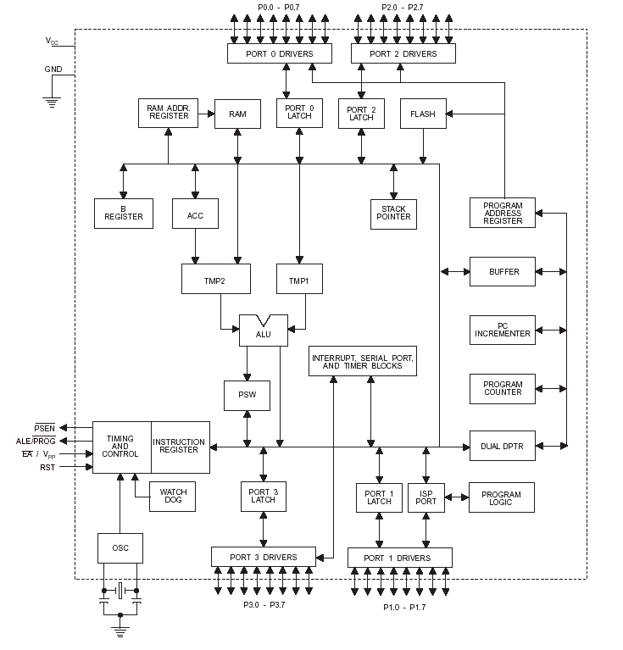

Slide 9
Relay:
The relay is the device that open or closes the contacts to cause the operation of the other electric control.
It detects the intolerable or undesirable condition with an assigned area and gives the commands to the circuit breaker to disconnect the affected area. Thus protects the system from damage.

Slide 10
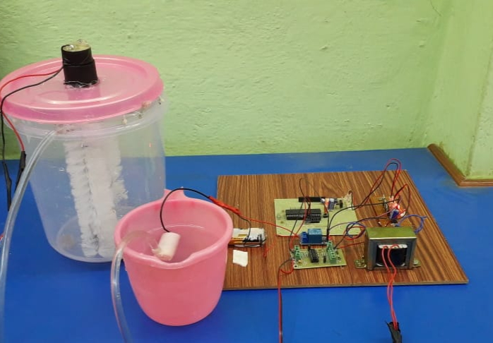
Result

Slide 11
Conclusion
In this work the automated water tank cleaner was successfully developed to clean the water tanks using rotating brushes. This strategy is more effective and safer than the conventional methods of cleaning which takes less time and human effort.
Water splashes everywhere along the dividers in the tank and the rotating brushes clean the external separators.

Slide 12
Scope for Future work
Design and build the water tank cleaning robot. For example, build the robot that can operater under the water and for specific storage tank with a flat surface only.
Study and design controller that can control the movement of the robot.
Develop the mechanism in the robot such as camera video that provided to allow an operator to monitor the progress of the vehicles

