Slide 1
Agriculture Soil moisture and ph detection using IOT

Slide 2
Abstract
In India economy is mainly based on agriculture still we are not able to make it profitable and make sustainable use of our land resources. Main reason is lack of knowledge regarding soil. There are many types of soil present and each type of soil has different characteristics. So it is necessary to test soil characteristics. There are different tools present for soil analysis, but these tools do not give accurate and desired result every time and also farmer needs to take pain of visiting laboratory for soil analysis. But it is very difficult to test all soil types in time from laboratory. Also tools which are present for soil analysis are not in regional language. Hence there is a need of tool to do soil analysis which can be made available to the farmer. The main objective of our work is to develop a soil based fertilizer recommendations system which can be used for regional soil analysis which in turn helps the farmers to cultivate and produce the proper crop. This tool will be in regional language so farmer can understand it easily.

Slide 3
Existing System
Soil fertility changes with every harvest and changing weather condition and also affects the nutrient content of soil. Also fertility of soil varies at different part of field and it requires to be monitored for healthy crop production.
For Testing Soil Every farmer should take the soil and travel to agriculture office and need to test there. so it will take more time to test soil in lab.

Slide 4
Disadvantage of Existing System
One accumulator
Register-bank switching is required to access the entire RAM of many devices
Operations and registers are not orthogonal; some instructions can address RAM and/or immediate constants, while others can use the accumulator only.
The following stack limitations have been addressed in the PIC18 series, but still apply to earlier cores:
The hardware call stack is not addressable, so preemptive task switching cannot be implemented
Software-implemented stacks are not efficient, so it is difficult to generate reentrant code and support local variables

Slide 5
PROPOSED SYSTEM :
The objective of proposed system is to replace the traditional farming technique of testing soil fertility by the automated remotely monitored fertility monitoring technique. In this system the farmer gets current status of soil fertility in his land at real time. The soil quality is determined by using the sensors to calculate the soil nutrient contents i.e. nitrogen, phosphorus and potassium (NPK). The farmer tests multiple sample of soil in his land using a portable device. Result of each test is averaged to determine the approximate fertility of total land. Result of all the tests will be displayed on display screen. The farmer physically enters the displayed value in his mobile application to get a digitally generated soil fertility e-report.

Slide 6
ADVANTAGE
Small instruction set to learn
RISC architecture
Built in oscillator with selectable speeds
Easy entry level, in-circuit programming plus in-circuit debugging PICKit units available for less than $50
Inexpensive microcontrollers
Wide range of interfaces including I²C, SPI, USB, USART, A/D, programmable comparators, PWM, LIN, CAN, PSP, and Ethernet[9]
Availability of processors in DIL package make them easy to handle for hobby use.

Slide 7
TITTLE | AUTHOR | DESCRIPTION
Crop Selection Method to Maximize Crop Yield Rate using Machine Learning Technique | Rakesh Kumar, M. P. Singh, Prabhat Kumar and J. P. Singh, | This paper proposed a method named Crop Selection Method (CSM) to solve crop selection problem, and maximize net yield rate of crop over season and subsequently achieves maximum economic growth of the country.
Automated Irrigation System Using a Wireless Sensor Network and GPRS Module | Joaquín Gutiérrez, Juan Francisco Villa-Medina, Alejandra Nieto-Garibay, and Miguel Ángel Porta-Gándara, | The system was powered by photovoltaic panels and had a duplex communication link based on a cellular-Internet interface that allowed for data inspection and irrigation scheduling to be programmed through a web page.

Slide 8
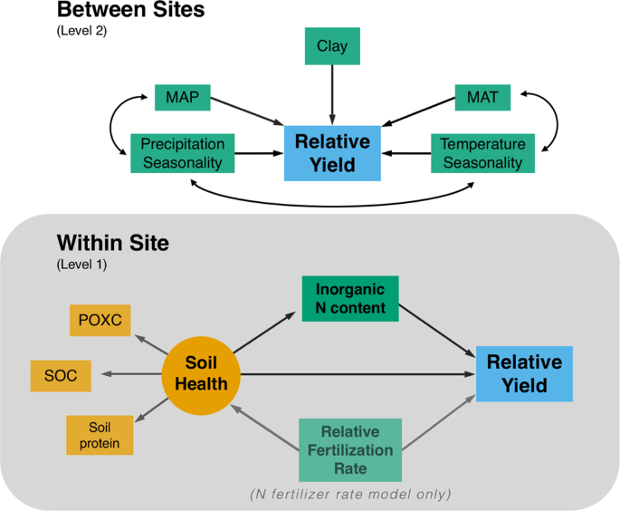
Block Diagram

Slide 9
SOFTWARE REQUIREMENTS:
Operating System : Windows 10
Platform : DOT NET TECHNOLOGY
Front End : ASP.Net 4.0
Back End : SQL SERVER 2014

Slide 10
HARDWARE REQUIREMENTS:
Keyboard
Mouse
Hard disk 500GB
Ram 4 Gb

Slide 11
CONCLUTION
In this project, Real time embedded based soil analyzer (RTEBSA) is used to do analysis of various soil nutrients parameters with the help of the pH value and the, soils Electrical Conductivity (EC). Depends on the pH value, The availability of various nutrients is calculated. Based on the nutrient availability, recommendation for cultivating particular crop is also done. Expansion of Hardware implementation of Real Time Embedded Based Soil Analyzer (RTEBSA) will be done in hard copy of report generation and also fertilizer recommendation for the particular crop will be given.

Slide 12
REFERENCE
[1] Rakesh Kumar, M. P. Singh, Prabhat Kumar and J. P. Singh, "Crop Selection Method to Maximize Crop Yield Rate using Machine Learning Technique", International Conference on Smart Technologies and Management for Computing, Communication, Controls, Energy and Materials (ICSTM), pp.138-145 ,May 2015.
2] Joaquín Gutiérrez, Juan Francisco Villa-Medina, Alejandra Nieto-Garibay, and Miguel Ángel Porta-Gándara, "Automated Irrigation System Using a Wireless Sensor Network and GPRS Module", IEEE Transactions on Instrumentation and Measurement. Vol. 63(1), pp. 166-176, 2014.
[3] Eric H. Fegraus, Ilya Zaslavsky, Thomas Whitenack, Jan Dempewolf, Jorge A. Ahumada, Kai Lin, and Sandy J. Andelman, "Interdisciplinary Decision Support Dashboard: A New Framework for a Tanzanian Agricultural and Ecosystem Service Monitoring System Pilot", IEEE Journal of Selected Topics in Applied Earth Observations and Remote Sensing, vol. 5, no. 6, 2012.
[4] Assem H. Mohammed, Ahmed M. Gad Allah, Hesham A. Hefny, "Fuzzy Time Series Approach for Optimizing Crops Planting Dates with Climate Changes", IEEE International Conference on Computer Engineering, pp. 36-41, 2014.
[5] X. Zhang, H. Tortel, S. Ruy, A. Litman, "Microwave Imaging of Soil Water Diffusion Using the Linear Sampling Method", IEEE Geoscience And Remote Sensing Letters, vol. 8, no. 3, 2011.

