Slide 1
Anomaly Detection in Self-Organizing Networks Conventional Versus Contemporary Machine Learning

Slide 2
Abstract
This paper presents a comparison of conventional and modern machine (deep) learning within the framework of anomaly detection in self-organizing networks.
While deep learning has gained significant traction, especially in application scenarios where large volumes of data can be collected and processed, conventional methods may yet offer strong statistical alternatives, especially when using proper learning representations.
For instance, support vector machines have previously demonstrated state-of-the-art potential in many binary classification applications and can be further exploited with different representations, such as one-class learning and data augmentation.
We demonstrate for the first time, on a previously published and publicly available dataset, that conventional machine learning can outperform the previous state-of-the-art using deep learning by 15% on average across four different application scenarios.

Slide 3
Existing System
Our fndings show that proposed deep learning approaches outperform existing feed-forward neural networks, and on the average, in more than 80% of the cases the outage states of the femtocells are correctly predicted among healthy and three anomalous states.
Tis study aims to develop a foresight for cell outage management in existing cellular systems and forthcoming next-generation networks within multi-tiered ultra-dense deployments.
Tis study demonstrates two deep network approaches, namely LSTM and 1D CNN, for detection and identifcation of anomalous states of densely deployed femtocells to inspire outage management in existing and upcoming cellular networks.

Slide 4
Disadvantage of Existing System
COD is basically a classifcation problem about detecting the non-healthy cell among healthy ones by making use of some statistics generated by UEs, base stations, and other network components.
Crippled FAPs have serious problems and may carry very little trafc. On the other hand, catatonic FAPs are generally out of service due to catastrophic failures like serious power cuts
FAP’s output power due to hardware or software failures such as implementation failures in channel processing, external power supply problems or even misconfguration, FAPs undergo anomalous states from the healthy state.

Slide 5
PROPOSED SYSTEM :
In both the proposed schemes, probable outagerelated anomalies in femto access points (FAP) are detected and classifed within predetermined time sequence intervals.
Moreover, aggregation decision methods are also incorporated into the proposed framework for boosting cell outage detection procedure on FAP level.
A method, based on the analysis of time evolution metrics, is proposed in for detecting faulty patterns arising from degraded cells
Besides, a classifcation tree-based method along with cell-level aggregation foridentifcation of faulty cells is proposed

Slide 6
ADVANTAGE
In channel quality indicator (CQI) is used within a composite hypothesis for outage detection by means of a discriminant function. Machine learning methods are also popular in outage detection of macro-cells.
As a variant of recurrent neural networks (RNNs), LSTM modules have been used with time sequence labeling tasks on many areas so far.
For the optimization process, gradient descent method with back-propagation in time can be used to compute the required gradients
On the other hand, 1D CNN is also used in data having time sequence character such as text, handwriting, speech signals, and natural language processing

Slide 7
TITTLE | AUTHOR | DESCRIPTION
Abnormal behavior detection based on trafc pattern categorization in mobile networks, | J.M. DeAlmeida, C.F.T. Pontes, L.A. DaSilva, C.B. Both, J.J.C. Gondim, C.G. Ralha, M.A. Marotta | Abnormal behavior in mobile cellular networks can cause network faults and consequent cell outages, a major reason for operational cost increase and revenue loss for operators.
‘‘Trafc analysis for 5G network slice based on machine learning. | M. Alias, N. Saxena, A. Roy | At present, there are few studies on the combination of machine learning, traffic analysis, network slice and the Internet.

Slide 8
TITTLE | AUTHOR | DESCRIPTION
Detecting mobile trafc anomalies through physical control channel fngerprinting: a deep semi-supervised approach. | H.D. Trinh, E. Zeydan, L. Giupponi, P. Dini, | In this paper, we propose a comprehensive framework for detecting network anomalies using mobile traffic data
Efcient cell outage detection in 5G hetnets using hidden Markov model, | Big data analytics services for enhancing business intelligence, | Next generation 5G wireless systems envision ultra dense networks with a huge number of heterogeneous cells.

Slide 9
OVERVIEW
Next-generation cellular systems are likely to set forth a lot of advancements in mobile communications such as more capacity, higher rates, ultra-low latency, massive connectivity, and lower energy consumption
Ultra-dense architectures are supposed to be one of the major features of these improvements.
In this regard, for better network maintenance, Tird-Generation Partnership Project (3GPP) has already come up with the concept of self-organizing networks (SON) which involves self-confguration, selfoptimization, and self-healing
In modern large-scale cellular network architectures, management of SONs containing tremendous number of network nodes becomes very complicated under the existence of anomalies which have the potential to degrade the user’s quality of experience (QoE).

Slide 10
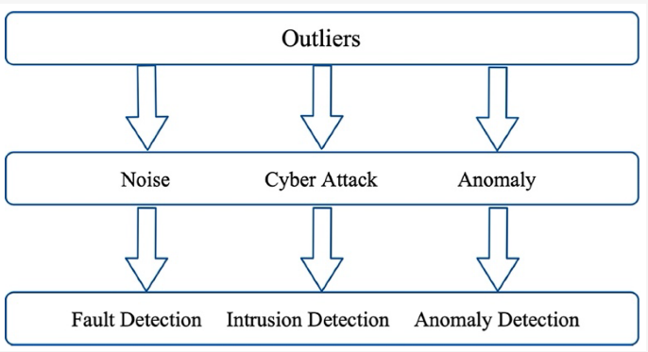
Block Diagram

Slide 11
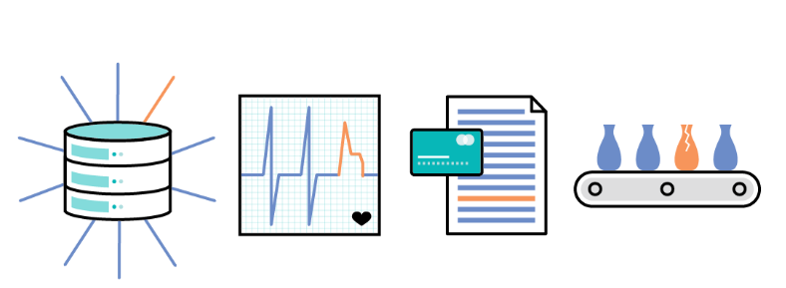
Architecture Diagram

Slide 12
SOFTWARE REQUIREMENTS:
Operating System : Windows 10
Platform : python

Slide 13
HARDWARE REQUIREMENTS:
Keyboard
Mouse
Hard disk 500GB
Ram 4 Gb

Slide 14
CONCLUTION
In this study, we work on detecting the anomalies in femtocells and classifying them into four categories as healthy, degraded, crippled, and catatonic.
By using KPI data of UEs along with LSTM and 1D CNN, we propose two diferent deep learning-based frameworks for efcient detection of anomalous FAP states which is much harder than detecting macro BS anomalies.
We also showed the usage of aggregate decision approaches on UE prediction scores for further improving prediction results of FAP states.
Our proposed method is capable of detecting anomalous cell states with more than 95% true positive rate and has an overall accuracy of more than 80% for four categorical state prediction of FAPs at the best.

Slide 15
REFERENCE
1. ETSI : universal mobile telecommunications system (UMTS); LTE; telecommunication management; self-organizing networks, (SON) policy network resource model (NRM), integration reference point (IRP); information service (IS) (3GPP TS 28.628 version 11.0.0 release 11) (2013). ETSI, intelligent transport systems (ITS): vehicular communications; Part 6: Internet Integration; sub-part 1: transmission of IPv6 packets over GeoNetworking protocols (2011), Accessed 25 Jan 2021
2. J.M. DeAlmeida, C.F.T. Pontes, L.A. DaSilva, C.B. Both, J.J.C. Gondim, C.G. Ralha, M.A. Marotta, Abnormal behavior detection based on trafc pattern categorization in mobile networks. IEEE Trans. Netw. Serv. Manag. 18(4), 4213–4224 (2021). https://doi.org/10.1109/TNSM.2021.3125019

Slide 16
3. F. Xie, D. Wei, Z. Wang, Trafc analysis for 5G network slice based on machine learning. EURASIP J. Wirel. Commun. Netw. 2021(1), 1–15 (2021). https://doi.org/10.1186/s13638-021-01991-7
4. H.D. Trinh, E. Zeydan, L. Giupponi, P. Dini, Detecting mobile trafc anomalies through physical control channel fngerprinting: a deep semi-supervised approach. IEEE Access 7, 152187–152201 (2019). https://doi.org/10.1109/ ACCESS.2019.2947742
5. M. Alias, N. Saxena, A. Roy, Efcient cell outage detection in 5G hetnets using hidden Markov model. IEEE Commun. Lett. 20(3), 562–565 (2016). https://doi.org/10.1109/LCOMM.2016.2517070

Slide 17
6. W. Wang, Q. Liao, Q. Zhang, COD: a cooperative cell outage detection architecture for self-organizing femtocell networks. IEEE Trans. Wirel. Commun. 13(11), 6007–6014 (2014). https://doi.org/10.1109/TWC.2014.2360865
7. O. Onireti, A. Zoha, J. Moysen, A. Imran, L. Giupponi, M. Ali Imran, A. Abu-Dayya, A cell outage management framework for dense heterogeneous networks. IEEE Trans. Veh. Technol. 65(4), 2097–2113 (2016). https://doi.org/10.1109/ TVT.2015.2431371
8. O.G. Aliu, A. Imran, M.A. Imran, B. Evans, A survey of self organisation in future cellular networks. IEEE Commun. Surv. Tutor. 15(1), 336–361 (2013). https://doi.org/10.1109/SURV.2012.021312.00116

Slide 18
9. P.V. Klaine, M.A. Imran, O. Onireti, R.D. Souza, A survey of machine learning techniques applied to self-organizing cellular networks. IEEE Commun. Surv. Tutor. 19(4), 2392–2431 (2017). https://doi.org/10.1109/COMST.2017.2727878
10. I. de-la-Bandera, R. Barco, P. Muñoz, I. Serrano, Cell outage detection based on handover statistics. IEEE Commun. Lett. 19(7), 1189–1192 (2015). https://doi.org/10.1109/LCOMM.2015.2426187
11. C.M. Mueller, M. Kaschub, C. Blankenhorn, S. Wanke, A Cell Outage Detection Algorithm Using Neighbor Cell List Reports, in Self-organizing systems. ed. by K.A. Hummel, J.P.G. Sterbenz (Springer, Berlin, Heidelberg, 2008), pp.218–229. https://doi.org/10.1007/978-3-540-92157-8_19

Slide 19
12. Q. Liao, M. Wiczanowski, S. Stańczak, Toward cell outage detection with composite hypothesis testing. in 2012 IEEE international conference on communications (ICC), pp. 4883–4887 (2012). https://doi.org/10.1109/ICC.2012.6364384
13. Y. Ma, M. Peng, W. Xue, X. Ji, A dynamic afnity propagation clustering algorithm for cell outage detection in selfhealing networks. in 2013 IEEE Wireless Communications and Networking Conference (WCNC), pp. 2266–2270 (2013). https://doi.org/10.1109/WCNC.2013.6554913
14. R.M. Khanafer, B. Solana, J. Triola, R. Barco, L. Moltsen, Z. Altman, P. Lazaro, Automated diagnosis for UMTS networks using bayesian network approach. IEEE Trans. Veh. Technol. 57(4), 2451–2461 (2008). https://doi.org/10.1109/TVT. 2007.912610
15. L. Bodrog, M. Kajo, S. Kocsis, B. Schultz, A robust algorithm for anomaly detection in mobile networks. in 2016 IEEE 27th Annual International Symposium on Personal, Indoor, and Mobile Radio Communications (PIMRC), pp. 1–6 (2016). https://doi.org/10.1109/PIMRC.2016.7794573

