Slide 1


VIVEKANANDHA
COLLEGE OF ENGINEERING FOR WOMEN
(Autonomous)
DEPARTMENT OF INFORMATION TECHOLOGY
II – M Tech Information Technology
PI9IT412 : Project Phase - II
Traffic Prediction for Intelligent Transportation System using Machine Learning
DATE:02.07.2021
SUPERVISED BY PRESENTED BY
MR.E.THANGADURAI AP/IT S.MERENA
VCEW 19204007
VCEW

Slide 2
CONTENTS
Project Introduction
Objective
Literature Survey
Existing work
Stake holders
Proposed work
Architecture Diagram
Modules
Result
Conclusion
Future work
Reference

Slide 3
Abstract
The intelligent transportation system in big data environment is the development trend of future transportation system, which effectively integrates advanced information technology, data communication transmission technology, electronic sensor technology, control technology and computer technology and is applied to overall ground transportation management.
Hence, it establishes a real-time, accurate, efficient and comprehensive transportation management system that functions in a wide range and all-round aspects. In order to meet the demands of the intelligent transportation big data processing,

Slide 4
CONT
this paper puts forward a high performance computing architecture of large-scale transportation video data management based on cloud computing, designs a parallel computing model containing the distributed file system and distributed computing system to solve the problems such as flexible server increase or decrease, load balancing and flexible dynamic storage increase or decrease, computing power and great improvement of storage efficiency.

Slide 5
CONT
On the basis of this technical architecture, the system adopts BP neural network-related algorithms to extract the static transportation signs in road videos, and uses interframe difference algorithm and Gaussian mixture model (GMM) fusion algorithm to extract the moving targets in road transportation videos.
In this way, they are taken as important integral parts and data sources of key frames of intelligent video image recognition to improve the recognition ability of key frames and eventually utilize semantic recognition model based on CNN (Convolutional Neural Network) to complete the intelligent recognition of whole transportation videos

Slide 6
OBJECTIVES
Traffic Prediction for Intelligent Transportation System using Machine Learning
This T.Y.B.Tech. Seminar Traffic Prediction for Transportation System using Machine Learning Dept.
This topic mostly pursuits to analyze extraordinary system mastering algorithms capable of manufacturing correct visitors glide forecasts..
CCOEW, Pune baseline can then be in comparison with the consequences given via way of means of the ML algorithms to determine their capacity success.

Slide 7
LITERATURE SURVEY
TITTLE | AUTHOR | DESCRIPTION
Distributed Integrated Control of a Mixed Traffic Network With Urban and Freeway Networks | Na Wu , Dewei Li , and Yugeng Xi | In recent years, the volume of traffic is rapidly increasing. When vehicles running through the tunnel are more intensive or move slowly, the tunnel environment occurs deteriorated sharply, which affects the normal operation of the vehicle in the tunnel.
Perimeter Control of Urban Traffic Networks Based on Model-Free Adaptive Control | Dai Li and Zhongsheng Hou | MFAC scheme is applied in both outer level and inner level to derive the detailed signal settings in the congested region and in the periphery of the congested region. Joint simulations using VISSIM and MATLAB verify the feasibility and effectiveness of the proposed method
Distributed Integrated Control of a Mixed Traffic Network With Urban and Freeway Networks
Na Wu , Dewei Li , and Yugeng Xi

Slide 8
CONT
TITTLE | AUTHOR | DESCRIPTION
Distributed Model-Free Adaptive Predictive Control for Urban Traffic Networks | Dai Li and Bart De Schutter | The formulated control problem is finally solved with an alternating direction method of multipliers (ADMM)-based approach. The simulation results for the traffic network of Linfen, Shanxi, China, show the feasibility and effectiveness of the proposed method
Dedicated short-range communications technology for freeway incident detection: | Joseph D Crabtree and Nikiforos Stamatiadis. | The assessment used the CorSim traffic simulation tool to simulate traffic and incidents on a segment of rural freeway.
TITTLE
AUTHOR
DESCRIPTION

Slide 9
EXISTING SYSTEM
In Existing system we use Gaussian mixture model (GMM) algorithm for traffic prediction methods are mainly based on short-to-medium-term prediction, and there are very few studies on long-term forecasting.
Most existing solutions are data intensive. However, abnormal conditions (extreme weather, temporary traffic control, etc) are usually non-recurrent, it is difficult to obtain data, which makes the training sample size smaller and learning more difficult than that under normal traffic conditions.
Existing methods usually treat data processing and model prediction as two separate tasks. It is of great practical significance to design a robust and effective traffic prediction model in the case of various noises and errors in the data.

Slide 10
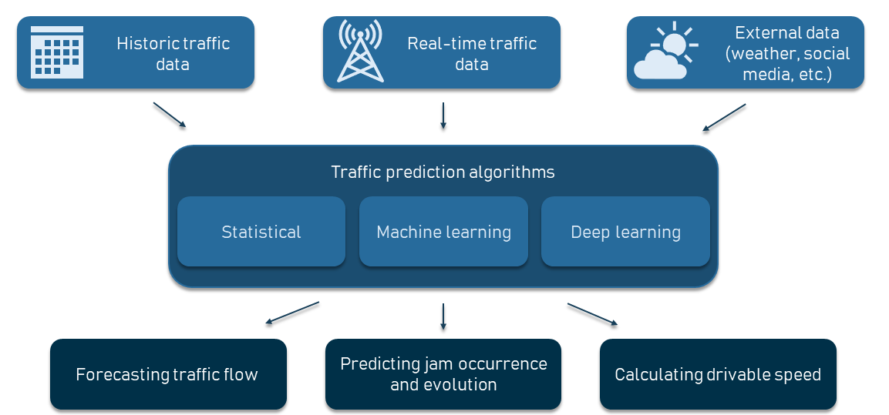
ARCHITECTURE DIAGRAM

Slide 11


STAKE HOLDERS
Hospitals
Clinics
Pharmacies
Patients
Investors

Slide 12
PROPOSED WORK
In Proposed system we use SVM(Support vector machine) the researchers proposed an end-to-end neural framework as an industrial solution for the travel time prediction function in mobile map applications, aiming at exploration of spatiotemporal relation and contextual information in traffic prediction.
As the field grows, more and more models have been proposed, and these models are often presented in a similar way.
Although recent approaches have been proposed, these researches have not been thoroughly studied, such as how to design a high-quality mathematical model to match two regions, or how to integrate other available auxiliary data sources, etc., are still worth considering and investigating.

Slide 13
MODULES
Register and Login
Traffic Data
Support Vector Regression (SVR)
Deep learning Approach

Slide 14
ARCHITECTURE DIAGRAM FOR BLOCK CREATION

Slide 15
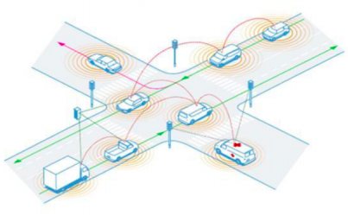

Slide 16
PROPOSED FRAMEWORK
User layer
Various users of the system interacting to block chain
Blockchain layer
Transaction record, Consensus rule, Peer to peer network
System implementation
Smart contract

Slide 17
ADVANTAGES OF EHR IN BLOCKCHAIN
It is easy to coach the deep network by applying the BP methodology with the gradient-based improvement technique. Unfortunately, it’s notable that deep networks trained during this method have dangerous performance.
It helps the riders and drivers to make better travel judgement to alleviate traffic congestion, improve traffic operation efficiency, and reduce carbon emissions.
The main advantage of ITS is to provide a smooth and safe movement of road transportation.
It’s also helpful in the perspective of environmentfriendliness to reduce carbon emission.
It provides many opportunities for automotive or automobile industries to enhance the safety and security of their travellers

Slide 18
Traffic Data
Here we get flow of vehicle in the road based on from and to location which is gathered from user.
This collected data will be stored in database . Using this data traffic congestion will be calculated.

Slide 19
Support Vector Regression (SVR)
Support Vector Regression helps to work with continuous data values whereas Support Vector Machine works for classification problems. Kernel function is used to map the lower dimensional data into higher dimensional data.
Hyper plane helps to predict the target value. A boundary line creates a margin, and the support vectors can be inside or outside the boundary line. The data points which are closest to the boundary are data points

Slide 20
Deep learning Approach
Deep learning is a subset of Machine learning. It comprises of multiple layers for transformation of features. Initial layer processes the raw input data. Second layer processes the information further by adding additional information and this process goes on till the desired result is achieved. Final layer would be the output.
Different types of models are used in deep learning. Recurrent Neural Network (RNN) is one among them which can be used to predicting the sequences. LSTM is the most popular RNN algorithm with many possible use cases.

Slide 21
Algorithm
SVM is one of the supervised learning algorithms in the field of machine learning. It is widely used for classification and regression problems.
The basic idea of SVM is to find a hyper plane in the feature space so that all classified data are farthest from the plane. The SVM theory for classification problems can be extended to a nonlinear regression problem (SVR) for traffic flow forecasting.

Slide 22
IMPLEMENTATION
Traffic congestion is raising a lot these days. Factors like expanding urban populations, uncoordinated traffic signal timing and a lack of real-time data. The effect of the traffic congestion is very huge these days.
Data collected in this paper are from the Kaggle website for the implementations of machine learning algorithms using python3 to show outputs in the traffic prediction. Two datasets are collected in which one is the 2015’s traffic data which comprises of date, time, and number of vehicles, junction and the rest one is the 2017’s traffic data with the same details so as to compare easily without any misconception.
The unwanted data has been deleted by pre-processing the data aggregated from 1 to 24 hours time interval to calculate traffic flow prediction with each 1 hour interval.

Slide 23
FUTURE WORK
In the future, the system are often further improved using more factors that affect traffic management using other methods like deep learning, artificial neural network, and even big data. The users can then use this technique to seek out which route would be easiest to achieve on destination. T
he system can help in suggesting the users with their choice of search and also it can help to find the simplest choice where traffic isn't in any crowded environment. Many forecasting methods have already been applied in road traffic jam forecasting.
While there's more scope to create the congestion prediction more precise, there are more methods that give precise and accurate results from the prediction. Also, during this period, the employment of the increased available traffic data by applying the newly developed forecasting models can improve the prediction accuracy.

Slide 24
CONT
These days, traffic prediction is extremely necessary for pretty much every a part of the state and also worldwide. So, this method of prediction would be helpful in predicting the traffic before and beforehand.
For better congestion prediction, the grade and accuracy are prominent in traffic prediction. within the future, the expectation are going to be the estimation of established order accuracy prediction with much easier and user-friendly methods so people would find the prediction model useful and that they won’t be wasting their time and energy to predict the information.
There will be some more accessibility like weather outlook, GPS that's the road and accident-prone areas will be highlighted in order that people wouldn't prefer using the paths which aren't safe and simultaneously they'll predict the traffic. This will be done by deep learning, big data, and artificial neural networks.

Slide 25
SOFTWARE REQUIREMENTS
Operating System : Windows 10
Platform : DOT NET TECHNOLOGY
Front End : ASP.Net 4.0
Back End : SQL SERVER 2014

Slide 26
HARDWARE REQUIREMENTS
Keyboard
Mouse
Hard disk 500GB
Ram 4 Gb

Slide 27
CONCLUTION
Although SVM(Support vector machine) and deep learning is an important problem in data analysis, it has not been dealt with extensively by the ML community. The proposed algorithm gives higher accuracy than the existing algorithms also, It improves the complexity issues throughout the dataset. Also we have planned to integrate the web server and the application. Also the things algorithms will be further improved to much more higher accuracy.

Slide 28
REFERENCES
[1] Fei-Yue Wang et al. Parallel control and management for intelligent transportation systems: Concepts, architectures, and applications. IEEE Transactions on Intelligent Transportation Systems, 2010.
[2] Yongchang Ma, Mashrur Chowdhury, Mansoureh Jeihani, and Ryan Fries. Accelerated incident detection across transportation networks using vehicle kinetics and support vector machine in cooperation with infrastructure agents. IET intelligent transport systems, 4(4):328–337, 2010.
[3] Rutger Claes, Tom Holvoet, and Danny Weyns. A decentralized approach for anticipatory vehicle routing using delegate multiagent systems. IEEE Transactions on Intelligent Transportation Systems, 12(2):364–373, 2011.
[4] Mehul Mahrishi and Sudha Morwal. Index point detection and semantic indexing of videos - a comparative review. Advances in Intelligent Systems and Computing, Springer, 2020.
[5] Joseph D Crabtree and Nikiforos Stamatiadis. Dedicated short-range communications technology for freeway incident detection: Performance assessment based on traffic simulation data. Transportation Research Record, 2000(1):59–69, 2007.

Slide 29
CONT
[6] H Qi, RL Cheu, and DH Lee. Freeway incident detection using kinematic data from probe vehicles. In 9th World Congress on Intelligent Transport SystemsITS America, ITS Japan, ERTICO (Intelligent Transport Systems and Services-Europe), 2002.
[7] Z. Zhao, W. Chen, X. Wu, P. C. Y. Chen, and J. Liu. Lstm network: a deep learning approach for short-term traffic forecast. IET Intelligent Transport Systems, 11(2):68–75, 2017.
[8] C. Zhang, P. Patras, and H. Haddadi. Deep learning in mobile and wireless networking: A survey. IEEE Communications Surveys Tutorials, 21(3):2224–2287, thirdquarter 2019.
[9] Chun-Hsin Wu, Jan-Ming Ho, and D. T. Lee. Travel-time prediction with support vector regression. IEEE Transactions on Intelligent Transportation Systems, 5(4):276–281, Dec 2004.
[10] Yan-Yan Song and LU Ying. Decision tree methods: applications for classification and prediction. Shanghai archives of psychiatry, 27(2):130, 2015.

Slide 30
THANK YOU

