Slide 1
A Deep Learning Approach for Task Offloading in Multi-UAV Aided Mobile Edge Computing

Slide 2
Abstract
Computation offloading has proven to be an effective method for facilitating resourceintensive tasks on IoT mobile edge nodes with limited processing capabilities. Additionally, in the context of Mobile Edge Computing (MEC) systems, edge nodes can offload its computation-intensive tasks to a suitable edge server. Hence, they can reduce energy cost and speed up processing. Despite the numerous accomplished efforts in task offloading problems on the Internet of Things (IoT), this problem remains a research gap mainly because of its NP-hardness in addition to the unrealistic assumptions in many proposed solutions

Slide 3
.
In order to accurately extract information from raw sensor data from IoT devices deployed in complicated contexts, Deep Learning (DL) is a potential method. Therefore, in this paper, an approach based on Deep Reinforcement Learning (DRL) will be presented to optimize the offloading process for IoT in MEC environments. This approach can achieve the optimal offloading decision. A Markov Decision Problem (MDP) is used to formulate the offloading problem. Delay time and consumed energy are the main optimization targets in this work.

Slide 4
Existing System
Hence, they can reduce energy cost and speed up processing. Despite the numerous accomplished efforts in task offloading problems on the Internet of Things (IoT), this problem remains a research gap mainly because of its NP-hardness in addition to the unrealistic assumptions in many proposed solutions. In order to accurately extract information from raw sensor data from IoT devices deployed in complicated contexts, Deep Learning (DL) is a potential method. . The proposed approach has been verified using extensive simulations.

Slide 5
Disadvantage of Existing System
When developing distributed decision-making solu81 tions for wireless task offloading problems, conventional 82 approaches such as convex optimization and mixed83 integer programming are not always appropriate. Mostly 84 because such models become more complicated f or systems 85 with numerous agents.
This work essentially devises Markov 86 Decision Problem (MDP) to model task offloading 87 according to real knowledge and tries to solve this problem 88 using a DRL algorithm.

Slide 6
PROPOSED SYSTEM :
The existence of multiple 301 UAV and MEC servers helps in increasing the number of 302 available servers for offloading in each layer. Consequently, 303 the offloading system can accept a large number of offloading 304 requests, which reduces the local computing requirements. 305 On the other hand, the last layer is the cloud server layer that is 306 used for computation-intensive tasks. UAV servers are closer 307 to the end devices than MEC servers to support mobility 308 and to provide fast response to users’ offloaded requests. 309 The proposed model jointly schedules resource allocation and 310 computation offloading in multi-UAV aided MEC through a 311 DDPG approach.

Slide 7
ADVANTAGE
Unmanned Aerial Vehicles (UAVs) with 57 MEC servers installed on board can be used to support MEC 58 systems by taking advantage of their flexibility and ease of 59 deployment.
Deep Learning (DL) has been widely used to learn 68 and optimize a variety of issues for UAV-aided MEC
Therefore, to reduce overall energy consumption, Deep Reinforcement Learning (DRL) approaches can be used to provide effective task offloading, resource allocation, and UAV con trol.

Slide 8
TITTLE | AUTHOR | DESCRIPTION
‘‘Future generation wireless networks for smart grid: A comprehensive review, | T. Dragičević, P. Siano, and S. R. S. Prabaharan, | Both the present day cellular technologies and the evolving new age 5G are considered to be advantageous for the smart grid..
‘‘A collaborative mobile edge computing and user solution for service composition in systems | I. Al Ridhawi, M. Aloqaily, Y. Kotb, Y. Al Ridhawi, and Y. Jararweh, 902 | Mobile edge computing (MEC) is an emergent technology that has revolutionized traditional cloud service solutions.

Slide 9
TITTLE | AUTHOR | DESCRIPTION
“‘‘Internet of Things (IoT): Opportunities, issues and challenges towards a smart and sustainable future,’’ | S. Nižetić, P. Šolić, D. López-de-Ipiña González-de-Artaza, and 906 L. Patrono, , | The rapid development and implementation of smart and IoT (Internet of Things) based technologies have allowed for various possibilities in technological advancements for different aspects of life.
Edge computational task offloading scheme using reinforcement learning for IIoT scenario | M. S. Hossain, C. I. Nwakanma, J. M. Lee, and D.-S. Kim | In this paper, end devices are considered here as agent, which makes its decisions on whether the network will offload the computation tasks to the edge devices or not

Slide 10
OVERVIEW
To decrease latency and traffic in the backbone network, end users can get data from nearby base stations rather than from the huge regional data centers.
MEC is a modern communication paradigm that has been utilized for bringing the energy resources and computing capability to the edge of the radio access network. Hence, computation capabilities can be distributed over the network instead of being centralized . Thus, MEC has proven to be crucial to the rollout of 5G.

Slide 11
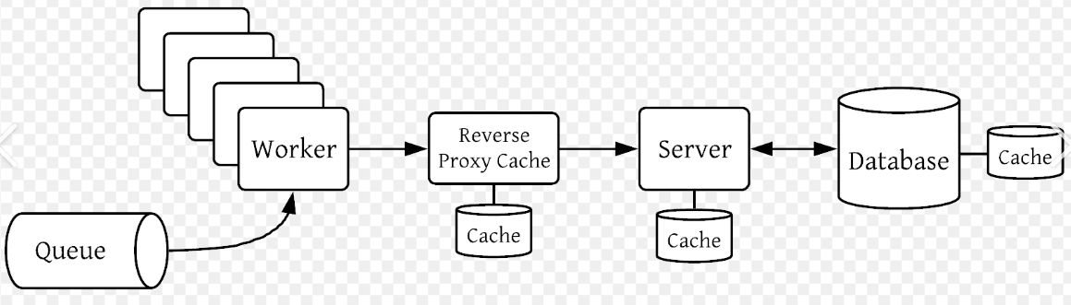
Block Diagram

Slide 12
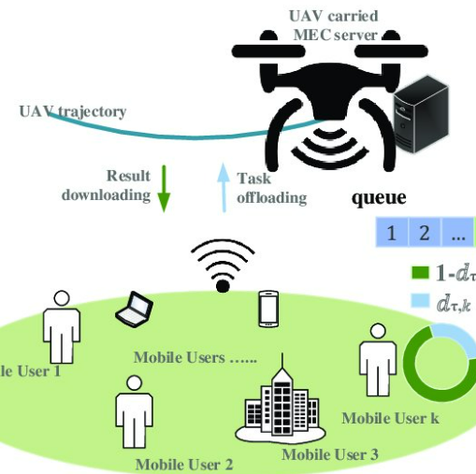
Architecture Diagram

Slide 13
SOFTWARE REQUIREMENTS:
Operating System : Windows 10
Platform : python

Slide 14
HARDWARE REQUIREMENTS:
Keyboard
Mouse
Hard disk 500GB
Ram 4 Gb

Slide 15
CONCLUTION
Edge computing is evolving rapidly toward the fundamental 875 infrastructure and facilitating the future of IoT. Efficient 876 coordination mechanisms and task offloading models are leveraged to enable mobile devices and edge-cloud to coop- 877 eratively work. This paper investigated one of the efficient 878 deep reinforcement learning algorithms, which is the DDPG 879 algorithm. It proposed a DDPG-based offloading system 880 to improve the efficiency of offloading decision strategy. 881 It assessed the UAV benefits in 5G IoT environments to 882 maximize the percentage of offloaded tasks from the total 883 requested task.

Slide 16
REFERENCE
[1] T. Dragičević, P. Siano, and S. R. S. Prabaharan, ‘‘Future generation 5G 898 wireless networks for smart grid: A comprehensive review,’’ Energies, 899 vol. 12, no. 11, p. 2140, Jun. 2019, doi: 10.3390/en12112140.
[2] I. Al Ridhawi, M. Aloqaily, Y. Kotb, Y. Al Ridhawi, and Y. Jararweh, 902 ‘‘A collaborative mobile edge computing and user solution for service 903 composition in 5G systems,’’ Trans. Emerg. Telecommun. Technol., vol. 29, 904 no. 11, p. e3446, Nov. 2018, doi: 10.1002/ett.3446. 905

Slide 17
[3] S. Nižetić, P. Šolić, D. López-de-Ipiña González-de-Artaza, and L. Patrono, ‘‘Internet of Things (IoT): Opportunities, issues and challenges towards a smart and sustainable future,’’ J. Cleaner Prod., vol. 274, Nov. 2020, Art. no. 122877, doi: 10.1016/j.jclepro.2020.122877.
[4] M. S. Hossain, C. I. Nwakanma, J. M. Lee, and D.-S. Kim, ‘‘Edge computational task offloading scheme using reinforcement learning for IIoT scenario,’’ ICT Exp., vol. 6, no. 4, pp. 291–299, Dec. 2020, doi: 912 10.1016/j.icte.2020.06.002.

Slide 18
[5] J. Almutairi and M. Aldossary, ‘‘Modeling and analyzing offloading strate gies of IoT applications over edge computing and joint clouds,’’ Symmetry, vol. 13, no. 3, p. 402, Mar. 2021, doi: 10.3390/sym13030402. 916
[6] W. Zhang, L. Li, N. Zhang, T. Han, and S. Wang, ‘‘Air-ground integrated mobile edge networks: A survey,’’ IEEE Access, vol. 8, 918 pp. 125998–126018, 2020, doi: 10.1109/ACCESS.2020.3008168.

Slide 19
[7] L. Zhang, Z.-Y. Zhang, L. Min, C. Tang, H.-Y. Zhang, Y.-H. Wang, and P. Cai, ‘‘Task offloading and trajectory control for UAV-assisted mobile edge computing using deep reinforcement learning,’’ IEEE Access, vol. 9, 922 pp. 53708–53719, 2021, doi: 10.1109/ACCESS.2021.3070908. 923
[8] Z. Zhou, H. Liao, B. Gu, K. M. S. Huq, S. Mumtaz, and J. Rodriguez, ‘‘Robust mobile crowd sensing: When deep learning meets edge computing,’’ IEEE Netw., vol. 32, no. 4, pp. 54–60, Jul. 2018, doi: 926 10.1109/MNET.2018.1700442.
[9] F. Jiang, K. Wang, L. Dong, C. Pan, W. Xu, and K. Yang, ‘‘Deep-learning based joint resource scheduling algorithms for hybrid MEC networks,’’ IEEE Internet Things J., vol. 7, no. 7, pp. 6252–6265, Jul. 2020, doi: 930 10.1109/JIOT.2019.2954503.

Slide 20
[10] A. M. Andrew, ‘‘Reinforcement learning: An introduction,’’ Kybernetes, vol. 27, no. 9, pp. 1093–1096, 1998, doi: 10.1108/k.1998.27.9.1093.3. 933
[11] V. Mnih, K. Kavukcuoglu, D. Silver, A. A. Rusu, J. Veness, M. G. Bellemare, A. Graves, M. Riedmiller, A. K. Fidjeland, G. Ostrovski, S. Petersen, C. Beattie, A. Sadik, I. Antonoglou, H. King, D. Kumaran, D. Wierstra, S. Legg, and D. Hassabis, ‘‘Human-level control through deep reinforcement learning,’’ Nature, vol. 518, no. 7540, pp. 529–533, 938 Feb. 2015, doi: 10.1038/nature14236. 939
[12] H. Mei, K. Yang, Q. Liu, and K. Wang, ‘‘Joint trajectory-resource optimiza tion in UAV-enabled edge-cloud system with virtualized mobile clone,’’ IEEE Internet Things J., vol. 7, no. 7, pp. 5906–5921, Jul. 2020, doi: 942 10.1109/JIOT.2019.2952677.

Slide 21
[13] Q. Wang, A. Gao, and Y. Hu, ‘‘Joint power and QoE optimization scheme for multi-UAV assisted offloading in mobile computing,’’ IEEE Access, 945 vol. 9, pp. 21206–212110.1109/ACCESS.2021.3055335.
[14] O. Alagoz, H. Hsu, A. J. Schaefer, and M. S. Roberts, ‘‘Markov deci sion processes: A tool for sequential decision making under uncer tainty,’’ Med. Decis. Making, vol. 30, no. 4, pp. 474–483, Jul. 2010, doi: 949 10.1177/0272989X09353194.
[15] M. McClellan, C. Cervelló-Pastor, and S. Sallent, ‘‘Deep learning at the mobile edge: Opportunities for 5G networks,’’ Appl. Sci., vol. 10, no. 14, 952 p. 4735, Jul. 2020, doi: 10.3390/app10144735.

